Slide 1

Optimising resources with Office 365, Project Online and edison365

Slide 2
Microsoft is helping enterprises to make their Project Portfolio Management (PPM) more efficient by using Microsoft Office 365

Slide 3

















About us
CPS is a privately owned consultancy firm with 3 directors, 60+ employees and over 20 years experience in delivering successful outcomes for our customers
Great Place to Work UK 8th place
Only Microsoft Partner with Gold competencies for Project, SharePoint, CRM and O365 solutions
Over 700 customers across all sectors
Implementation partners located
across EMEA and USA
Two award winning solutions for O365:
PS+ and Edison365

Slide 4


































Slide 5






Continuous innovation
INNOVATION IN OFFICE365
ACCELERATED VALUE DELIVERY
CONSISTENCY WITH OFFICE
SHAREPOINT INTEGRATION
CONSOLIDATED PPM SOLUTION
PPM IN THE CLOUD
CUMULATIVE VALUE ON-PREM
GETTING STARTED EXPERIENCE
ODATA IN
SSIS
INCREASED PWA INSTANCES
POWER BI CONTENT PACK
TIME REPORTER MOBILE APP
PROJECT LITE
SSIS DELTA UPDATES
RESOURCE ENGAGEMENTS
DASHBOARD IPAD APP
2003
2007
2010
2013
2016
2017
Configuration / Templates
Reporting Packs
Financial Planner
Resource Modeller
Stakeholder UI

Slide 6





PPM Capabilities
Project Online
Programme
Management
Demand
Planning
Portfolio Analytics & Selection
Business Intelligence & Reporting
Team Collaboration & Social
RAID – Risk & Issue
Management
Schedule Management
Time
Reporting
Resource Management
Financial Management
Edsion365
projects
Single source of truth; for Project & Resource Management Decision making

Slide 7
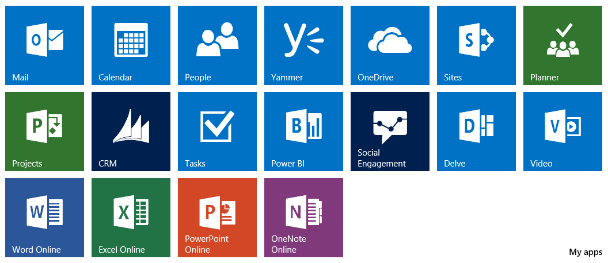




Deployed easily as another Office365 service
Skype for Business
Office 365 Pro plus
Visio

Slide 8

Create Strategy
Set Challenges
Crowdsource Ideas
Select Ideas
Initiate Projects
Plan
Model
Select
Deliver
Benefit
Value realization

Slide 9



Demonstration

Slide 10
Questions?

Slide 11



Duncan Griffin
07580 101725
duncan.griffin@cps.co.uk
@edison_365
www.edison365.com

