Slide 1


Resource Portfolio Management
Getting Away From Disjointed Short Term Guess Work And Build a Reliable Project Pipeline

Slide 2

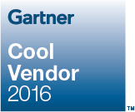
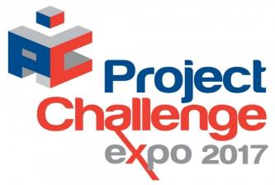
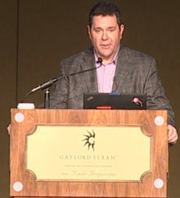
Booth 80
Greg Bailey
gbailey@prosymmetry.com
713-985-9997
http://Prosymmetry.com

Slide 3










































About Tempus Resource
Tempus Resource is a next generation Resource Portfolio Management solution available in the cloud or on premise. Uniquely, it provides actionable intelligence to Executives, PMO’s and resource managers through an array of real time modeling and what if simulation capabilities.
Tempus Resource is available as a stand alone resource planning tool replacing spreadsheets or integrated with other systems. Clients have from 50 to 15,000 resources.
Tempus Resource by ProSymmetry named Cool Vendor 2016 for PPM Resource Management
Tempus Resource named in 2015 PPM Market Guide (strategic decision making).
Tempus Resource in Gartner 2016 Hype Cycle-Resource Planning
“We needed a tool that would be robust, easy to use and able to perform fast, flexible ‘what-if?’ scenarios so that we could make decisions in a properly informed way. It’s very easy to create a new project, create or change a model, create custom fields and understand how they will impact the look and feel of our capacity analyses”
Yoav Shulman, FUNDtech’s VP PMO Manager
Integrations
Tempus Resource allows for flexible data capture. Direct entry, bulk update and flexible off the shelf integrations all play a key role. Open API connects to any system. Some of our notable integrations include:

Slide 4
What is Resource Portfolio Management?
Resource Portfolio Management (“RPM”) is a business capability that seeks to most effectively utilize resources for the delivery of strategy by matching resource supply and demand.
RPM can be benchmarked and exploited in innovative ways such as scenario planning. RPM practitioners place emphasis on analyzing project carrying capacity with the intent of maximizing resource utilization in light of dynamic organizational demands.

Slide 5
RPM Benefits
Truly identify what CAN be done (what is my carrying capacity) (different than conventional linear project selection)
Improved velocity of decision making (answer questions most important to management)
Improve utilization of critical AND non-critical resources.

Slide 6
The Worst Performing Organizations Score the lowest in
RPM.
Cooper, Robert G.; Edgett, Scott J.; Kleinschmidt, Elko J. "Benchmarking Best NPD Practices." Research-Technology Management, Volume 47, Number 1, 1 January 2004.

Slide 7
PWC 2014 Global Portfolio and Program Management Survey
Interviewed over 3,000 project professionals in more than 100 countries.
  Their results were striking – in the ten years the research has been carried out, resource management has remained a consistent challenge for project delivery. PWC echo the Gartner reports on resource

Slide 8
PWC 2014 Global Portfolio and Program Management Survey
The challenge of resource management has remained a consistent theme in the challenges related to project delivery.
Having the right mix of resources and being able to flexibly adapt to a variety of challenges is crucial to successfully delivering programs and projects.
Optimizing constrained resources and actively balancing demand management is required to drive successful transformation.

Slide 9
Aligning Resources with Strategy
It is a fairly simple concept, yet it’s remarkable how many organizations fail to grasp the importance of their resources. In research sponsored by the International Personnel Association, only 60% of the largest multi-national corporations in the United States recognized a direct correlation between their relative success and an effective workforce.
Linda K. Stroh and Paula M. Caligiuri. "Global Competitiveness Depends on Effective People Management.” Chemtech Volume 29, Number 2 February 1999. Print.

Slide 10
Aligning Resources with Strategy
Resources define project delivery capabilities.

Slide 11
Why is it critical to align resources with strategy?
First and foremost comes the issue of project delivery. Only so much can be accomplished.
In most companies, the strategic ambitions of management often exceed the capacity of the organization to execute the required projects.
Strategic choices in project selection boil down to how many resources you can allocate. This statement alone highlights the importance of resources in realizing strategy.

Slide 12
How companies select and value projects and initiatives ?
In many cases, the process of selecting the projects to perform does not include the most critical aspect of the delivery process.
Without considering the impact of projects on the resource pool, decision makers make a critical mistake.
Selection and planning of projects should take place concurrently. Many companies have a better understanding of how capital and assets are allocated than they do about how resources should be allocated.

Slide 13
How companies select and value projects and initiatives ?
Detailed allocation data are not required to be successful. Aggregated project data are sufficient at this point.
Failure to incorporate resource planning into the project selection process has been shown to result in companies attempting to execute between two-times and three-times the number of projects than they have the capacity to execute.
Wheelwright, Steven C. and Kim B. Clark, Revolutionizing Product Development. New York: The Free Press, 1992.

Slide 14
“Behind every major resource allocation decision a company makes lies some calculation of what that move is worth."
Organizations exist for a purpose. A group of people get together to effectively coordinate their efforts and get things done. In other words, their assembly is designed to drive a common purpose – a strategy. While strategy is typically the output of both analytically derived and market driven factors, there are two primary approaches to formulating strategy:
Deliberate – analytical or creative – processes are used to formulate strategy.
Emergent understanding of realities cause strategy to form.
The combination of the right people with the right skills, using the correct plant and equipment through effective business processes is fundamental to the delivery of the company’s strategic intent. Without resources, we can’t do work, we can’t do projects and we can’t implement strategy. In the most fundamental sense, our ability to select and deliver projects is limited exclusively by our access to qualified resources.

Slide 15
Gartner 2015
People capacity planning becomes critical to ensure execution. People capacity planning is the ability to know, for example, that if you approve these 10 projects, then you will need 100 people from IT, 10 from finance, five from marketing, 15 from supply chain and 20 consultants/contractors to execute projects you’ve chosen to fund.
It will support tracking that the required individuals are actually available and committed before the project can start.

Slide 16
How-to implement a Resource Management strategy
Maximizing R&D Portfolio Value, 2005 Industrial Research Institute Inc. Rainer Kolisch, Konrad Meyer and Roland Mohr

Slide 17
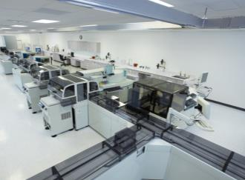







A global leader in key IVD market segments
Lab Automation/
Diagnostics IT
Chemistry
Immunoassay
Drug Testing
Hematology
Hemostasis
Plasma Proteins
IDD
Largest Number of Installed Track-based Automation Systems*
* Worldwide In Vitro Diagnostic Laboratory Automation Market Review, 2015 data. Report generated by independent research company in June 2016.
A91DX-CAI-160513-GC1-4A00

Slide 18

WHERE WE STARTED
3
R&D Functions
Resource
Management
maturity Level
1
9
Product Lines
> 500
Concurrent
Projects
Time
Entry
Usage of
>1,000
Excel Files
2
PPM Tools
Time
Approval
Laboratory Diagnostics –
Product Life Cycle Organization
7
Project Steering
Boards
> 2,000
R&D Resources
3
PMO’s
81
Cost Center

Slide 19

THE GOAL
Top Projects
MUST DO
Projects
3 Year project portfolio
Project Pipeline
Above the waterline
Projects
WATERLINE
Gap filling Projects
below the waterline
Never will do them projects
Establish a robust 3 to 5 year PPM roadmap

Slide 20
THE GOAL
Top Projects
Resource Portfolio Management
MUST DO
Projects
3 Year project portfolio
Project Pipeline
Above the waterline
Projects
WATERLINE
Gap filling Projects
below the waterline
Never will do them projects
Establish a robust 3 to 5 year PPM roadmap

Slide 21

THE CONCEPT OF STRATEGIC PORTFOLIO MANAGEMENT –
MY BLUEPRINT
Management
plan + execute
Business Strategy
Management
validate + adjust
defined+
weighted
Project Portfolio Management
adjustment
Goal Portfolio
Project Portfolio
Resource Portfolio
Asset Portfolio

Slide 22

THE MAIN CHALLENGE TO ADDRESS
Disjointed, stakeholder driven Resource Planning by functional heads

Slide 23

WHAT IS THE HORIZON
Now
Near future
Far future
Vision
Timesheet
Planning tool
Resource modeling
Time
using the right tool for the right answer

Slide 24









RESOURCE PORTFOLIO MANAGEMENT MATURITY –
WHERE WE ARE, WHERE DO WE WANT TO BE
1. Visibility of work
2. Controlled allocation
3. Managed capacity
4. Assignment defined by project plan
5. Granular management
The organization knows who is working, and on which task, however the resources was assigned without control and overview.
The organization has already implemented a resource approval process, but the organization only compares resource release and resource availability.
The focus has shifted to capacity management. Implementation of a project priorities require a structured management
The resource approval process and capacity management process are driven by project and at times phase level project plan.
The detailed knowledge about project activities leads to better resource assignment and capacity management prozess
Itemization

Slide 25


TOOL AND PROCESS CHANGE ARE ONLY THE TIP OF THE ICEBURG
CULTURAL CHANGE

Slide 26
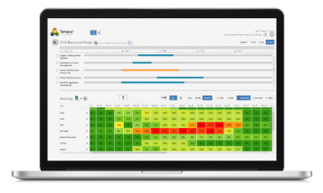
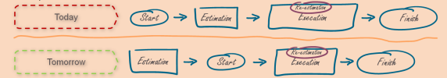
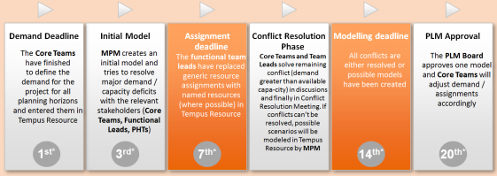
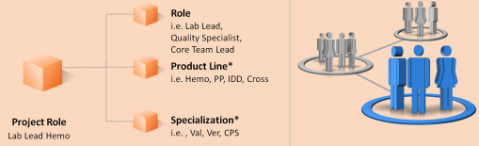
THE 4 KEY COMPONENTS OF OUR IMPLEMENTATION
Tempus Resource as the software tool
How we start new projects
Project orientated resource aggregation
Process, Rules, Guidelines > Common understanding

Slide 27
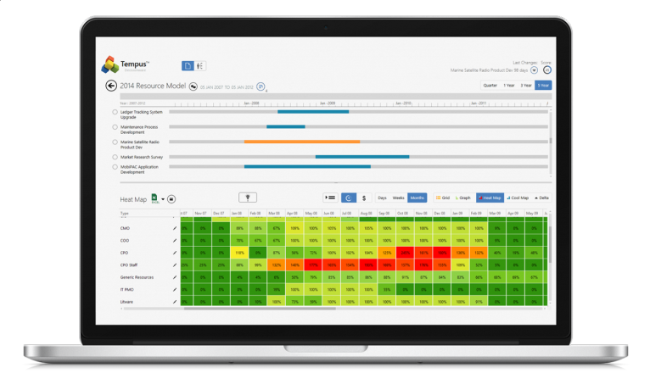
KEY SUCCESS DRIVERS – TEMPUS RESOURCE
Software tool that is easy to implement and focus on the problem to solve

Slide 28

KEY SUCCESS DRIVERS – PROJECT INTAKE
Demand estimation of new initiatives up front

Slide 29
KEY SUCCESS DRIVERS – QUARTERLY PLANNING CYCLE
Demand Deadline
The core teams have finished
to define the demand for the project for all planning horizons and entered them in Tempus Resource
Initial Model
MPM creates an initial model and tries to resolve major demand / capacity deficits with the relevant stakeholders
Assignment deadline
The team leads have replaced generic resource assignments with named resources (where possible) in Tempus Resource
Conflict Resolution Phase
Core Teams and Team Leads solve remaining conflict (demand greater than available capacity) in discusions and finally in Conflict Resolution Meeting. If conflicts can’t be resolved, possible scenarios will be modeled in Tempus Resource by MPM
Modeling deadline
All conflicts are either resolved or possible models have been created
PLM Approval
The PLM Board approves one model and core teams will adjust demand / assignments accordingly
1^{st*}
3^{rd*}
7^{th*}
14^{th*}
20^{th*}
Quarterly Process > Feedback and Adoption after every cycle

Slide 30
KEY SUCCESS DRIVERS – FOCUS ON CULTURAL CHANGE
RPM
Today
6
7
1
2
3
4
5
8
9
10
11
12
13
14
15
16
17
18
19
20
21
22
23
24
25
26
27
28
29
30
31
Presence
Future
Training with emphasis on cultural change > Clear communication
of why, how and what the future vision is

Slide 31
Expected ROI
Siemens Healthineers expects to be able to run 20% more projects due to Tempus.
Siemens was already able to move 3 major product development projects forward by more than 1 year.

Slide 32

Tempus Resource
Customer benefits
50%
Transforming the project planning process means that BMC IT is able to support business agility and make faster, more informed decisions.
Faster response to project requests
30%
Enabling capabilities:
Reduction in resource over allocations
Drag and drop modelling/simulation for quickly performing ‘what if’ analysis across multiple, current and future projects and resources
Complete, holistic insight into the entire portfolio with visibility to all Project information
Flexible resource pool management makes it simple to monitor activity and utilization and make adjustments necessary to optimize
Easy direct entry replacing spreadsheets and also integrated with our PPM tool
25%
Increase in the number of projects completed
© Copyright 2016 BMC Software, Inc.

Slide 33

“Vision without Execution is Hallucination.
Execution starts with a plan.”
Thomas Edison et al.

Slide 34
Greg Bailey
gbailey@prosymmetry.com
713-985-9997
http://Prosymmetry.com
Questions ?

