Slide 1


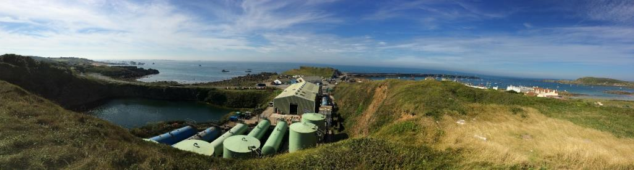
An EPCM Approach
Bringing Sustainable Energy to Alderney
Dr John Henry Looney
Sustainable Direction Ltd
Project Challenge 2017

Slide 2

About Sustainable Direction
Sustainability Consultancy
Environmental Engineering
Project Delivery

Slide 3
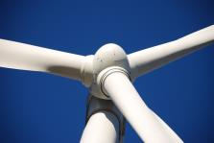
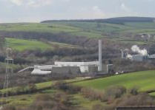
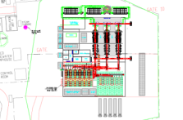
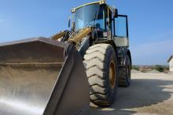
About Sustainable Direction
Project Delivery
Feasibility Studies
Financial Modelling
Front-End Engineering and Detailed Designs
Public Consultation
Technical Due Diligence
Planning, EIA and Environmental Permitting
Construction oversight and support services
Overall Project Management

Slide 4


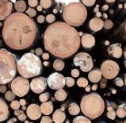

About Sustainable Direction
Project Delivery
Particular experience in sustainable energy projects
  Helping clients increase security of supply
  Gain greater control over energy costs
  Low or Zero Carbon Focus
No ‘one-size-fits-all’ – we find the right solution for your demand, which will be different every time
We call this approach meso energy
Experience in gas CHP, biomass, AD, wind, solar, hydro and marine

Slide 5

Case Study: Alderney Electricity Ltd
Energy solutions for a more prosperous island

Slide 6
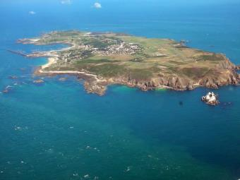
Case Study: Alderney Electricity Ltd
Project Overview
AEL updating electricity generation and distribution system for entire island
Includes new generation plant and opportunities for future renewable energy and district heating
The improvements proposed will provide
better value for domestic and business customers
improved energy security and continuity
a more sustainable and prosperous economy for Alderney
Start with WHY!
Our Role
Initial Feasibility Study & Public Consultation
Full Engineering, Procurement, Construction Management (EPCM)
With a Twist!

Slide 7
Engineer- Procure- Construct- Management
So what is it? And why would you do it?
  Conventional PC
  EPC / EPC – M
  DBOO / DBOT
  PFI / PPP
  Other versions?
What is best for the full life cycle, for the owner / user / investor?
  Risk / Reward / Return
  When are these questions asked by the stakeholders and when, where and how does Governance happen? (The 2012 Olympics provided very good examples (see the web))

Slide 8
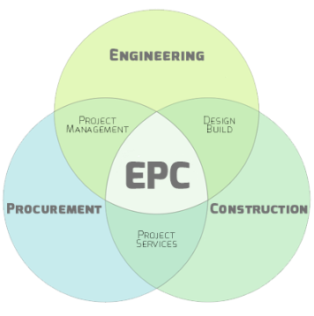
Engineer- Procure- Construct- Management
What is EPC?
Integrated Engineering, Procurement and Construction contracting
EPC Contractor delivers project on turn-key basis
Client benefits include:
  Better risk management
  Consolidated responsibility
  Drives ownership of project lifecycle
  Enhanced management oversight
The EPCM Role
Management services contracted on behalf of Client- acting as “Owners Agent”
Combined management and administration of project controls, budget, program + quality
On the client side of the table in terms of delivery by the supply chain

Slide 9
Engineer- Procure- Construct- Management
EPCM – Client Requirement Management
Always, Sometimes, Evolve into knowing what they want
They change it
And change it again (which is good and fair)
The EPCM Role
When does Design Freeze Occur?
When Should Optioneering Occur?
When Should Value Engineering Occur?
How do we understand, communicate and manage this

Slide 10
Engineer- Procure- Construct- Management
EPCM – Construction and Vendor Management
EPC M Contractor is to deliver the project on a turn-key basis
Vendors/ Suppliers/ Contractors want:
  Profit, Additional Work, Fair Process
  Communication is key and roundtable engagement
  Clarity and Timeliness on change and we require that from them
The EPCM Role
Management services contracted on behalf of Client- acting as “Owners Agent”
Combined management and administration of project controls, budget, program + quality
Control Scope, Optioneering and Value Engineering at the RIGHT time

Slide 11
Engineer- Procure- Construct- Management
EPCM – Programme and Budget Management
As always:
  Scope
  Schedule (Programme)
  Budget
  And Change Management
  Drives ownership of project lifecycle
  Enhanced management oversight
The EPCM Role
This is our main job
To keep the parties aligned

Slide 12
Engineer- Procure- Construct- Management

Slide 13
Engineer- Procure- Construct- Management

Slide 14
Engineer- Procure- Construct- Management

Slide 15
Engineer- Procure- Construct- Management

Slide 16
Engineer- Procure- Construct- Management

Slide 17
Engineer- Procure- Construct- Management

Slide 18
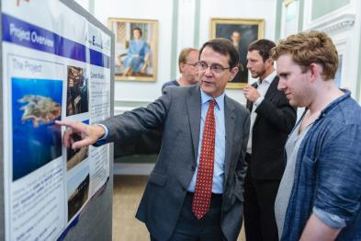
Case Study: Alderney Electricity Ltd
Why has EPCM approach been successful on Alderney?
Specialist role: Client does not resource this kind of work frequently!
Integrated within Client team across project life-cycle:
Feasibility Assessment > FEED/ Detailed Design > Project Financing > Delivery
Unbiased, “trusted partner” function: Enhances Client team expertise
Additional management complexity: Client also acting as Principal Contractor
The Twist

Slide 19
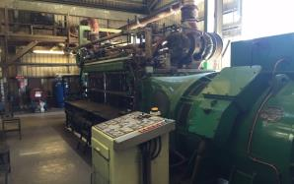
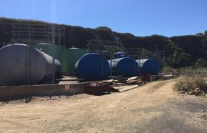
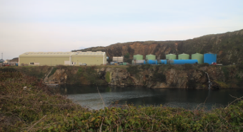
Case Study: Alderney Electricity Ltd
Old System
1,903 people on the island, forecasting an increase to 2036 by 2036
Demand is 1.2 MW peak, with baseload of 400 – 500 kW
Current system is complex and aging, with manual controls and a one-way grid
7x diesel generators, between 20 and 50 years old
Generators will soon need an expensive overhaul, giving opportunity the Alderney to rethink its energy generation making it more sustainable for the future

Slide 20

Case Study: Alderney Electricity Ltd
Feasibility Stage
Needed to consider unique demands and constraints of island environment
Demand cannot be met purely with renewables due to issues of reliability and consistency of supply

Slide 21
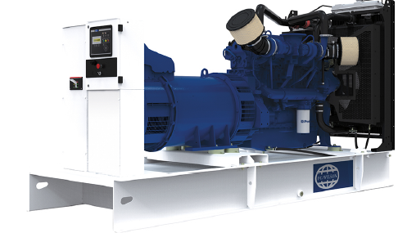
Case Study: Alderney Electricity Ltd
Proposed Solution
Installation of 8x modern, dual-fuel engines, capable of using both fossil- and bio-fuels
Compact, reliable, with excellent fuel consumption
Load-sharing to maximise efficiency and extend useful life
Fully integrated automatic control system
Plug-and-play format – simple to maintain and change system to meet demand
Control system compatible with future solar PV

Slide 22

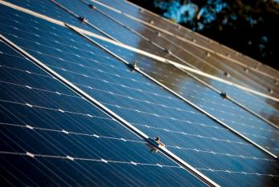
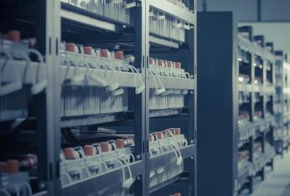
Case Study: Alderney Electricity Ltd
Added Benefits
District heating of community buildings with waste heat
Solar PV to meet demand peaks
Battery backup for uninterruptible power supply

Slide 23
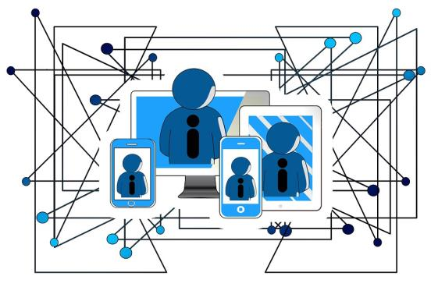
Summary
The Sustainable Direction Approach
Guiding Energy Strategy
Integrated EPCM Role
Working with specialist design & install teams
Co-ordinating interfaces (e.g. client doing civils and prep works)
Managing risk & contractual issues
Benefit to the Client
Trusted partner
Impartial technical experts, not suppliers of specific technology
Bringing the best solution for the client, with no preconceptions
Continued technical due diligence throughout the project
Firm project management with many players, phases and interfaces involved

Slide 24
Any Questions?
Dr John Henry Looney and Kris Atkins
Sustainable Direction Ltd
www.sustainabledirection.com
+44 (0) 1452 382218
@SDirectionL
With special thanks to
James Lancaster and Alan Graca, Alderney Electricity Ltd,
and
Jon Stokes, Team Stokes Ltd

