Slide 1


Recognising resistance to Change
Ranjit Sidhu and Jack Pinter
@ChangeQuestLtd
@Jackpinter
#projchallenge
©ChangeQuest 2017

Slide 2
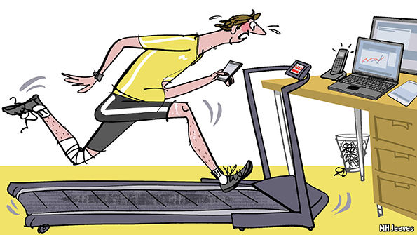
Pace of change

Slide 3

Balancing delivery focus with people focus

Slide 4
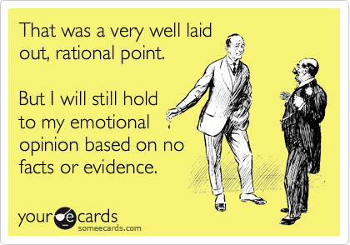
People are not rational robots

Slide 5




Resistance to change

Slide 6

Different levels of resistance
What we see
Behaviours
Thoughts
Feelings
Needs
Notes:
A range of unspoken rules, expectations, assumptions develop over time. Change can disrupt these, leading to a loss of trust and commitment

Slide 7


Example change – ACME Business Services
Player A
Player B
Changing from having own office to hot-desking in open plan office
Senior Executive
at Acme Business Services
and player A’s manager
Mid level manager
at Acme Business Services

Slide 8
Different levels of resistance
What we see
Behaviours
Thoughts
Feelings
Needs
Notes:
A range of unspoken rules, expectations, assumptions develop over time. Change can disrupt these, leading to a loss of trust and commitment

Slide 9
We think much faster than we speak
Think much faster!
600 – 800 words per minute
Speak 120 – 150 words per minute

Slide 10
Different levels of resistance
What we see
Behaviours
Thoughts
Feelings
Needs
Notes:
A range of unspoken rules, expectations, assumptions develop over time. Change can disrupt these, leading to a loss of trust and commitment

Slide 11
Different levels of resistance
What we see
Behaviours
Thoughts
Feelings
Needs
Notes:
A range of unspoken rules, expectations, assumptions develop over time. Change can disrupt these, leading to a loss of trust and commitment

Slide 12
Different levels of resistance
What we see
Behaviours
Thoughts
Feelings
Needs
Notes:
A range of unspoken rules, expectations, assumptions develop over time. Change can disrupt these, leading to a loss of trust and commitment

Slide 13
Appealing to hearts and minds
Recognise and acknowledge other’s emotions, needs and values
Respect
Acknowledgement
Understanding
Fairness
Competence
Honesty
Cooperation
Gratitude
Appreciation
Achievement
Integrity
Responsibility
Status
Ambition
Trust

Slide 14



Balancing yours and other’s views
Player A
Player B

Slide 15



Discover more
Certified Local Change Agent
NEW qualification (2 days)
Change Management
Foundation and Practitioner (5 days)
Aligned with Change Management Institute’s Competency Framework

Slide 16
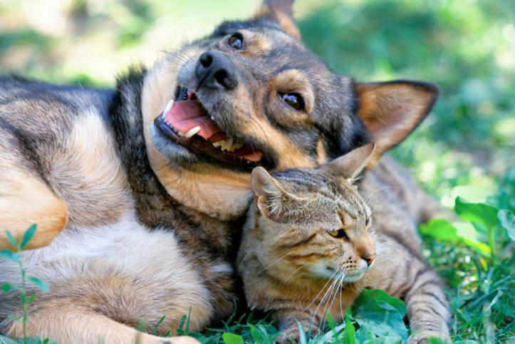
“Trust is the most essential factor
in effective communication”
Stephen Covey

Slide 17

About ChangeQuest
Helping you and your organisation grow
Your development needs are at the heart of everything we do.
We offer accredited and bespoke training and coaching in
Change management
Project management
People skills
Enabling you and your organisation to manage people, projects and change more effectively and with less stress.

Slide 18







Thank you
You will find more articles on our blog at www.changequest.co.uk and you can keep up to date with the latest tips and resources by following us on LinkedIn and Twitter.
ChangeQuest
@ChangeQuestLtd
+44 (0)1276 34480
info@changequest.co.uk
www.changequest.co.uk

