Slide 1
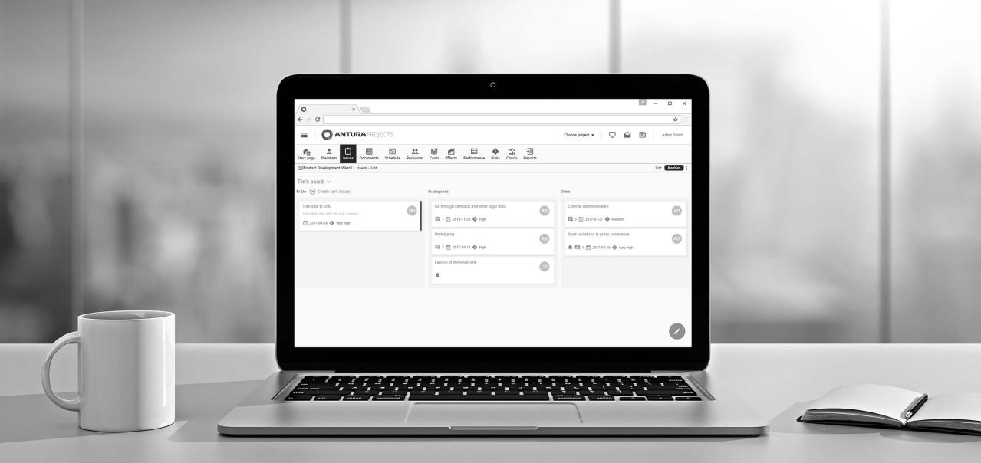
Breaking the chains: Skanska UK’s journey from spreadsheets and ad-hoc governance to an industry standard Project Delivery Framework.
Doug Sorrell, Governance and Process Consultant and Acting Head of IT PMO for Skanska UK

Slide 2
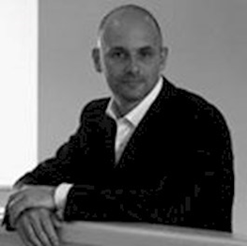
Doug Sorrell
A dynamic change agent with close to 28 years’ experience in the IT and Corporate arena across Europe & the USA.
Consulted for emerging businesses (Viatel, Netcomm, Hermes Europe Railtel) through to large multi-national organizations (AT&T, ATT / Shell, BT, Cable & Wireless, Uniworld etc) and has managed large change programmes on both operational and commercial levels.
Has worked across diverse industries such as Oil & Gas, Telecommunications and Construction all of which have a very different understanding, and need of change.
Currently leading a Project Delivery Transformation programme within the IT department of Skanska UK and is acting Head of PMO.

Slide 3
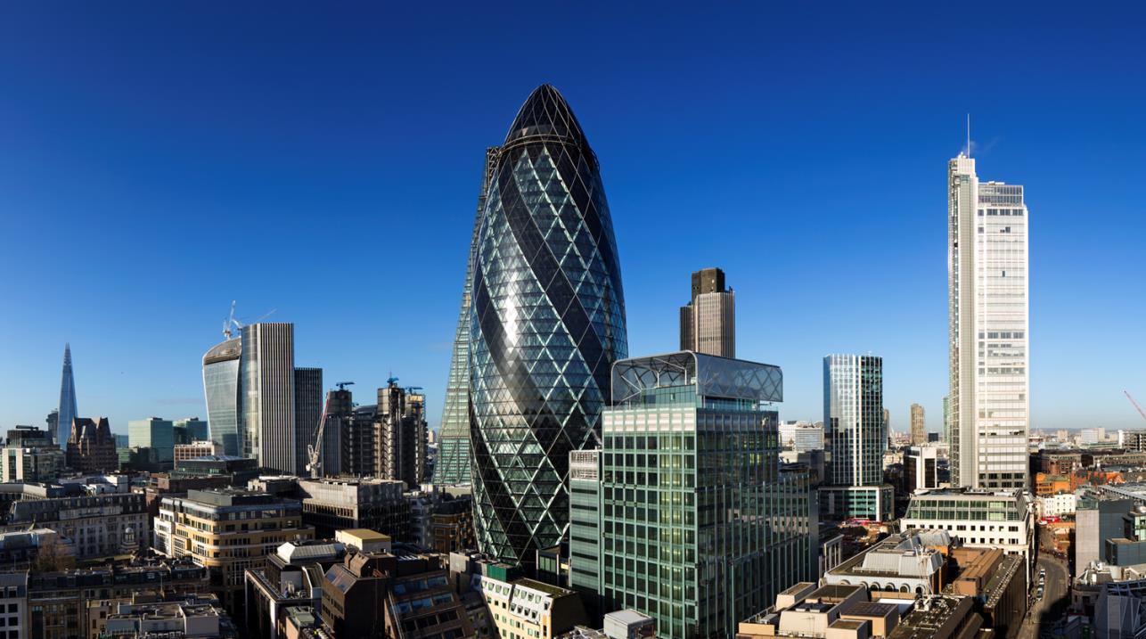
Introducing Skanska UK

Slide 4
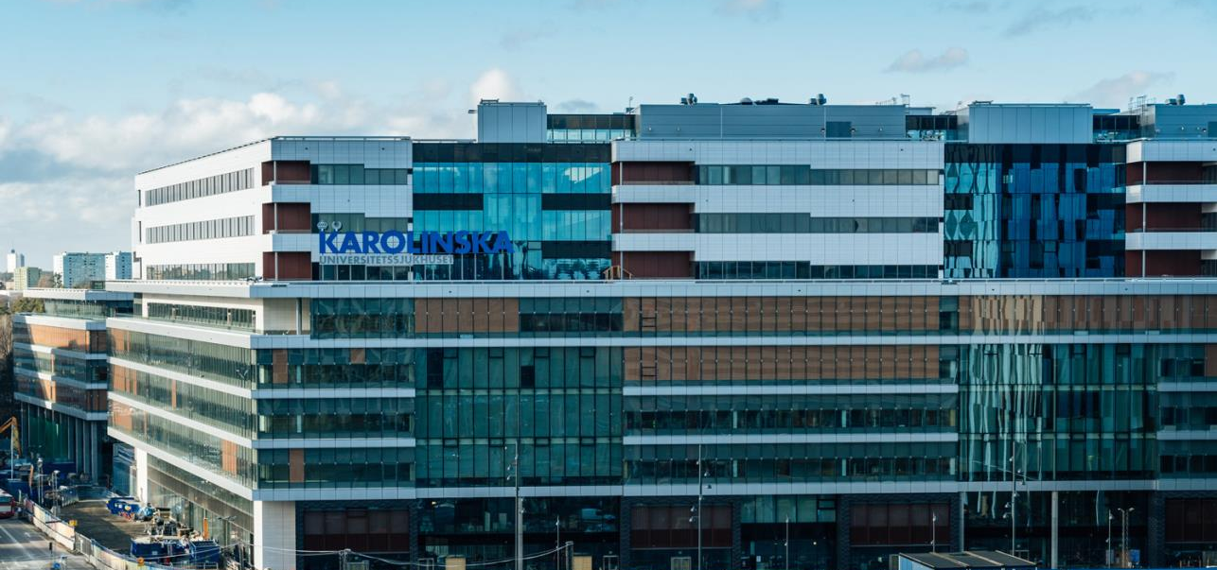
Skanska in brief
Founded 1887 in Sweden
International business since 1897
Quoted on the Nasdaq Stockholm
2016 SEK 151 billion revenue
2016 41,000 employees
New Karolinska Hospital, 2017

Slide 5
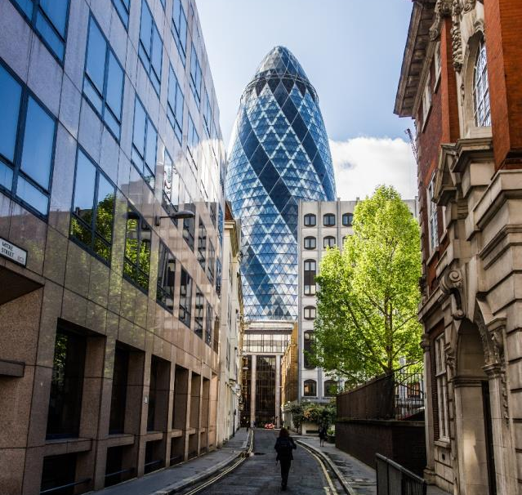
In the UK
Established in
2000
6,000 employees
2016 revenue £1.678 billion
2016 operating income £35.1 million
The Gherkin, London

Slide 6
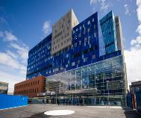
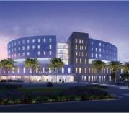
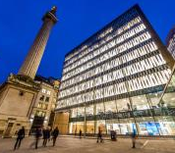
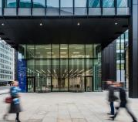
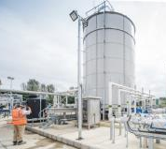
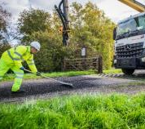
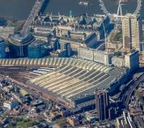
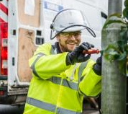
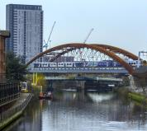
Project highlights
Barts and The London
New Papworth Hospital
The Monument Building
Creechurch Place
Bristol schools
Water frameworks
FM projects
Highways maintenance
Waterloo and South West Upgrade
A14 Cambridge to Huntingdon Improvement Scheme
Gloucestershire street lighting
Crossrail
Northern Hub
Notes:
Recent project highlights
The design, construction, operation and maintenance of the UK’s biggest hospital project, the £1 billion redevelopment of St Bartholomew’s and The Royal London.
With a value of more than £400 million, seven Crossrail contracts have been secured by a Costain Skanska joint venture since 2010, including Bond Street and Paddington stations.
Water – Skanska is delivering long-term value for Thames Water, Welsh Water and Anglian Water, using collaborative working to create broad-based, innovative solutions that benefit consumers.
In the last 10 years, we’ve built, refurbished and extended over 40 schools in Bristol to deliver over 7,500 new primary places, and improved the learning environment for more than 13,600 secondary pupils.
New Papworth Hospital – part of a new biomedical campus in Cambridge, this cardiothoracic centre of excellence will provide 310 beds, seven operating theatres and five catheterisation labs, funded through a private-finance initiative.

Slide 7
Information Overload

Slide 8
What to do?

Slide 9
What we did

Slide 10
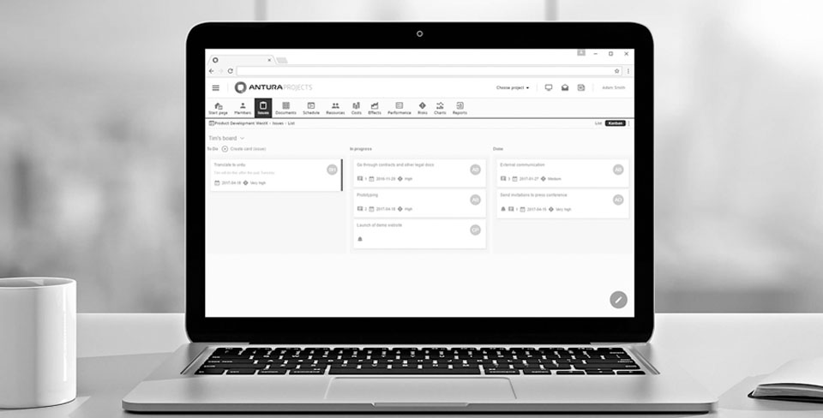
Why Antura?
Competitive tendering process
Listening to what we needed
Antura Projects matched what we needed

Slide 11
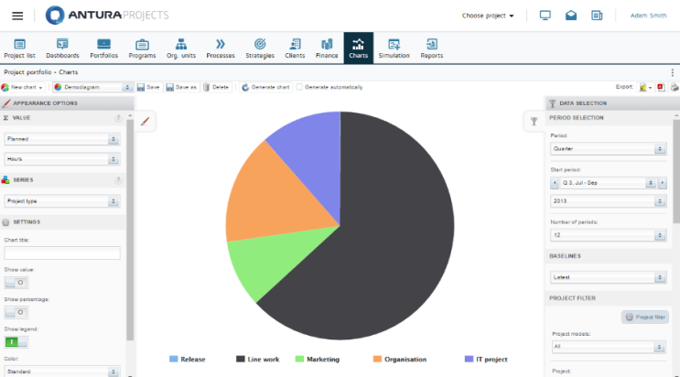
A Complete Solution
Fast to implement & Easy to Use
Project
Portfolio
Resource Mgt
Proven results - over 200,000 satisfied users in more than 50 countries

Slide 12
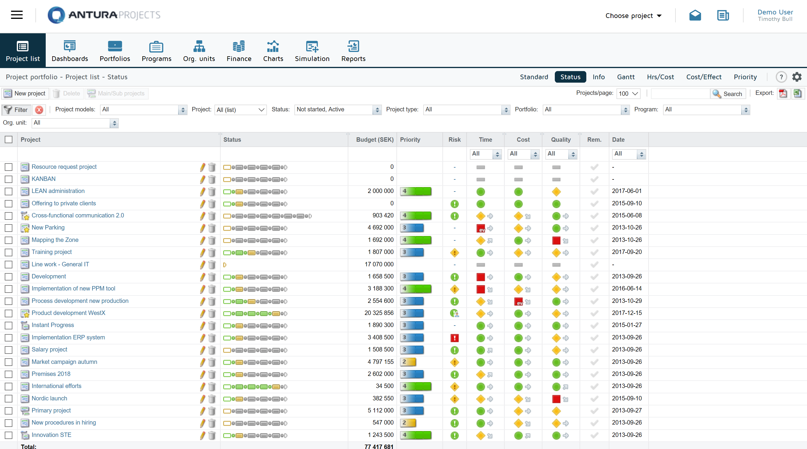
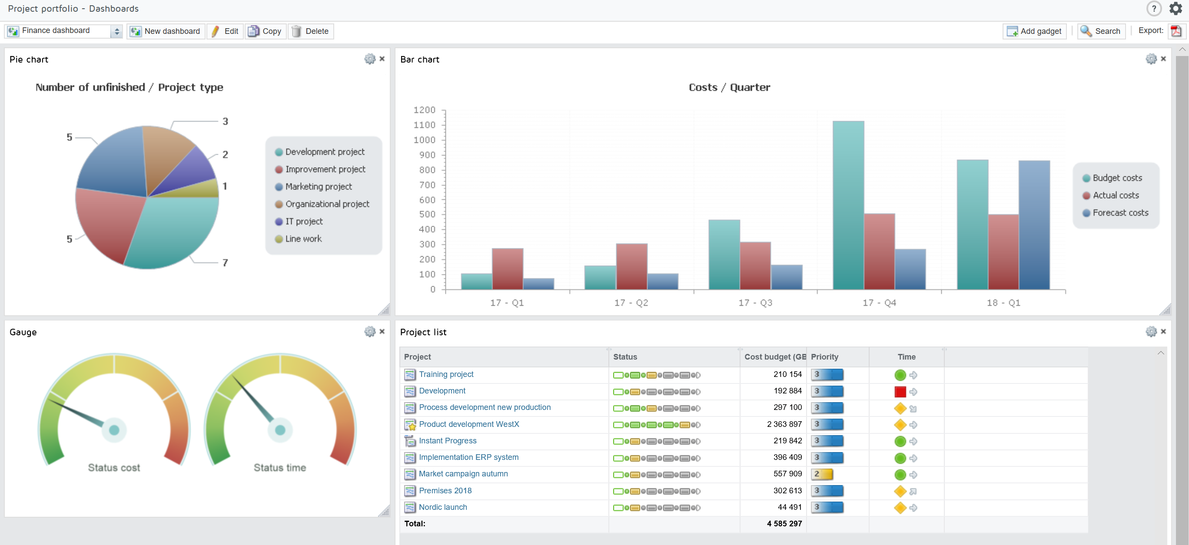
Journey to maturity
Single point of truth
Maturity
New abilities like management being able to find finer details on project portfolios quickly

Slide 13
What did we learn?
Ease of use
Transparency
Importance of matching people, processes and tools

