Slide 1


EFFECTIVE Sponsorship IS THE KEY TO SUCCESS
Martin Samphire
Project Challenge – 7 March 2018

Slide 2
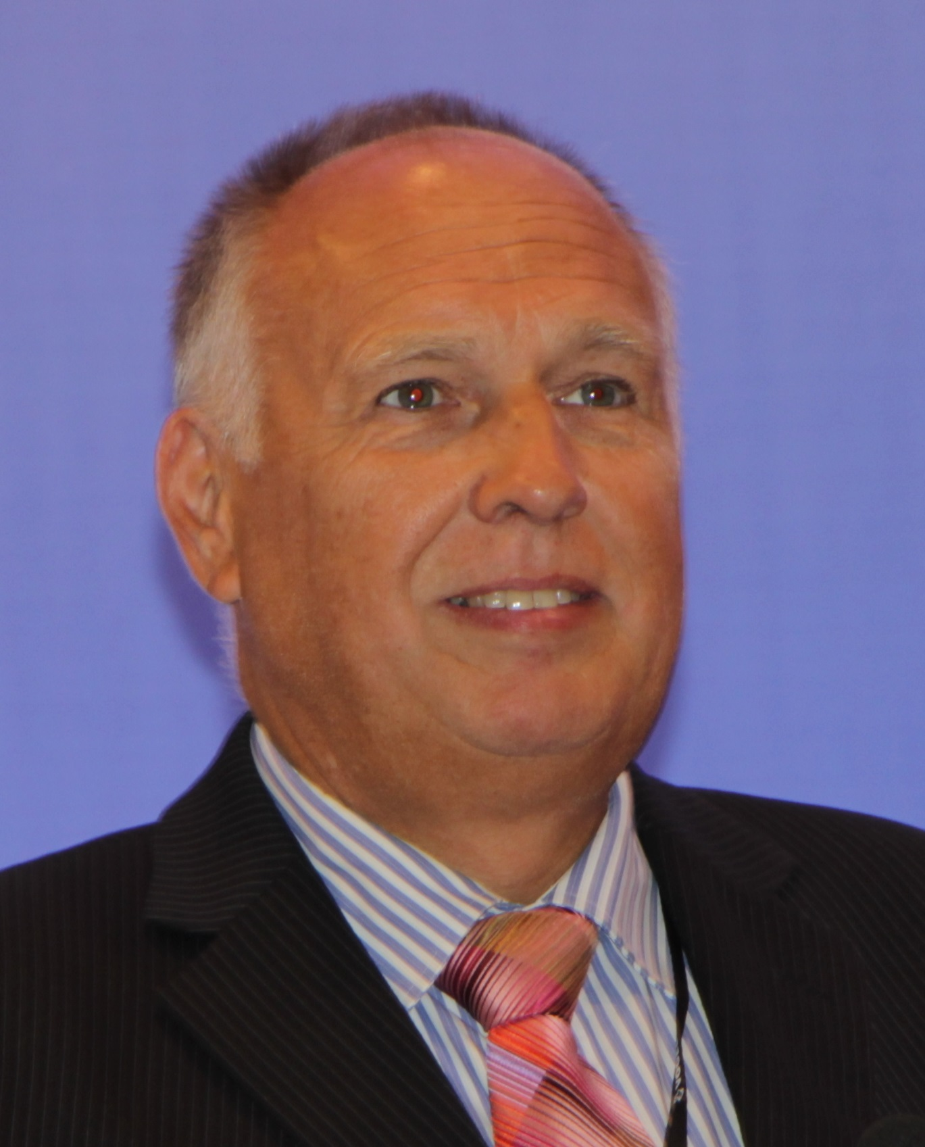

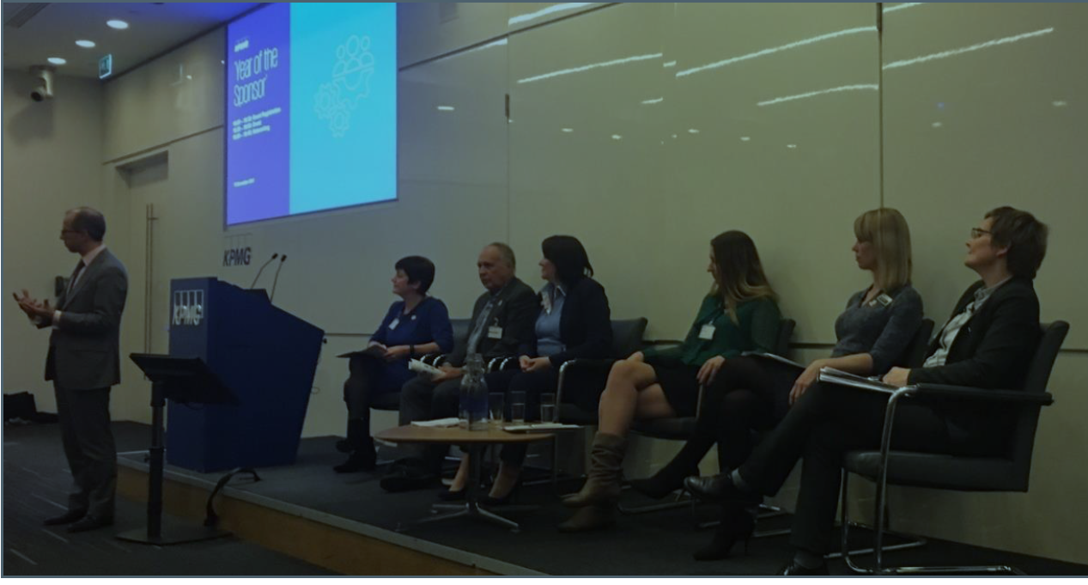
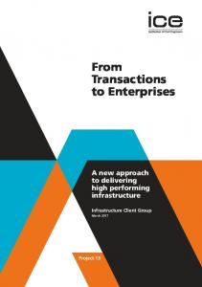
Martin Samphire
Owner and MD – 3pmxl Ltd
Fellow APM
Member IoD
Chairman of APM Governance SIG
Sectors – Central Civil Government, Police, Defence, Rail, Energy, Financial Services, Construction, Oil & Gas
3pmxl
Panel Member for “Year of the Sponsor” Conference
Dec 2017
Contributor to Project 13

Slide 3

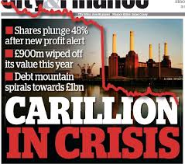
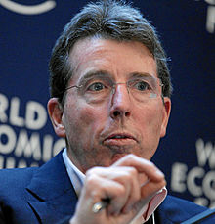

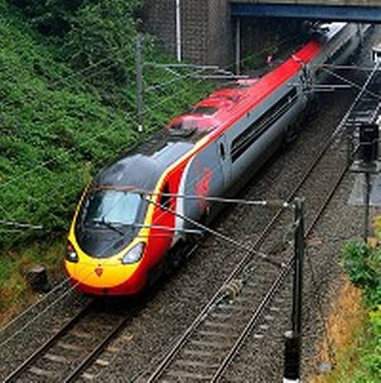


Governance AND SPONSOR ROLE
Poor sponsorship is major cause of project failure
“no such thing as project failure, only failure of governance” – Andrew Bragg, Former CEO APM
3pmxl

Slide 4
Common Causes of project Failure
Lack of a clear link with key strategic priorities.
Lack of clear senior management and, in government projects, ministerial ownership and leadership.
Lack of effective engagement with stakeholders.
Lack of skills and proven approach to project and risk management.
Lack of understanding of, or contact with supply industry at senior levels.
Evaluation of proposals driven by initial price, rather than long-term value for money.
Too little attention to breaking down development and implementation into manageable steps
Inadequate resources and skill to deliver the total delivery portfolio.
MOST common causes are down to poor sponsor performance
3pmxl
Notes:
From OGC – similar to Standish
PM success – T,C,Q
Sponsor – benefits realisation
Most are to do with governance in some way – and in particular little to do with the PM role
PM role does not equal project management

Slide 5
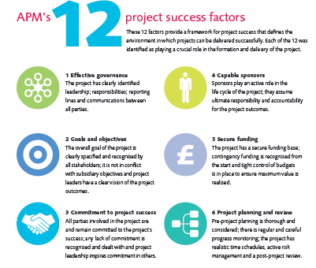
APM project success factors - 2015
Notes:
APMs recently published survey on factors for project success. What contributes most to success / failure.
Governance is stated in it’s own right
However over 50% of other factors are factors in good governance ( see Directing Change – COME BACK TO THAT) and are the responsibility of the Company Directors, sponsors or portfolio managers for getting right – not the PM. They need to set the right culture and rules – checks and balances to ensure that these aspects are in place.

Slide 6
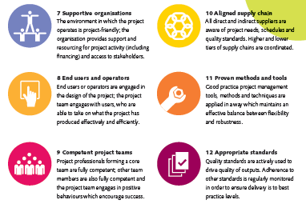
APM project success factors - 2015
Notes:
LOOK AT OTHER research from a range of sources

Slide 7
Other Recent research
“only 62% of programmes have an established or mature link between programme objectives and organisational strategy and only 50% of the respondents felt that the boundaries of their organisations portfolio were clearly defined and decision making well supported”
“Fit-for-purpose governance strongly influences project and programme success”
“higher performance is correlated with higher maturity”.
“there is a highly visible disconnect between Executive Teams and Project Managers”
Under 7% of respondents used a Competency Framework for selecting a Sponsor
“50% didn’t understand the role or felt competent”
“Only 57% of sponsors had received sponsor training”
“80% of the projects with active sponsors reported a success rate of 75%, which is much higher than the average”
“actively engaged sponsors is the top driver of project success”
“only 38% of programmes had established processes to identify benefits at the outset”
“only 20% had robust benefits measurement processes in place during implementation”
“C-Suite are often missing in action”.
“62% of portfolios do not have benefits in the sponsor’s personal performance targets”
Sources:
2014 PMI Pulse Survey
PwC 2104 Global Survey
PwC 2012 Global Survey
GovSIG Benchmarking
3pmxl
Notes:
So some overwhelming evidence for good governance being the critical success factor for project success.
GOOD GOVERNANCE HAS TO START AT THE TOP

Slide 8
Sponsor role

Slide 9
Governance of 3PM
Strategic Outcomes – achieve strategic objectives
Portfolio Sponsor = Board
Portfolio
Right investments / projects – optimise selection and prioritisation to maximise business value
Specific business performance and benefits
Programmes
Right way – integrated delivery of related projects to maximise realisation of benefits
Programme or Project Sponsor
Projects
Products and Capability
Done well – delivery to time, cost, quality and scope objectives
Notes:
Project and Programme management is about delivering specific products and benefits into the organisation
Processes largely designed for getting things done in a “good” way, (about the what & how)
PfM is fundamentally different – it is about selecting and starting/stopping/amending scope of projects – to maximise the combined benefits for the organisation (about the why & what). Optimising outcomes/benefits
Benefits Management is core to the success of Projects, Programmes and Portfolios - but needs to be treated differently at each level
PfM is not just “big PM or PgM” – it is ongoing and integral to successful strategic planning

Slide 10
The big questions
We need to be sure that we are maximizing the value of our investments in change (all projects) such that?:
We deliver against our strategic objectives
We gain best value through optimal benefits
At an affordable cost
With a known and acceptable level of risk
In a controlled and transparent way
With few surprises
Across the whole life cycle
Sustainably
And behaving ethically.
Sponsor role is crucial – apex of governance
Notes:
Organisational more than single project – PRiNCE2
Previously
Considered tactical rather than strategic
Suspicious because it fosters visibility, transparency - difficult to hide mistakes
Creates clear accountabilities – nowhere to hide
Now
Greater focus on governance as disaster projects highlighted
Corporate scandals have led to new legislation e.g. Sarbanes Oxley, UK Corporate Governance Code 2010
Directors have real liability
Attitude to transparency and disclosure changing
Financial pressures require “every pound to count

Slide 11






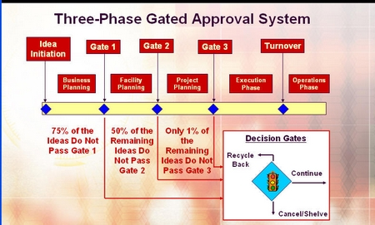


Responsibilities of the sponsor
leadership and culture
golden thread of delegation
alignment and relationships
keeping the destination in sight
vision and roadmap
capacity and competence
process and decision gates
Notes:
Engaging with stakeholders to ensure change supports organisational objectives (alignment and relationships)
Defining clearly the destination and method for the journey (vision and roadmap)
Defining where what type of change decisions can be most effectively made (golden thread of delegation)
Defining when critical change decisions need to be made and those involved in making them (process and decision gates)
Ensuring accountability to deliver (clearly allocated roles)
Ensuring excellent management control and effective forecasting (keeping the destination in sight)
Ensuring transparency of change decisions/actions and communicating their outcome (reporting)
Ensuring appropriate resources are in place (capacity and competence)
Corroborating through independent review (assurance)
Demonstrating the right behaviours from the top (leadership and culture)

Slide 12

Sponsor / SRO - pivotal link
The Business
The Project
Temporary Organisation - Project
Permanent Organisation -
BAU
Sponsor straddles both and has pivotal role. Effective performance in Sponsor role is crucial for success of project

Slide 13
different focus
The Business
The Project
Ensure alignment
Manage context
Manage key stakeholders
‘Harvest benefits’
Live with ambiguity
Provide direction
Provide support
Set Objectives
Ensure resources
Remove ambiguity
Notes:
JUST LKIKE FOOTBALL – DEFENCE / ATTACK – DFFERENT FOCUS BUT BOTH INVOLVED

Slide 14
Responsibility of the sponsor / SRO
For the Board / Client
Provides leadership on culture and values
Owns business case
Maintains project alignment with portfolio strategy and direction
Governs project risk
Works with other sponsors
Focuses on realisation of benefits
Pursues opportunities to optimise cost / benefits
Ensures continuity of sponsorship
Provides assurance
Learns lessons
For the Project Manager
Provides timely decisions
Clarifies decision making framework
Clarifies business strategy and priorities
Communicates business issues
Provides resources
Engenders trust
Manages relationships with key stakeholders
Supports PM role
Promotes ethical working
Remain Conscious – assume the worst
Other
Stakeholder communications
Governance framework
Client communications
3pmxl
Summarised from APM guide – Sponsoring Change
Notes:
Suggest that sponsor and PM have an “emotional contract”
Time commitment
Frequency and nature of reports from PM
Frequency of meetings
How problems are to be solved and escalated

Slide 15
RELATIVE EFFORTS
Project Manager
Level of Effort / Decision Making
Sponsor
Lifecycle / time

Slide 16



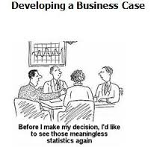



Characteristics of a good SRO / sponsor
Harvester- Realises the Benefits
Governor – directs + friends in high places + stakeholders
Champion – demonstrates commitment
“Owner“- Owns Business Case + Strategic Alignment + Problem / Opportunity
Clairvoyant – Manages the Context
GP - Feels the pulse of the project – Assurance + Gateway checks
Facilitator - Ensures business ready to adopt change

Slide 17
OBSERVATIONS ON THE SPONSOR ROLE
But Not:
Project Manager’s Line Manager
Senior Project Manager
Dictator
Sponsor vs Sponsor Agent role
Who makes the best sponsor?

Slide 18
Support for the sponsor role

Slide 19

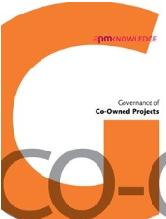


APM Publications
Directing Change
Update for 2018
Governance of
Co-owned Projects
2017
Directing Agile Change 2016
Sponsoring Change
Update for 2018
Free to APM members at www.apm.org.uk/memberdownloads
Notes:
Show of Hands - Who has used? Who has copy of DAC?
Directing Change - 60000 thousand copies downloaded / sold. Well regarded advice and guidance on how to go about applying good governance practice to the Management of Projects. 2nd edition Being revised currently to 3rd Edition.
Directing Agile Change – guidance

Slide 20
Achieving Conscious Capability
Individuals often unaware of limitations / afraid to admit
New and complex programmes often mean uncharted waters
External circumstances change
Capability of each role will vary according to the stage of the programme, or particular issue
New business model being implemented – new roles / accountabilities
Role locations are examples only
Danger Zone
Seeks advice / training
Aware of limitations
Anticipates changing environment
Challenges established practices
Encourages challenge
Conscious
Workstream Leaders
Sponsor
Methodology myopia
Only uses own experience
Flying blind
Programme Manager
Delivery, but
without structure
Opportunities / benefits missed
Doesn’t recognise others’ shortcomings
Prog Board
Unconscious
Business Reps
Lower capability
Higher capability
“Programme Conscience” – work alongside sponsor, improve capability, provide additional assistance to bridge the capability gap
“Sponsor Agent” – support a busyt senior sponsor to implement role (beware)
3pmxl

Slide 21
SUMMARY
Sponsor role is most crucial to project success / failure – most causes of failure are down to poor sponsorship
The Board is Portfolio Sponsor
We need to develop Sponsor competencies and professionalism (APM developing competency framework)
Sponsors need to remain “conscious” and challenge
Recognise competence weakness – adopt plan to fill gap
Experienced PMs do not necessarily make good Sponsors
3pmxl

Slide 22
Contact:
Martin Samphire – Managing Director
Email: msamphire@3pmxl.com
Mobile: 07798 700314
Office: 01189 730114
3pmxl Ltd
303 Nine Mile Ride
Finchampstead
RG40 3NL

