Slide 1
Enabling step change in your PPM Maturity

Slide 2
Introduction
Vince Hines
The State of Project Management Annual Report
The State of Project Management is the largest annual piece of research of its kind in the UK. Published by Wellingtone and involving hundreds of organisations it provides deep insight into the state of our industry
Vince will combine this data with practical advice on how your organisation can use this knowledge to enable a step change in your project and portfolio management maturity
You will gain rich industry data and thought provoking practical advice from this entertaining presentation

Slide 3
Driving change since 1995
Developing your PPM Maturity

Slide 4
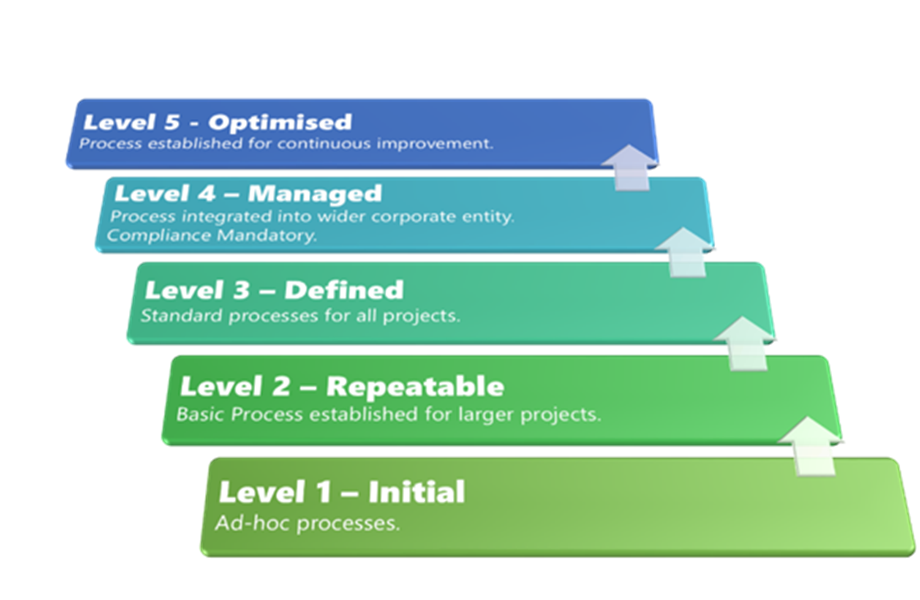
PPM Maturity Model

Slide 5
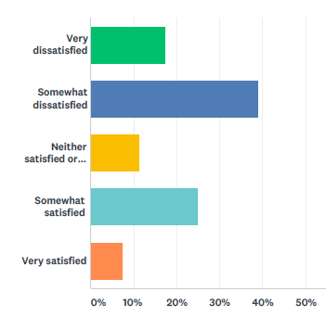
Project Management Maturity
Only a third of respondents were somewhat or very satisfied with current PPM maturity

Slide 6
Project Performance
46%
40%
of organisations most or always complete on budget
of organisations most or always complete on time
50%
of organisations most or always have a track record of success
36%
of organisations most or always deliver full benefits

Slide 7
Top 5 PPM Challenges
Poorly trained Project Managers
Too many projects
Lack of project funding [11th in 2017]
Inconsistency in approach
Doing the wrong projects (lack of strategic alignment)

Slide 8
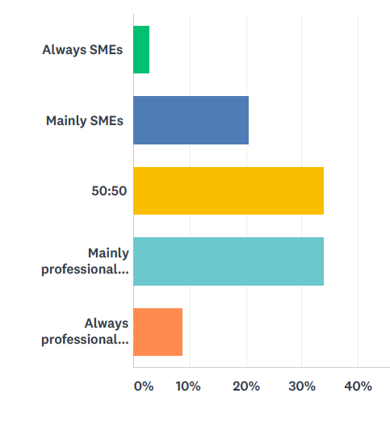
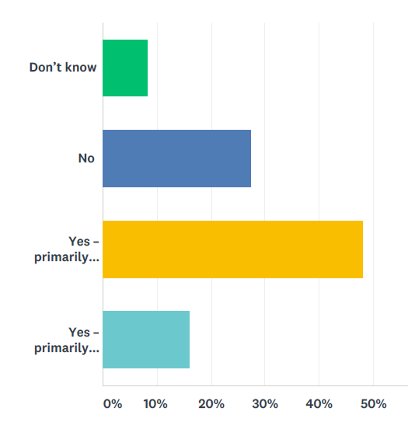
Project Manager Capability
Who tends to run projects in your organisation?
Does your organisation invest in PM training?
Accredited Training
In-house Training

Slide 9
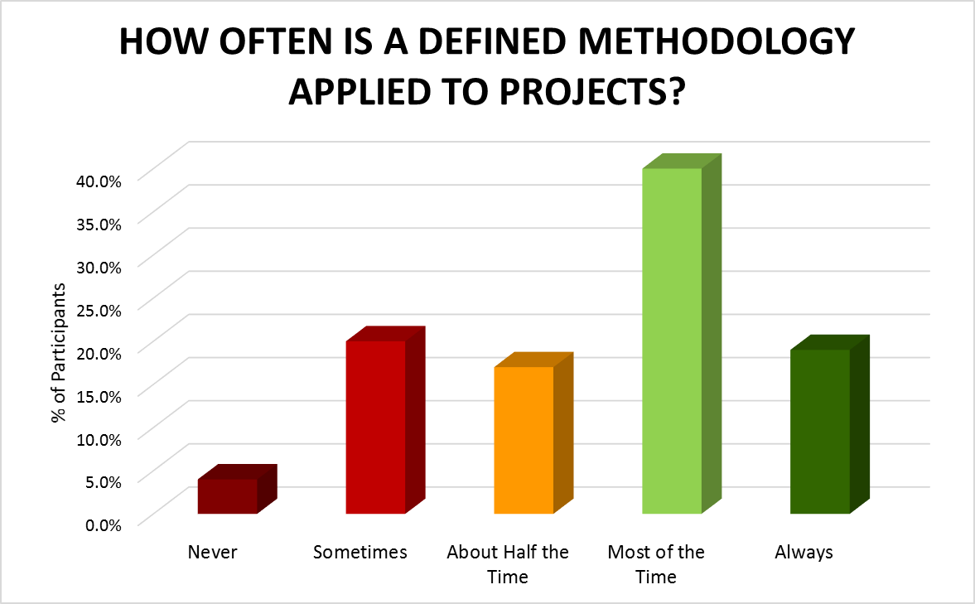
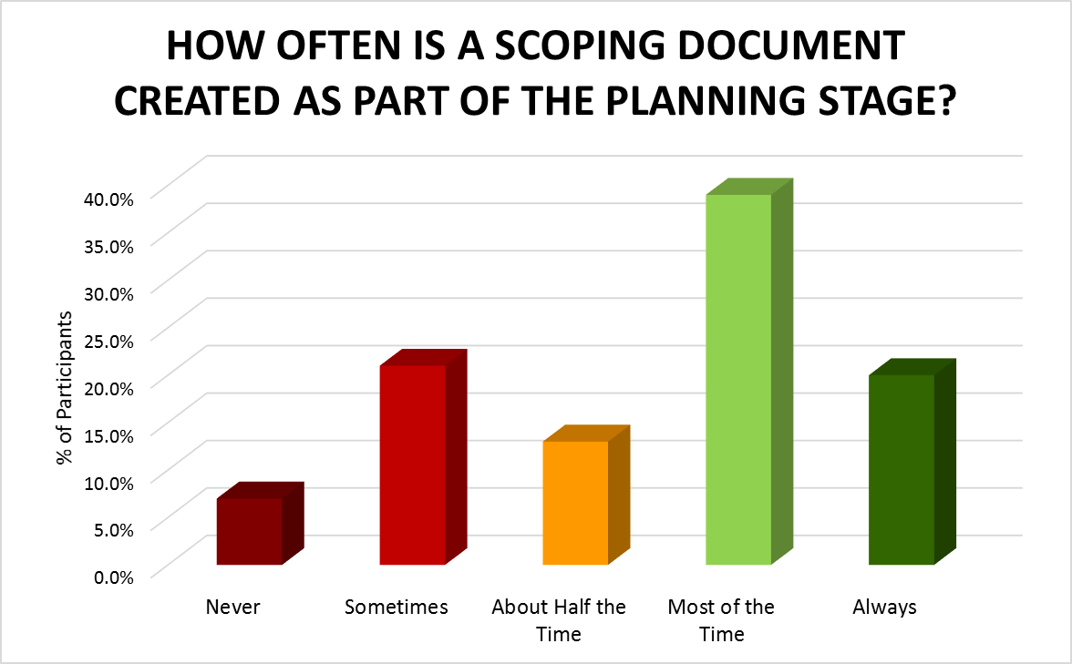
PPM Methodology Benchmark
60%
60%
mostly or always apply a methodology
mostly or always create a scoping document

Slide 10
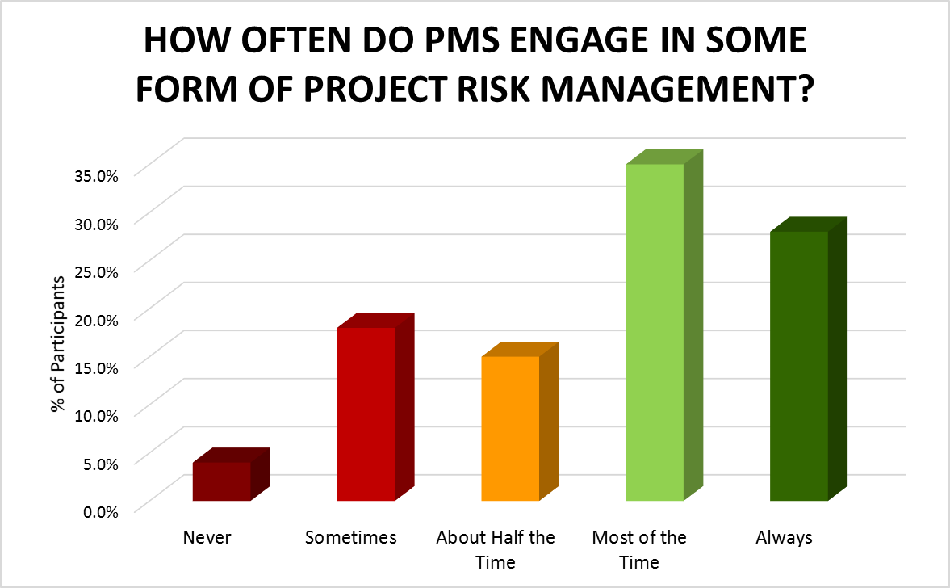
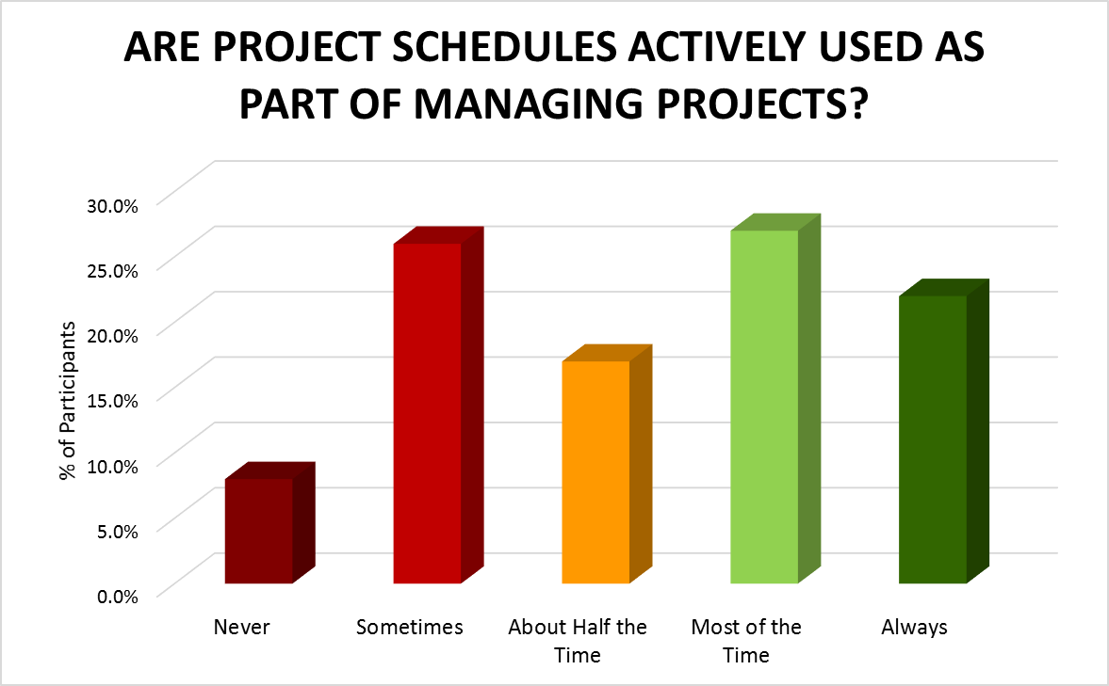
PPM Methodology Benchmark
63%
49%
mostly or always engage in risk management
mostly or always actively use schedules

Slide 11
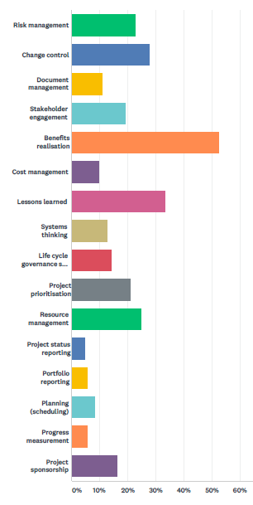
Top 6 PPM Processes Most Troublesome to Embed
Benefits Realisation
Lessons Learned
Change Control
Resource Management
Risk Management
Project Prioritisation

Slide 12
Key Drivers to PPM Maturity
04
Training & Support
Establish training in methodology & practical PPM tools & techniques. Establish a PPM Community of practitioners, mentoring and career development
Training & Support
Technology
03
Leverage enterprise PPM solution to enable consistency in approach, one version of the truth, transparency & collaboration
Develop PPM Tools
02
Project Management Office
Leverage PMO
Develop PMO capability to support best practice Project, Programme and Portfolio Management. Benchmark, establish a PPM Maturity Roadmap, and ensure PMO value
Methodology
01
Define consistent, practical, fit for purpose PPM Methodology, Lifecycle & Governance structures based on best practice, but tailored to the organisation
Develop Methods

Slide 13
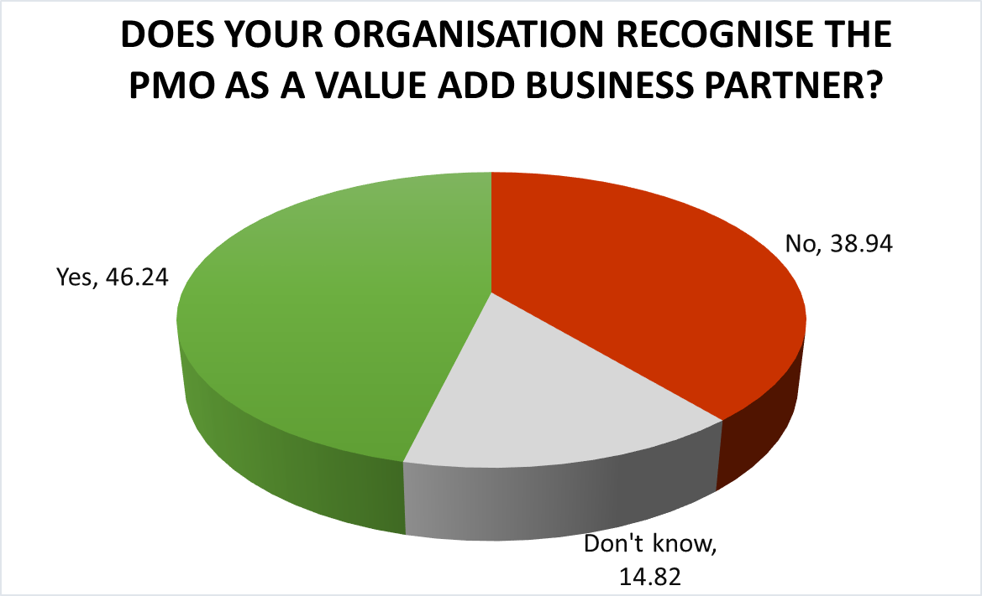
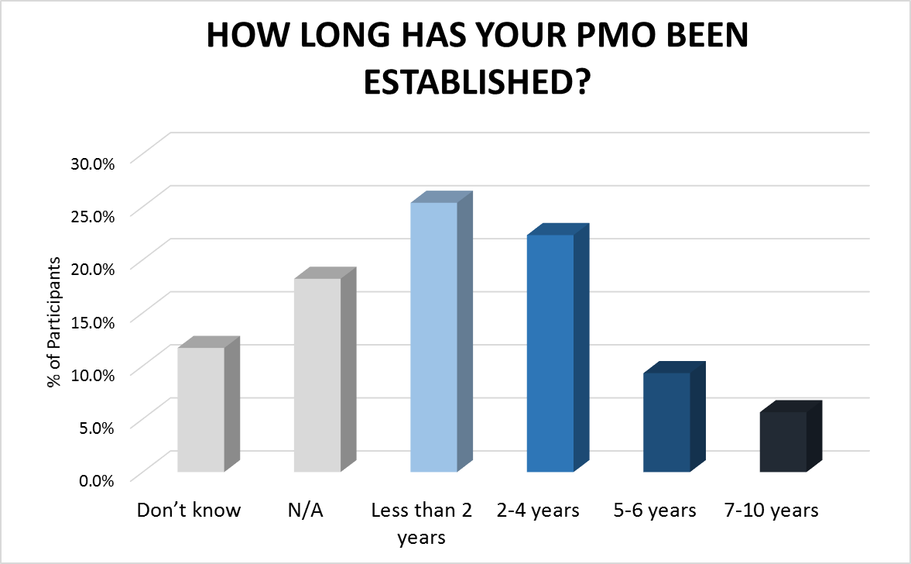
PMO Benchmark Data
80%
of organisations have a PMO

Slide 14
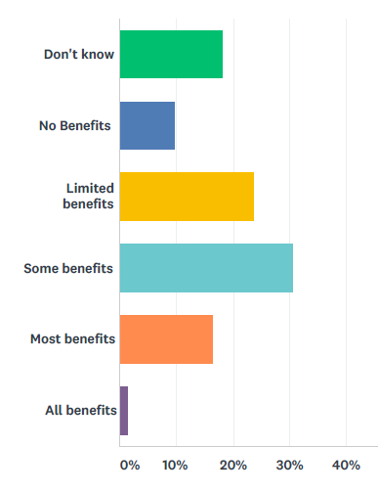
Technology Benchmark Data
Are you achieving the benefits from your PPM solution?
55%
of organisations do NOT have access to centralised project KPIs
48%
of respondents spend 1 or more days every month collating project status information
What about Resource Management?
43% use Excel
17% use nothing
13% use a PPM solution

Slide 15
Characteristics of “good”...
Defined governance, including project approval and oversight
A defined project lifecycle & stage gates
Consistent use of project management documents & tools
Agreed and signed off scope of work
Clarity of and focus on benefits
Clarity of project roles and responsibilities
A planning phase before work starts
A progress cycle when works starts
Honesty with RAG KPIs and help when needed
Identified lessons fed back into future projects
A PMO function to drive maturity
Training for those given the challenge to run or sponsor projects
Continuous improvement through the PMO and a Community of Practitioners

Slide 16
The 6 Killer Questions
How many projects have you got?
Who is the PM for each project?
Who is the Sponsor, and do they know what their role is?
How were these projects approved?
Who approved the scope?
What is the current actual status of each project?

Slide 17
Wellingtone Key Drivers
Keep it Simple
If we develop something sophisticated, it often leads to complexity and this results in lack of buy-in. We need an approach that is simple to use, but effective. This provides a firm foundation for enhancement over time as part of your PPM Maturity Roadmap
Engage Stakeholders
It is important that any recommendations to develop PPM maturity are reviewed and agreed by key stakeholders. Everyone must be happy to support change
Leverage Technology
Where practical, proven and cost effective we should leverage technology to enable collaboration, transparency of project information, resource management and consistency
Scalable
The recommended approach must be scalable to fit the organisation today and in the future

Slide 18
Next Steps
The State of Project Management Annual Report being published on 16th of March
Download from our web site
Use to benchmark your PPM Maturity
Recognise developing PPM Maturity is a journey...a project! presentation

Slide 19
