Slide 1
From Global Telecoms to Local Authority
A Journey in Portfolio Management

Slide 2
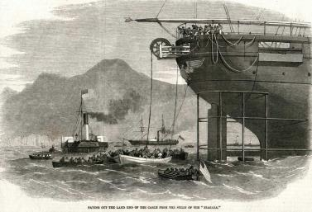
Vodafone Group Plc
Voice, Messaging, Data
Mobile
Fixed
26 Countries
450m customers
Newbury HQ
13k people in UK

Slide 3
Vodafone PPM
Within IT there is a mature and tested model
Strong PMO function delivers assurance, PM guidance and benefits realisation/tracking
Less mature model within other parts of the business

Slide 4
Digital Operations
Responsible for all change to Vodafone UK web estate, including sales, self-service platforms and internal facing
~2,500 projects of varying size per year
Mix of strategic large-scale Projects, EBU refresh, with numerous BAU projects e.g. handset launches & brand campaigns
~100 resources
Mix of User Experience, Programme and Product managers, with Developers, Graphic Designers, Copywriters etc.

Slide 5
Demand Management
Daily demand triaged daily, by a dedicated multi-disciplinary team
Focus on business benefits
Team decide ‘in the room’ on ‘Go / No Go’
Immediate decision on resources
Demand can iterate back into the room before it is sent to the Planning team
A virtual planning team, led by Business Support, co-ordinate the planned demand to completion

Slide 6
Why Dynamic Portfolio Management?
How do we…?
Match resources available to our demand pipeline?
Get everyone focussed on a single list of things to do?
Clearly state and communicate priorities?
Communicate the benefit of doing specific projects?
Explore (quickly!) different scenarios?
Communicate to the wider business what is, and isn’t, in scope for delivery?

Slide 7
Buckinghamshire County Council
Buckinghamshire County Council

Slide 8
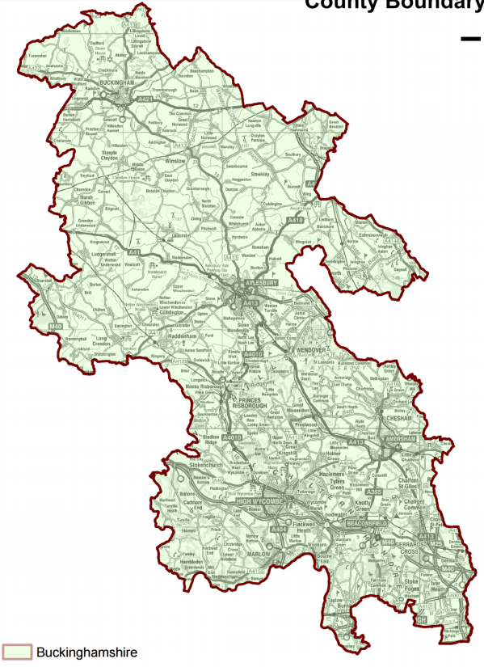
The County of Buckinghamshire
Northamptonshire
Bedfordshire
Buckinghamshire
Oxfordshire
Hertfordshire
Greater London
Berkshire
Notes:
Buckinghamshire is a ceremonial county in South East England.
It borders Greater London to the south east, Berkshire to the south, Oxfordshire to the west, Northamptonshire to the north, Bedfordshire to the north east and Hertfordshire to the east.

Slide 9
Buckinghamshire – the Facts & Figures
86% in Good Health
76% Households
are Homeowners
87% Access to Vehicle
505,000
people
Households with Children
Biggest Proportion
54% Married
Pockets of
Social Deprivation
as per 2011 census
Notes:
Home to approximately 505,000 people
73% of households own their own home
86% of people describe themselves as being in good or very good health
87% of households have access to a car or a van
54% of the residents are married
Households with Children make up the greatest group
However, over a third of the population is within the bottom 20% most deprived in England in terms of geographical barriers to services
Overall age profile is similar to UK, but lower in 20/30 year olds
There are pockets of social deprivation, Currently 3.6% of residents live in the 20-30% most deprived areas of the country

Slide 10
The Political Landscape
District Councils
Parish Councils (168 Parishes)
8 Town councils, 131 parish councils and 29 parish meetings
Notes:
Three tier local government
County Council – Buckinghamshire County Council founded in 1889, stable political environment
District Councils – Four district councils, Aylesbury Vale, Chiltern, South Bucks and Wycombe
One Unitary – Milton Keynes
Parish Councils – 168 parishes (8 Town councils, 131 parish councils and 29 parish meetings)
Member led

Slide 11
Our Strategic Plan
Notes:
Safeguarding Our Vulnerable
Creating Opportunities and Building Self Reliance
Keeping Buckinghamshire Thriving and Attractive

Slide 12
Business Unit
Transport, Economy & Environment
Environment
Growth & Strategy
Regeneration & Infrastructure
Transport Services
Strategic Business Planning & Commercial Development
Notes:
Consists of 5 Delivery Units
Environment
Growth & Strategy
Regeneration & Infrastructure
Transport Services
Strategic Business Planning & Commercial Development

Slide 13
What does the work look like
A smaller number of larger projects, unlike Vodafone which generally had a large number of smaller projects
A mixture of capital (CapEX) and revenue (Opex) projects
Projects can range from building a road or a school through creating mobile apps for Country Parks to looking at local devolution

Slide 14
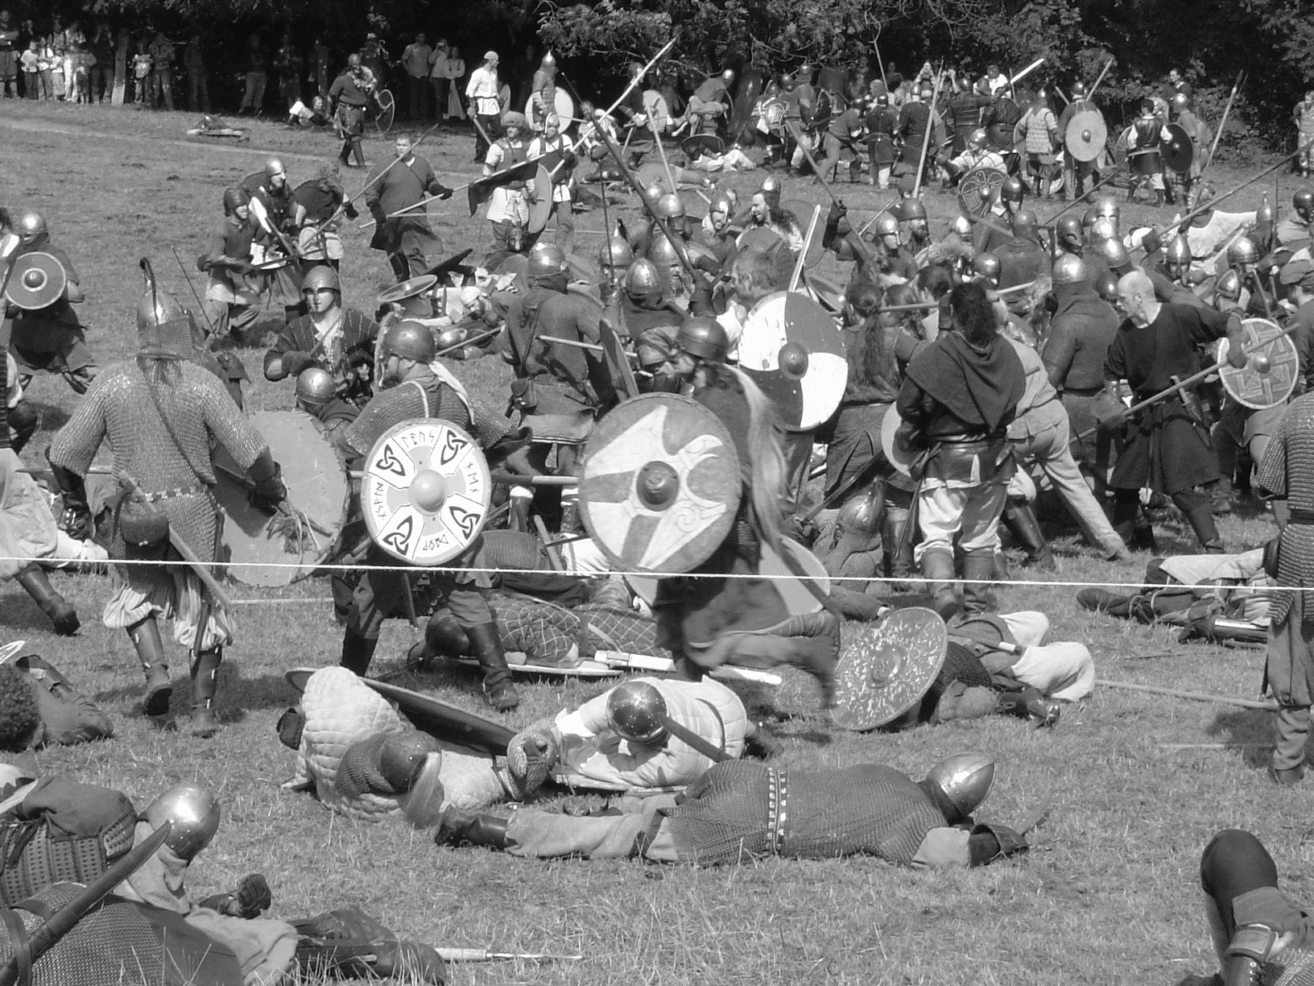
The Challenge
Who’s doing what, when?
Poor Communication
Units work in Silos
Poor Visibility
Multiple Methodologies
No Long- term Pipeline
No Consolidated View
Notes:
Not only do Business Units work in silos but individual Delivery Units work in silos
No one could quite articulate when people were available
No one at a business unit level knows exactly what projects are being worked on and by whom across delivery units
Individual project managers were really busy, but nobody was sure that the things they were working on were the highest priorities
Lots of different project methodologies being used Prince 2 remains strong, but Agile is making inroads
No Single View of Change and no long term pipeline

Slide 15
The Elephant in the Room
Notes:
The public sector is not overwhelmed with money
Austerity has hit local government even harder than central government
We have becoming as lean as we possibly can with respect to staff
Some of the options to drive further efficiencies and savings, such as digital are not as far advanced as they could be

Slide 16
Dynamic Portfolio Management - Revisited
How do we…?
Match resources available to our demand pipeline?
Get everyone focussed on a single list of things to do?
Clearly state and communicate priorities?
Communicate the benefit of doing specific projects?
Explore (quickly!) different scenarios?
Communicate to the wider business what is, and isn’t, in scope for delivery?

Slide 17
Dynamic Portfolio Management - Revisited
How do we…?
Match resources available to our demand pipeline?
Get everyone focussed on a single list of things to do?
Clearly state and communicate priorities?
Communicate the benefit of doing specific projects?
Explore (quickly!) different scenarios?
Communicate to the wider business what is, and isn’t, in scope for delivery?
THE SAME

Slide 18
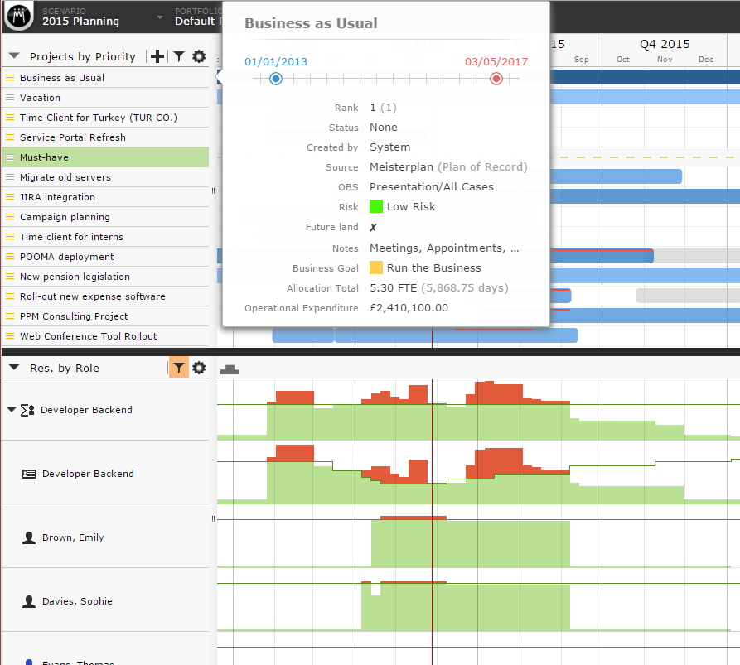
Capacity vs demand
Notes:
Portfolio Management – What it’s given us:
We are aligning projects not only to the Strategic Plan but also to our Business Unit Objectives
We have real Portfolios, and a cabinet member that aligns to them, Environment and Transport
We have now built a successful Single View of Change
We have real time information that means that the Directors and MD of the Business Unit cam make quick decisions around the projects that we progress
It’s given us the flexibility to change with either business priorities or political priorities
We have successfully developed a pipeline for the next 12-18 months
We now more fully align to Business Unit goals and Strategic Objectives

Slide 19
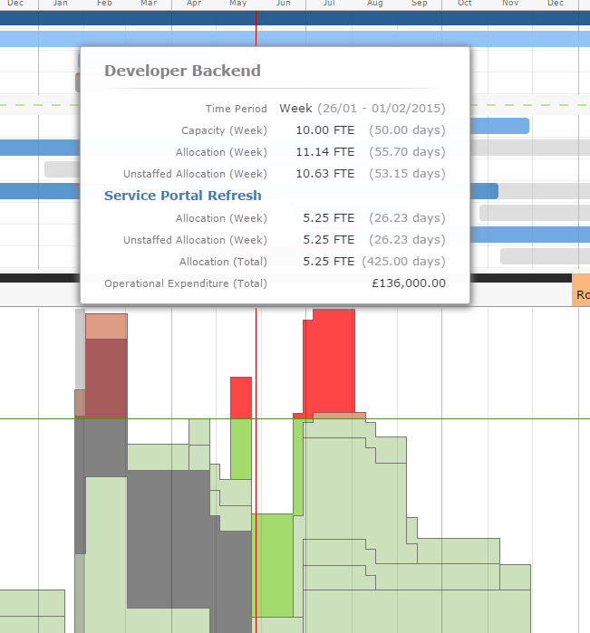
Resource Detail

Slide 20
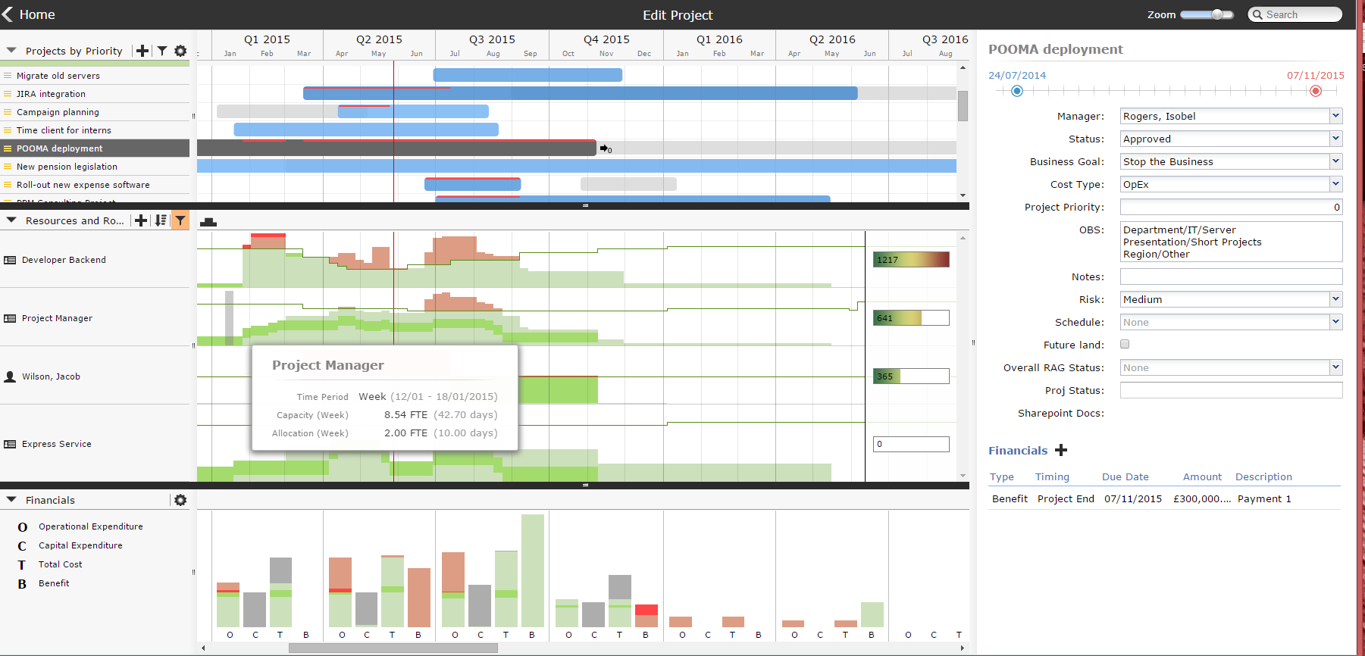
Full Project Metadata

Slide 21
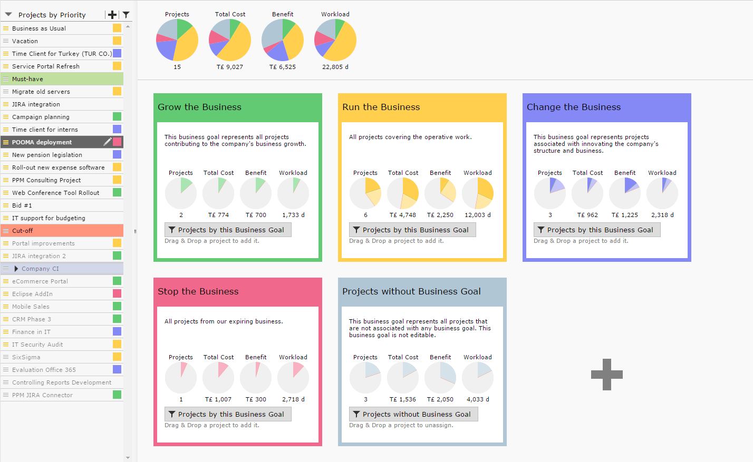
Alignment to Business Goals

Slide 22
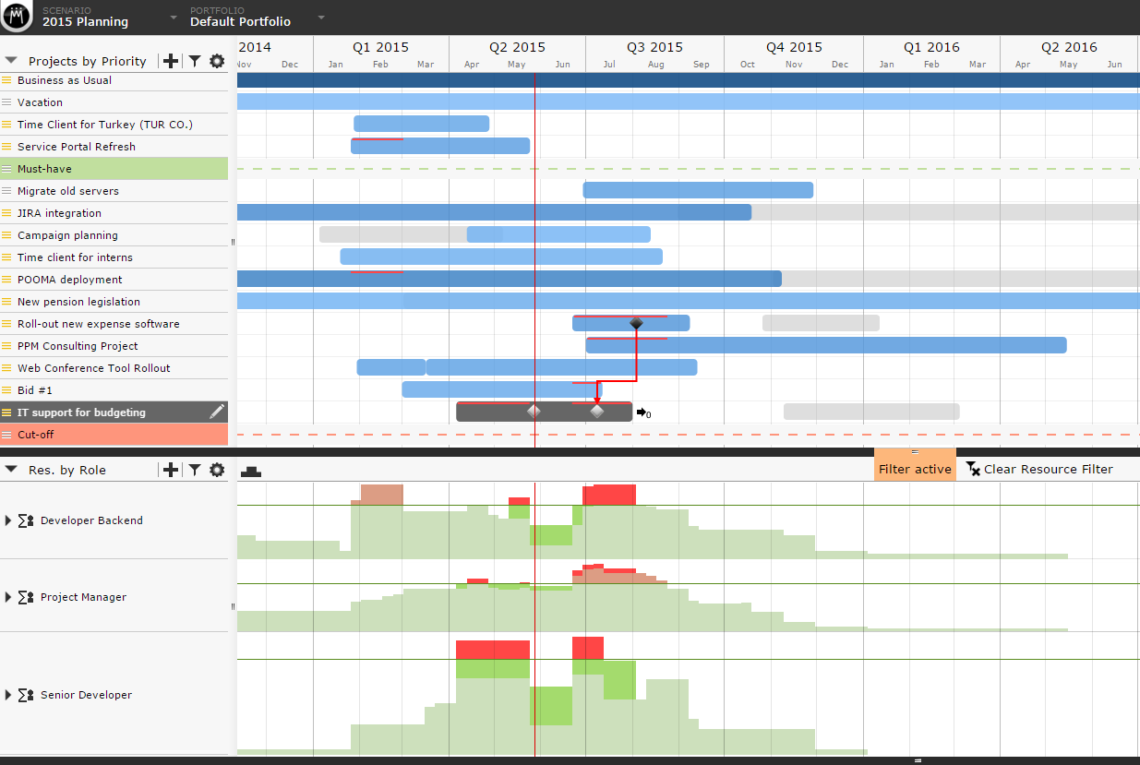
Full Milestone & Dependency Tracking

