Slide 1
The Intelligent Organisation ©
John Beckford
Project Challenge
Olympia, 11th October 2016

Slide 2
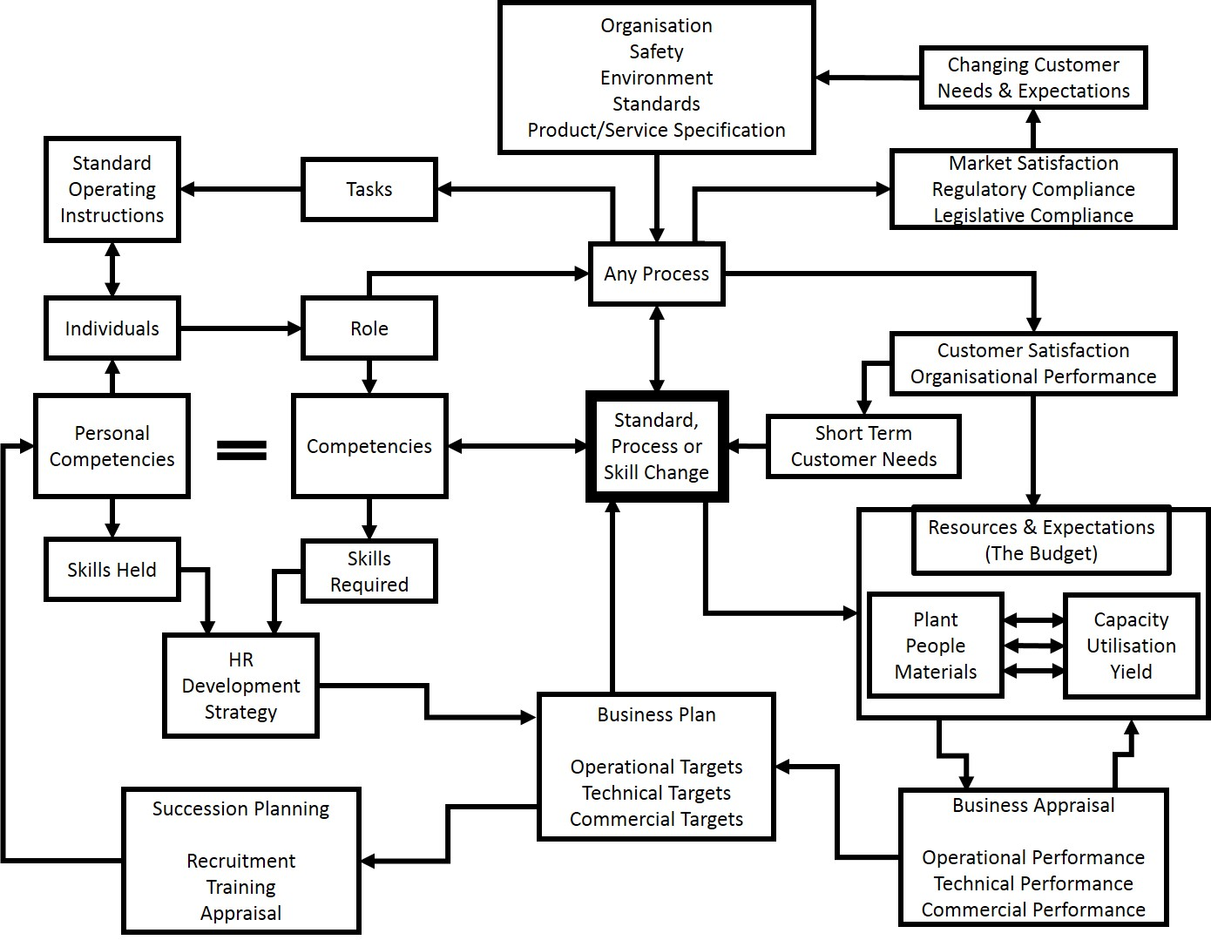
The Management Challenge

Slide 3
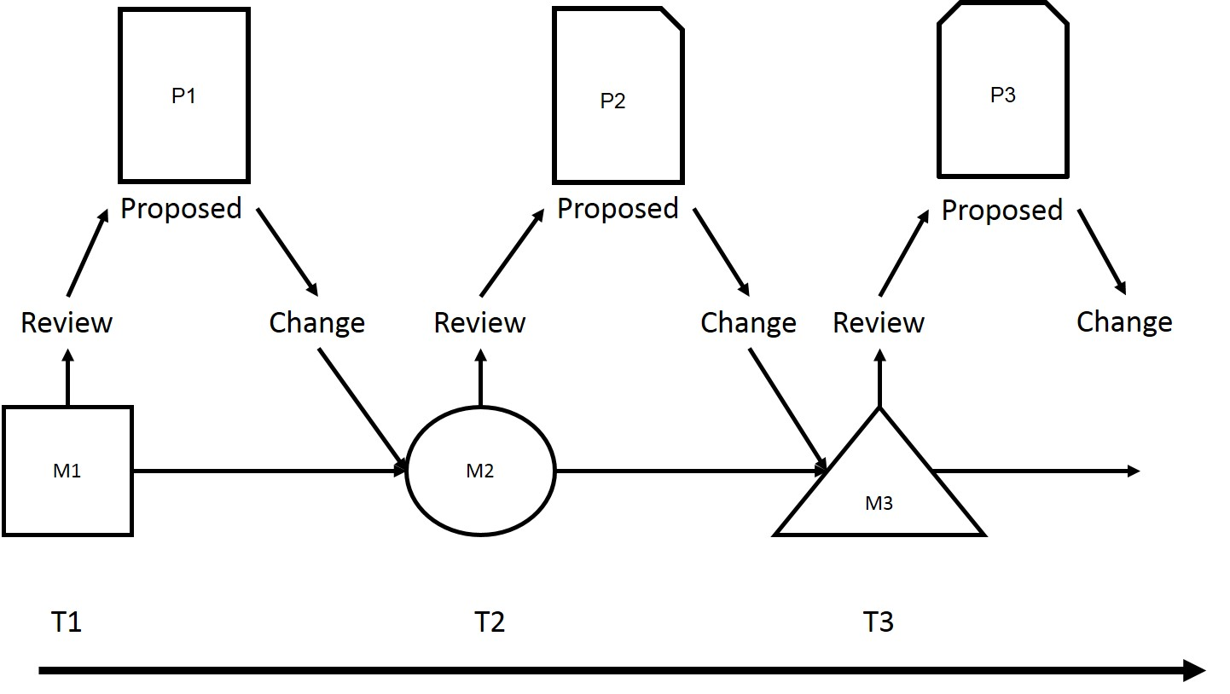
The Management Challenge
The Perpetually Failing Problem Solving Engine

Slide 4
The Management Challenge
Solve current problems at the same rate as they arise
Anticipate future problems and presolve them
Adapt the organisation so that potential problems are dis-solved and do so synthesising three dimensions:
Process
People
Information

Slide 5
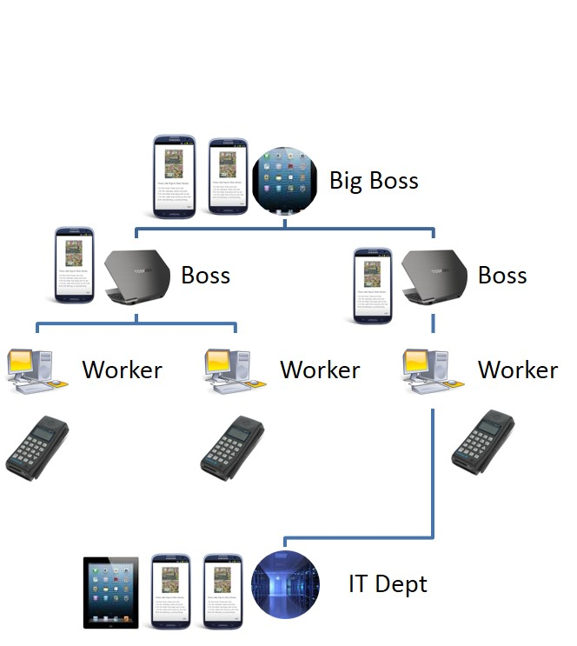
The Information Challenge
Awesome development of technology
Festooned the organisation (and the people) with ‘kit’
Bolted on NOT integrated
80% plus of data is unstructured
Word documents
Emails
Pictures
Scans

Slide 6
The Information Challenge
Massively effective Data Proliferation Engine
Beckford’s Law:
“The more data we have, the less information we have, relatively”

Slide 7
The Information Challenge
Massively effective Data Proliferation Engine
Beckford’s Law:
“The more data we have, the less information we have, relatively”
Data proliferates as a function of:
the number of users
multiplied by the number of devices
multiplied by the number of applications
multiplied by the number of back ups
multiplied by the ease of transmission (the propagation rate)
Information proliferation is the inverse function.

Slide 8
The Information Challenge
Massively effective Data Proliferation Engine
Beckford’s Law:
“The more data we have, the less information we have, relatively”
Data proliferates as a function of:
the number of users
multiplied by the number of devices
multiplied by the number of applications
multiplied by the number of back ups
multiplied by the ease of transmission (the propagation rate)
Information proliferation is the inverse function.
information is more important than technology

Slide 9
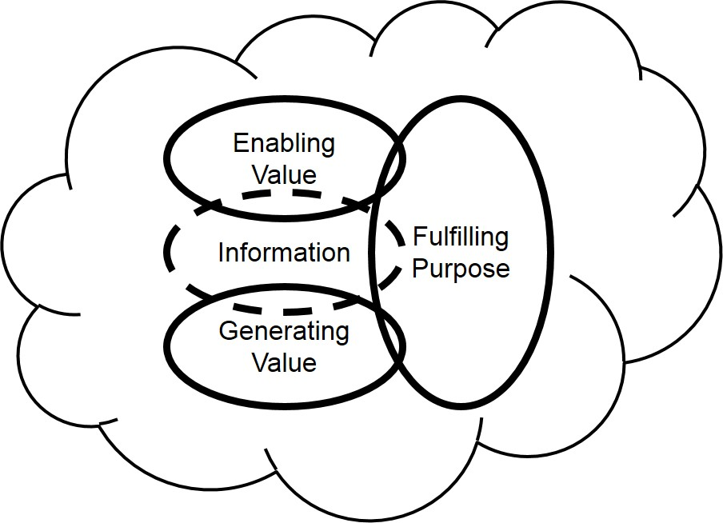
The Intelligent Organisation

Slide 10
Generating Value
A process is the chain of activities that deliver value to customers.

Slide 11
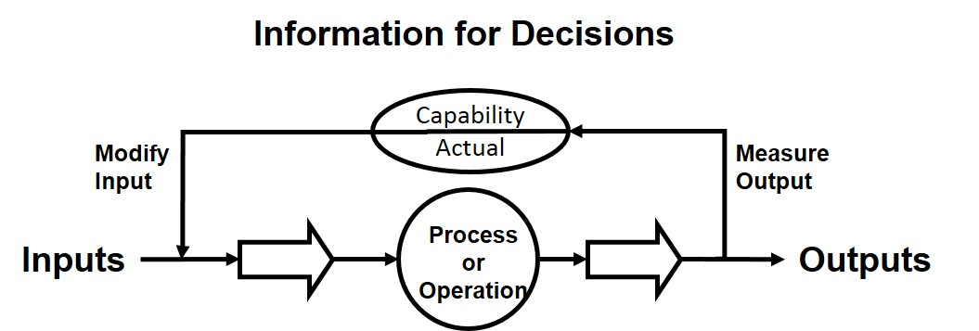
Generating Value

Slide 12
Generating Value
A Model of Self
The Homeostat: The Fundamental Unit of Organisation

Slide 13
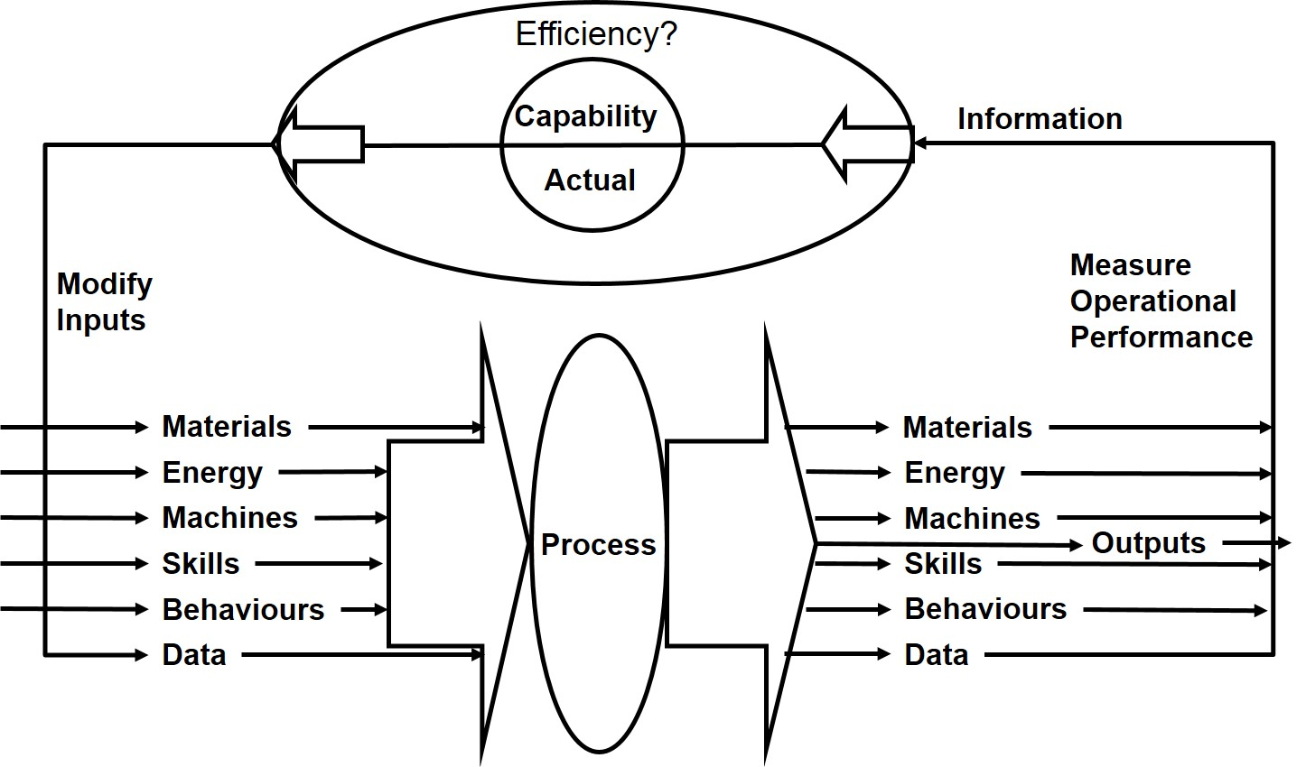
Generating Value

Slide 14
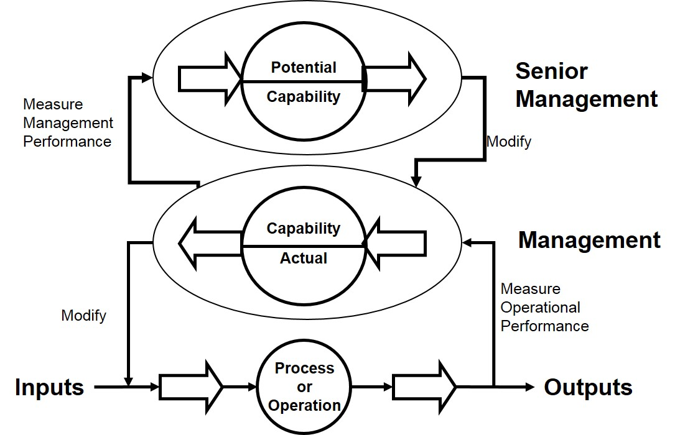
Generating Value

Slide 15
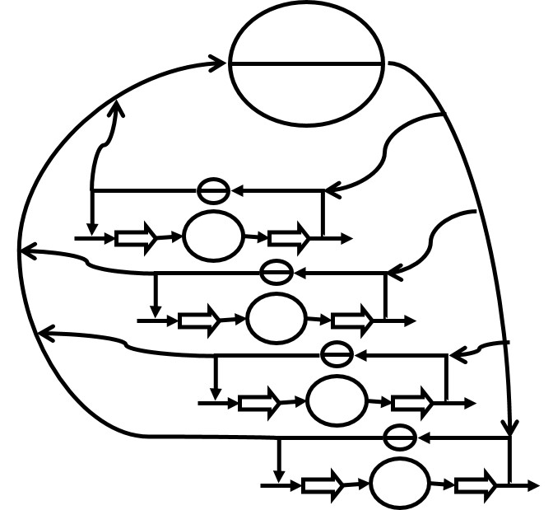
“Managing Doing” Generating Value
Multiple Processes
Each self-regulating
Each enjoying (some) autonomy
Each probabilistic in behaviour
BUT
Can only do what it has been designed to do
Autonomic NOT Intelligent!

Slide 16
“Managing Managing” Enabling Value
“Managing the present” is not enough
Must also “Create the Future”

Slide 17
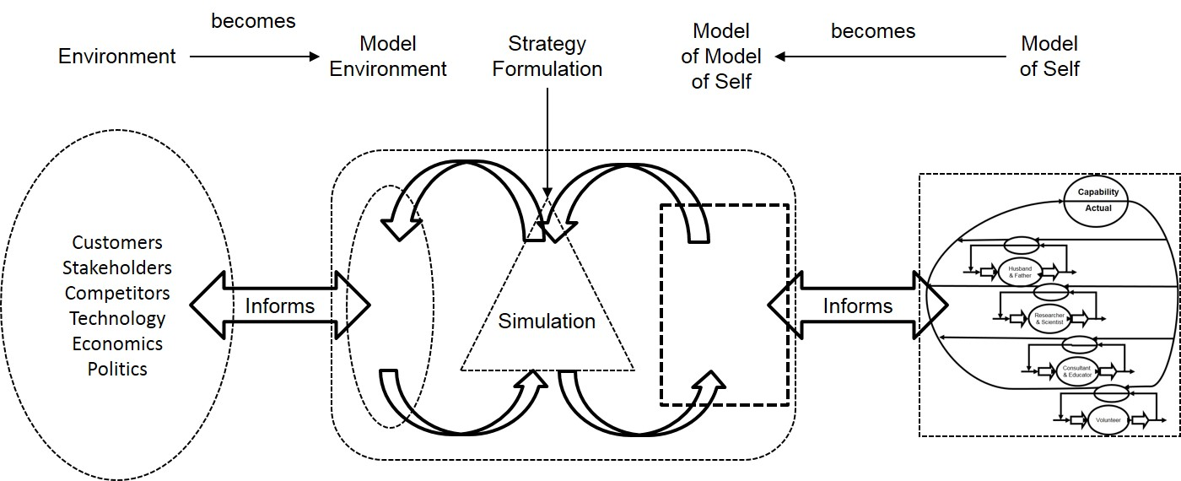
“Managing Managing” Enabling Value

Slide 18
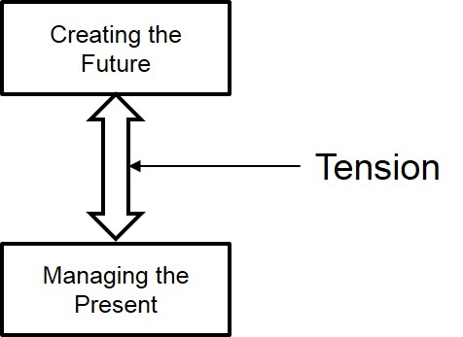
“Managing Managing” Enabling Value

Slide 19
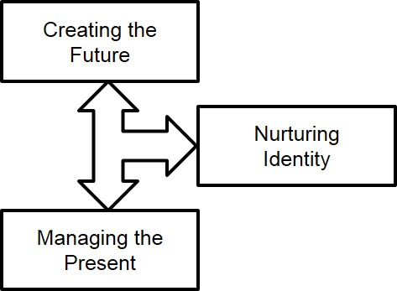
“Managing Managing” Enabling Value

Slide 20
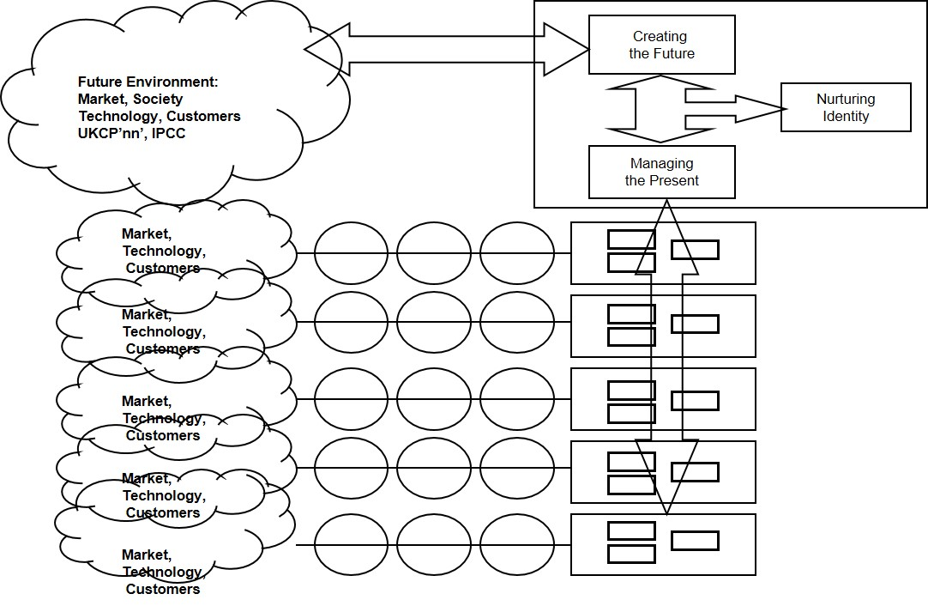
“Managing Managing” Enabling Value

Slide 21
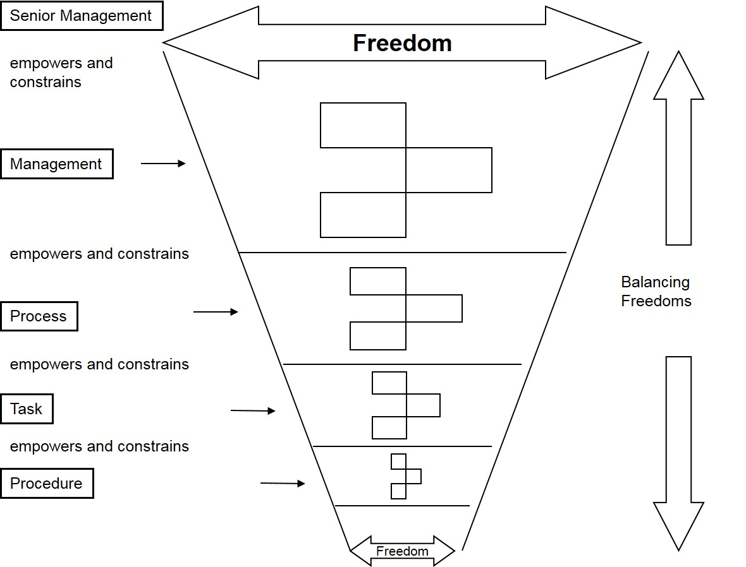
Managing Autonomy

Slide 22
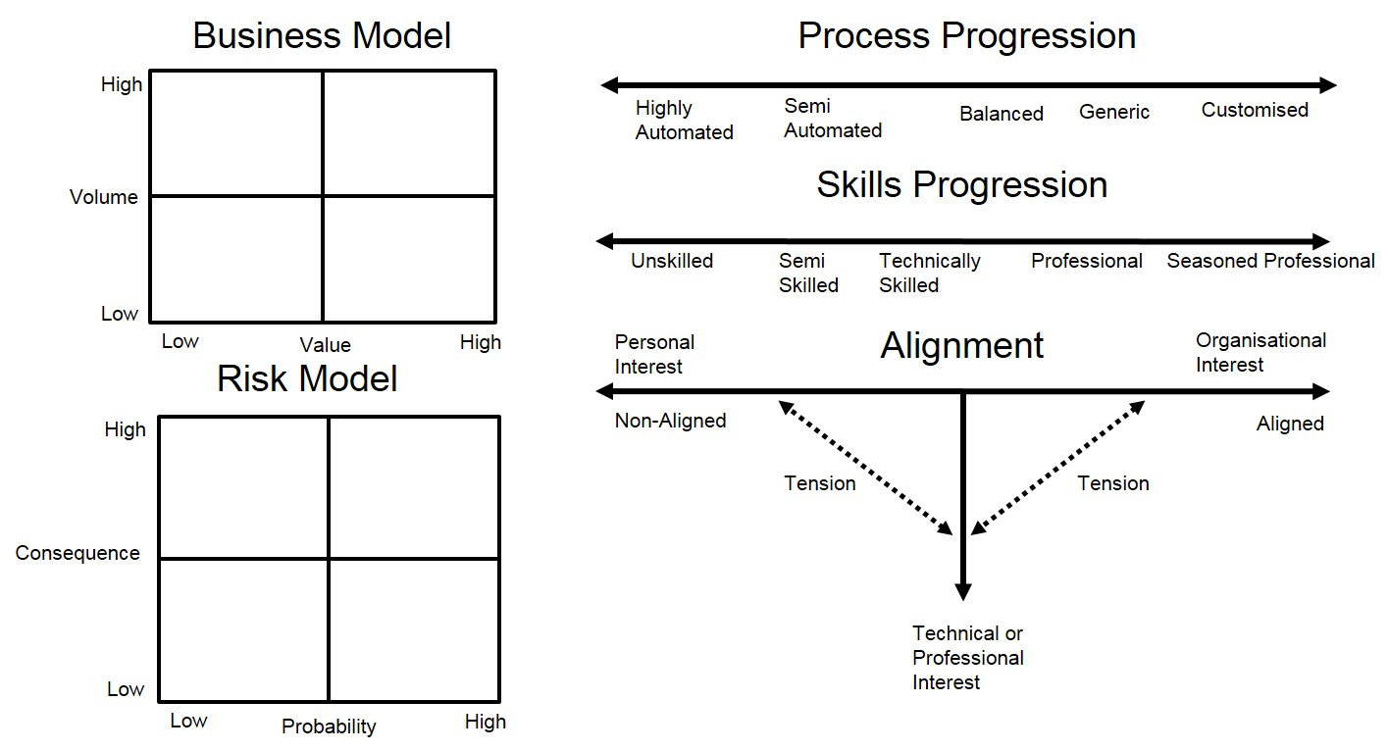
Managing Autonomy

Slide 23
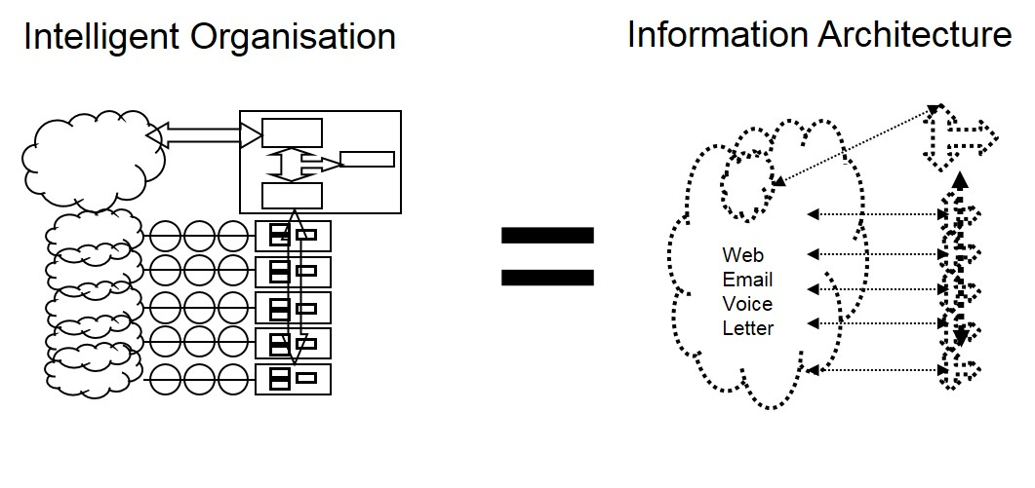
Information for Business Value

Slide 24
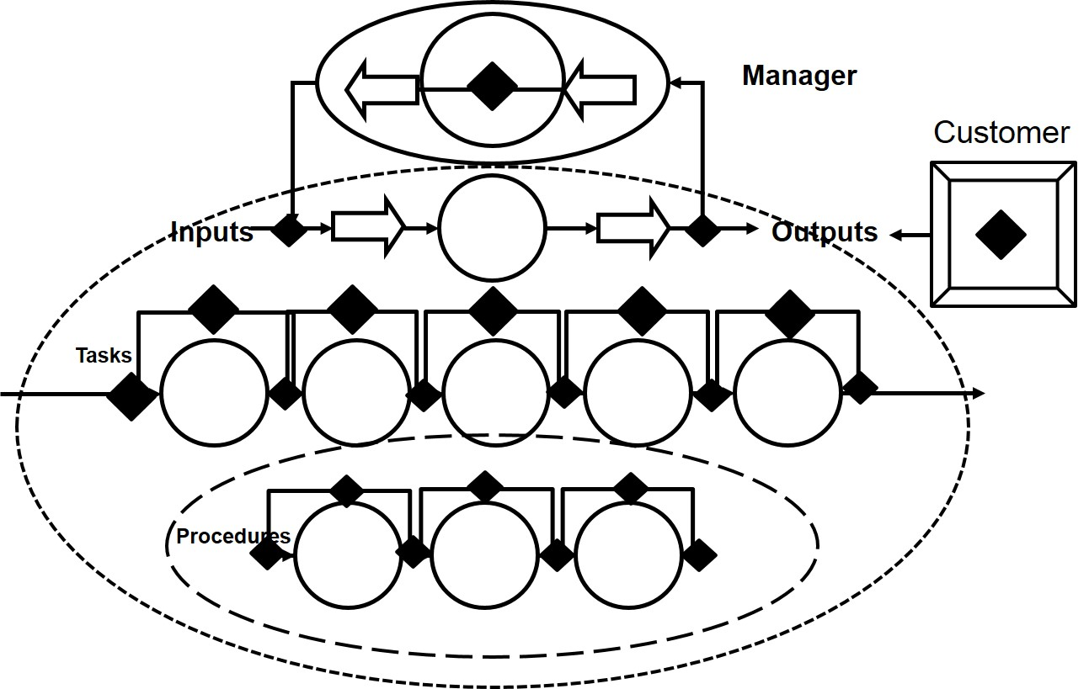
Information for Business Value

Slide 25
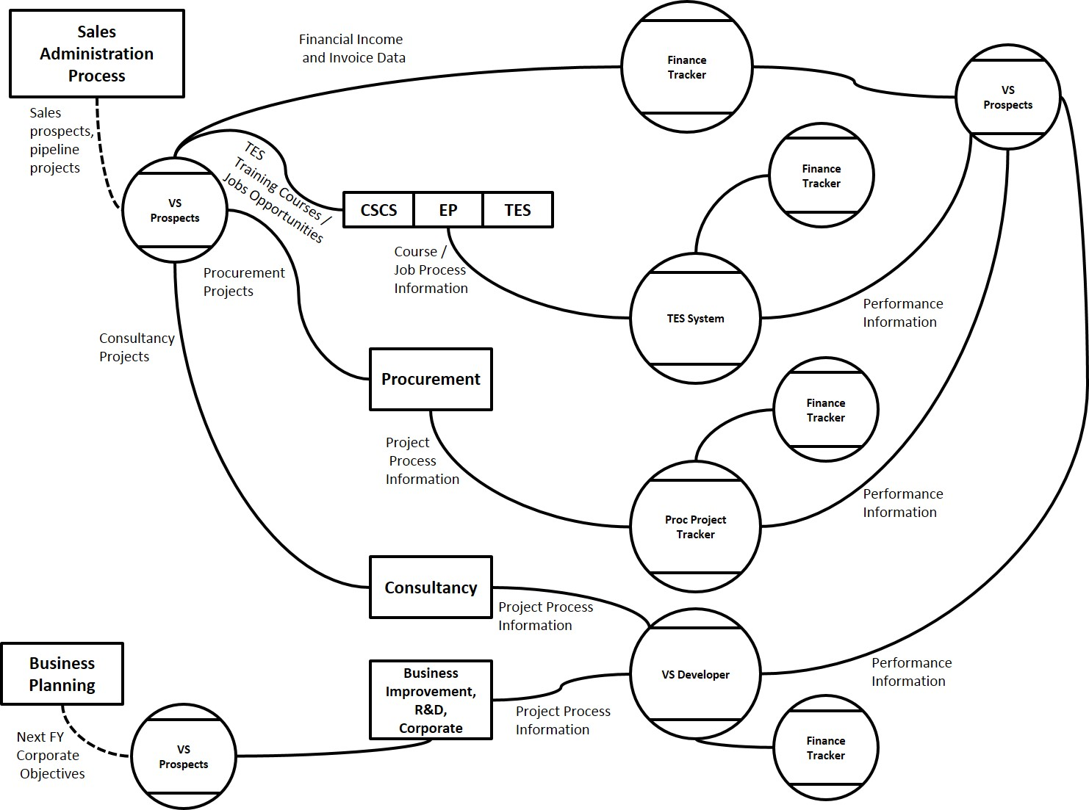
The Lean Information System

Slide 26
The Lean Information System
Understand what decisions need to be made
Pull through the data
Create a structure in which data is captured once, used many times

Slide 27
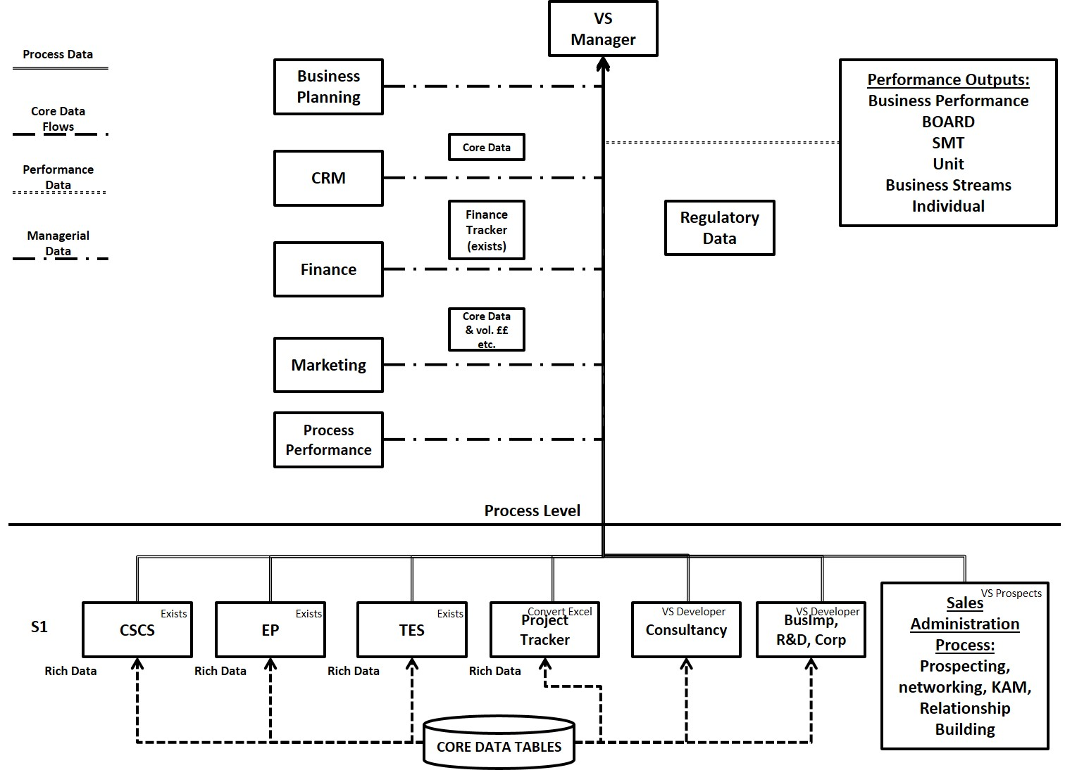
The Lean Information System

Slide 28
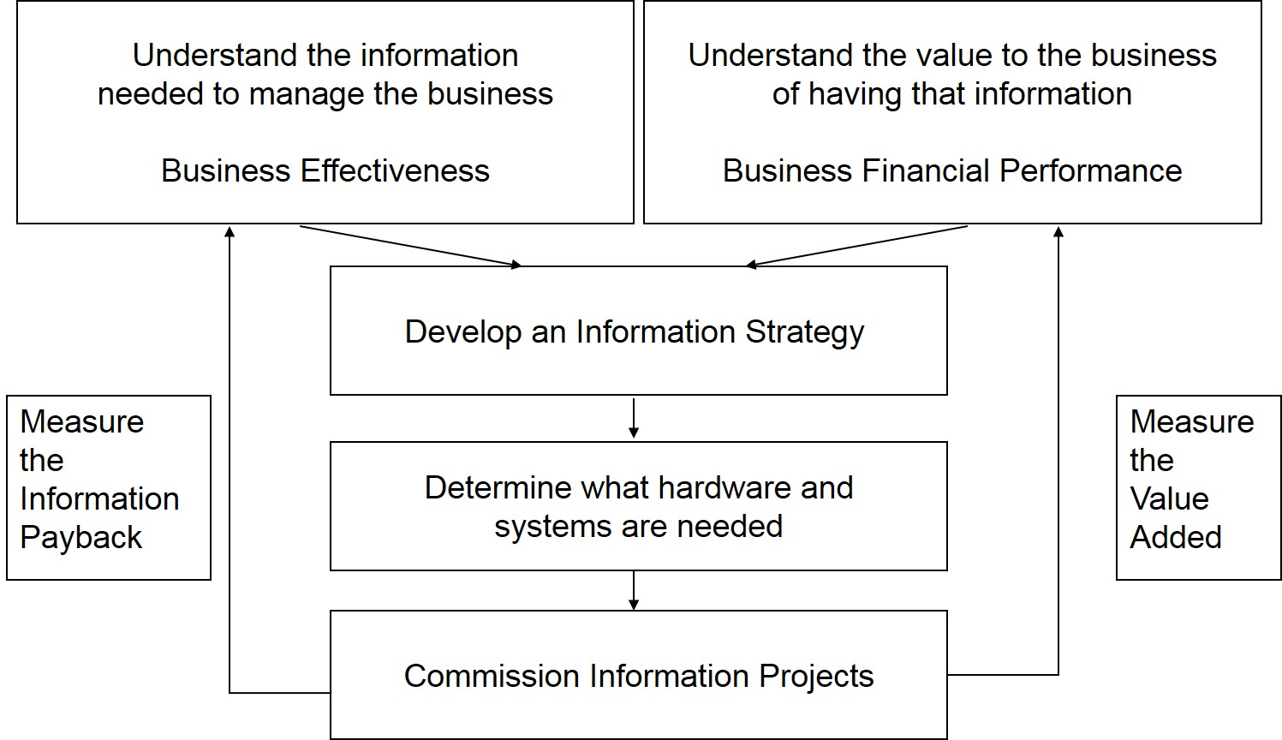
Information for Business Value

Slide 29
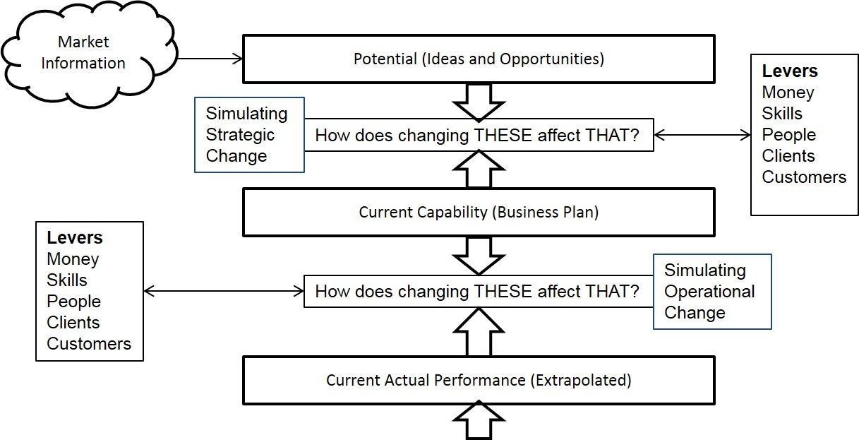
Information for Business Value

Slide 30
Information for Managing Performance
Self-regulation built in to the homeostat
So, do we need to manage performance?
Not locally
BUT across the whole
Synthesis, integration!

Slide 31
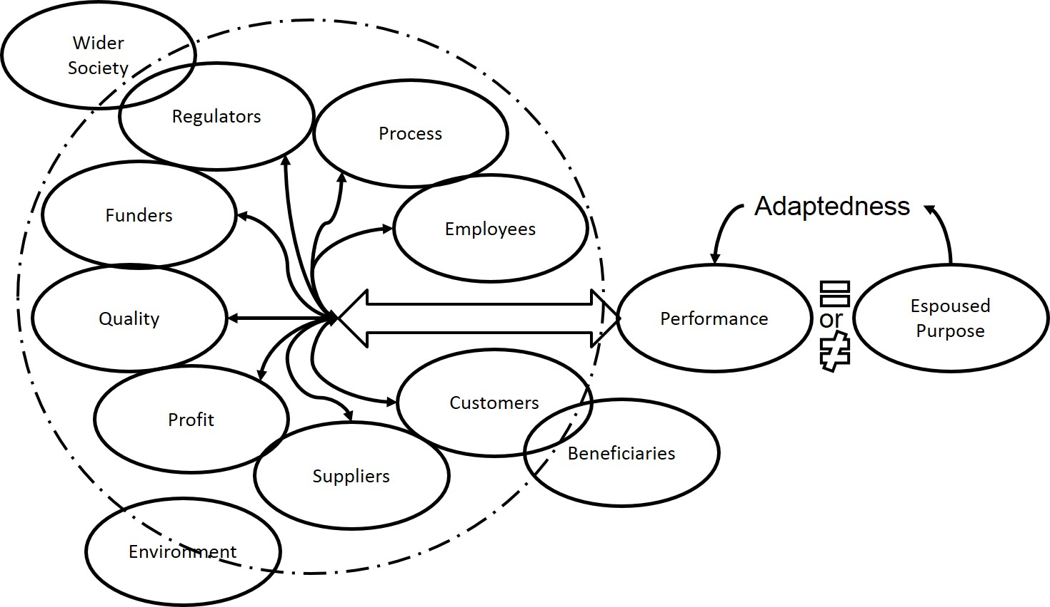
Information for Managing Performance

Slide 32
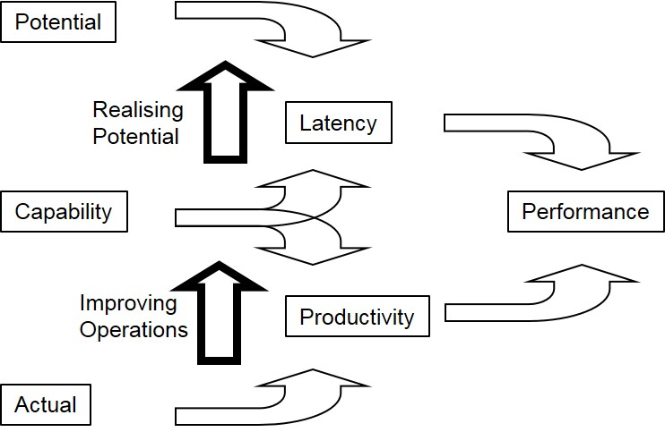
Information for Managing Performance

Slide 33
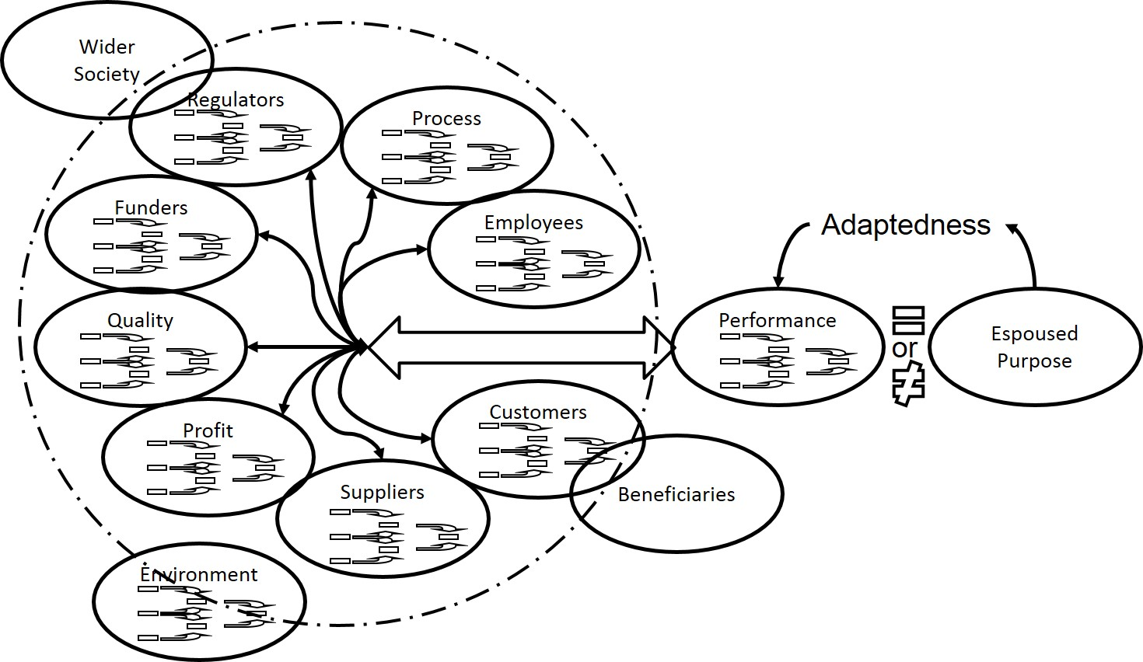
Information for Managing Performance

Slide 34
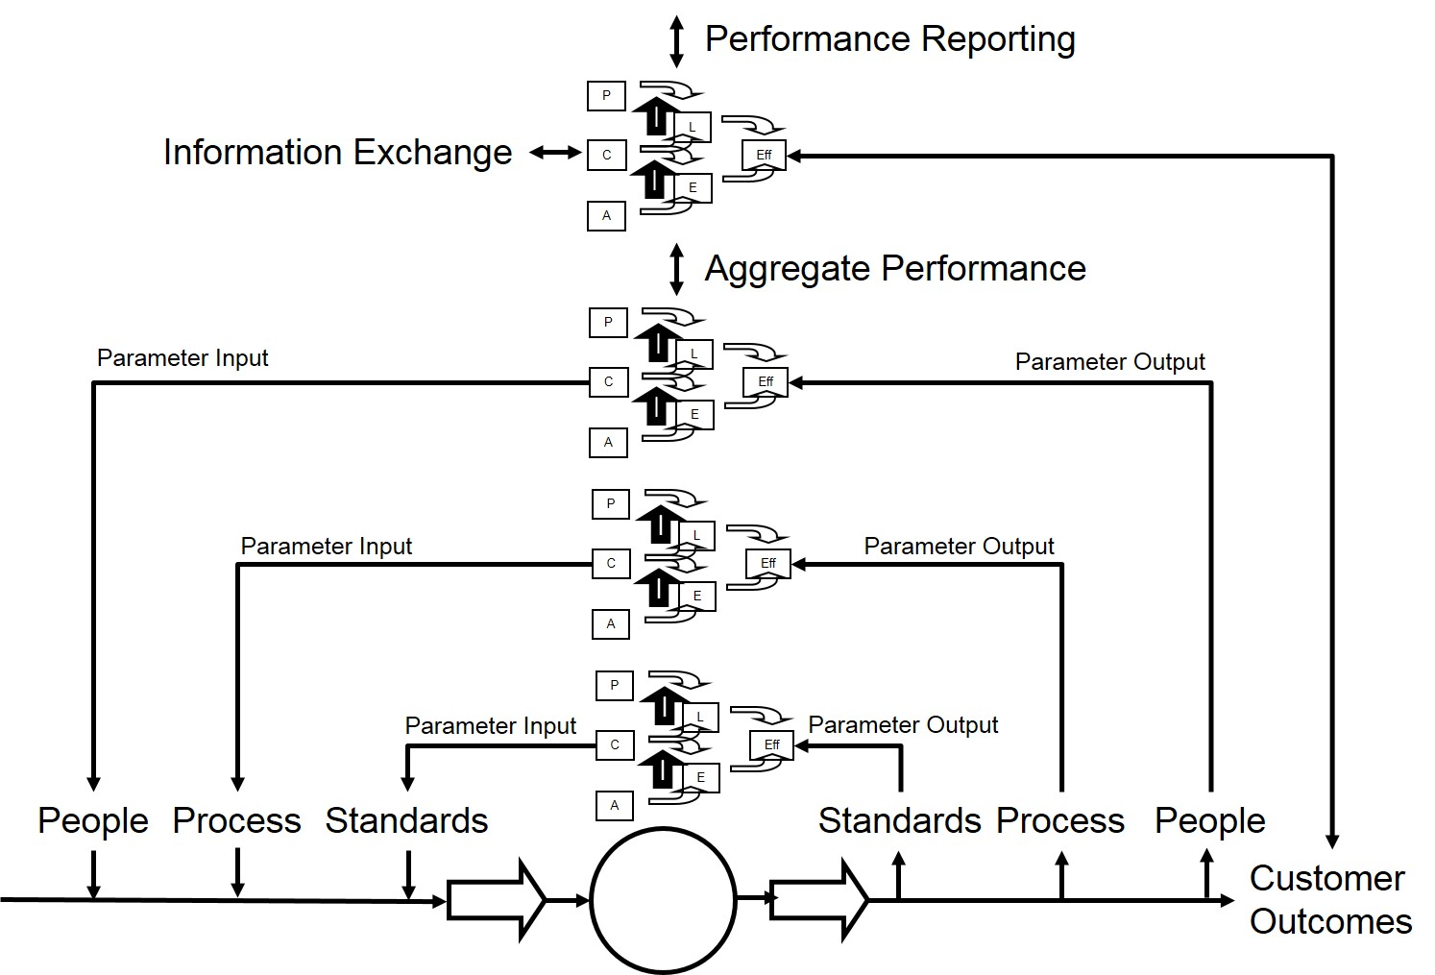
Information for Managing Performance

Slide 35
The Value of Intelligent Organisation

Slide 36
The Value of Intelligent Organisation
How might we understand the value of information:
How much is a happy customer worth?
Net Profit per Item * Number of Repeat Purchases = £V(☺C)
What is the value of time in the market?
Net Profit per Item * Volume per Day * Number of Days advantage
What is the true cost of error or failure?
Measure of opportunities missed?
How productive are we?
Measure of the actual performance against capability

Slide 37
The Value of Intelligent Organisation
Paper
Area: Operations and Logistics
Impact
£5m pa
20% on bottom line
Railways
Area: TOC Performance
Impact
£5m pa
= 10% on bottom line
Rail Infrastructure
Area: Network Failure
Impact
Increased track availability
Increased network resilience
Water
Area: Asset Management
Impact
£50m pa
20% reduction in capital spend for the same performance
Logistics
Area: Operational Effectiveness
Impact
£16m pa
Social Care
Area: Operations
Impact
£5m pa

Slide 38
The Intelligent Organisation
Stand 94
john.beckford@beckfordconsulting.com
Tel: +44 7785 360249
@johnbeckford

