Slide 1



How to Identify the strengths & weaknesses across your 3PM Organisation
www.ilxgroup.com
Mike Saville – ILX Head of Consulting
PROJECT CHALLENGE OCTOBER 12TH 2016

Slide 2
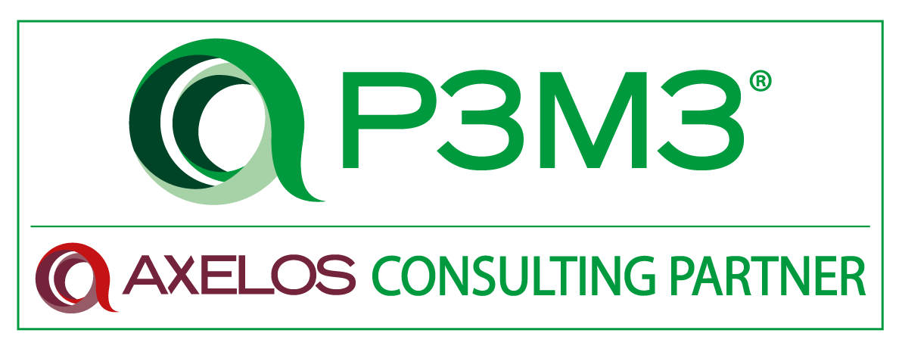
ILX Capability Consulting
ACO since 2004. ACP since July 2015
SOME FIRSTS…
1st formal PMMM & P2MM assessments at Vodafone
1st formal P3M3 assessments at Pension Protection Fund
1st formal P3M3 assessments in GCC at Abu Dhabi Police
1st Combined Capability Assessment for US Department of Energy

Slide 3

Why Measure Capability?
Manage Capacity
Improve Results
Learn Lessons
Break Patterns

Slide 4
How do you measure capability?
Focus
Framework
Plan
Implement
Benchmark?
Roadmap?
Diagnosis?
Right Scope?
Does it scale?
How will this impact the teams?
How will you use the results?
Establish the context
Share the results
Notes:
Needs a better slide…
Why measure capability?

Slide 5
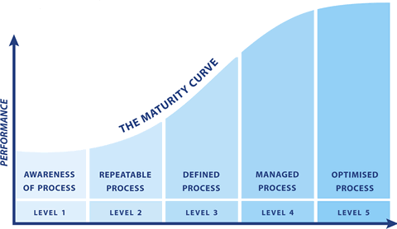
What do Capability Models tell us?
Notes:
Keep – But Elaborate – what do they enable us to do…
The shift from Individual Capability to Organisational Capability.
What is an example – describe it as to Javier

Slide 6




What are the Organisational Models?
Notes:
Organisational Assessment answers the following Questions
Do we have a repeatable process?
Where do we need to focus our efforts to raise our performance initially?
Where should we be setting our sights for the kind of projects that we run?
How do we measure up to other organisations?

Slide 7
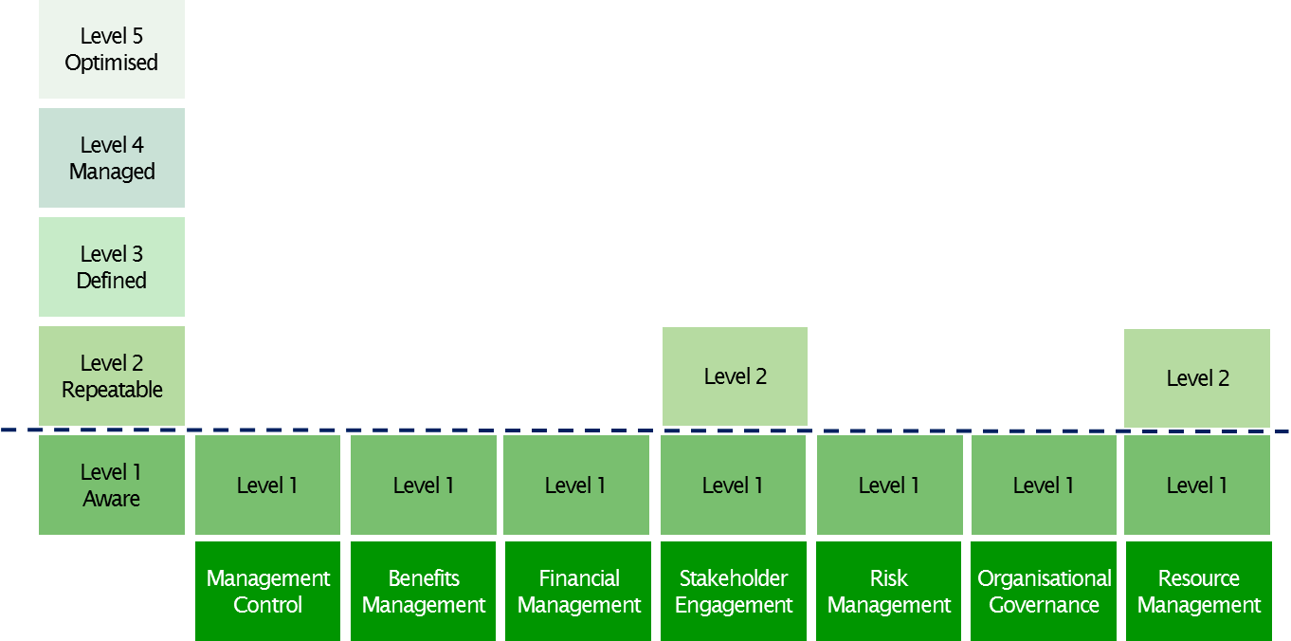
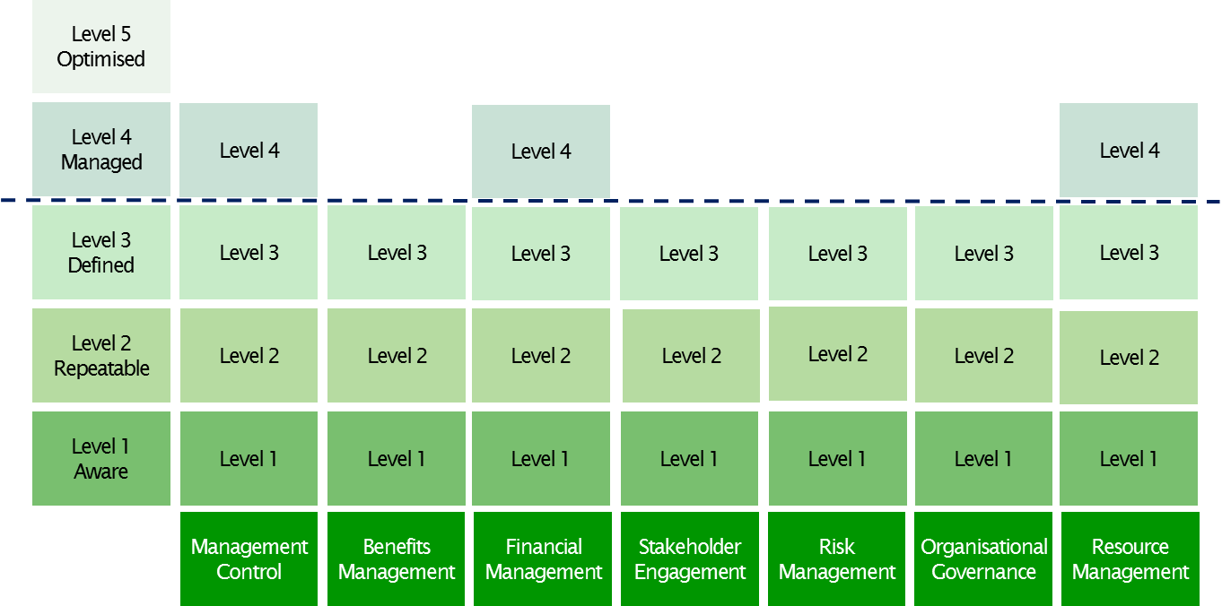
Actionable Outputs from Organisational Models
2012
2015
Notes:
Has to go

Slide 8
Assessing an Organisation
Set Scope
Defined Areas of Focus
Measurable Impact
Workshop with teams to
Understand performance patterns
Select Perspectives
Prioritised Results
Engage Teams
Focus groups with small teams
Actionable Results
Before & After
Individual engagement
Example Scores
Validate
Results
Self-Assessment

Slide 9
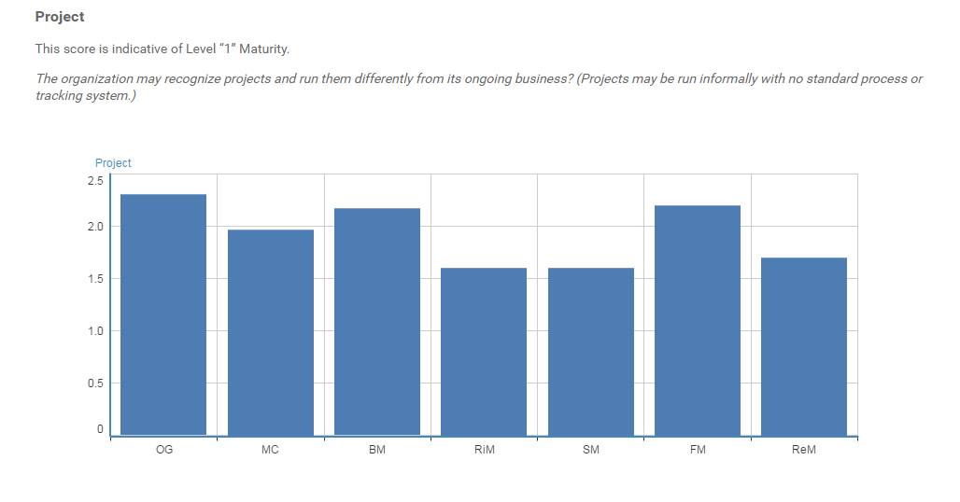
Organisational Self-Assessment

Slide 10



What are the Individual Models?
Notes:
What’s the difference between competence and capability? Individual competence is one of the vectors of organisational capability
What each one does…
What the approach is
APM focused on the domains of technical behavioural and contextual. Version 2 now maps the competences to Roles with some capacity for seniority built in.
PMI – personl, professional , knowledge,
Self Assessment – self-reflection may be the first way that we ecounter them. We hve deliberately used them
Manager Review
SME Validation
Development plan

Slide 11
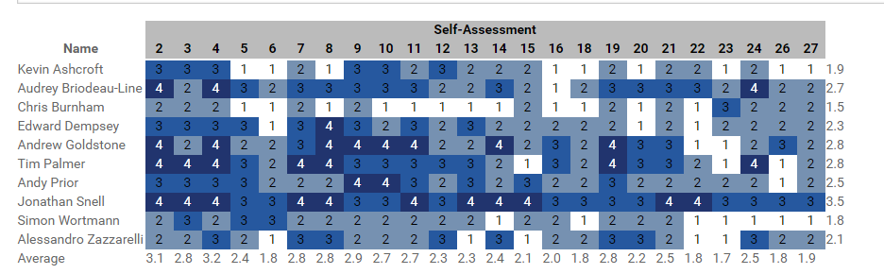
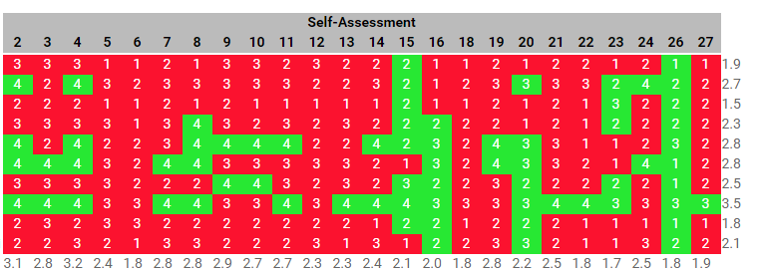
Actionable Outputs from Individual Models
Notes:
Needs a better slide
Another V diagram

Slide 12
Assessing an Individual Competence
Profile Roles
Defined Goals
Performance Development
Workshop with teams to
Develop common understanding
Selected Questions
Actionable Outputs
Focus groups to capture
compelling examples
Model Scores
Consistent Results
Public & Personal
Communication
Clear Message
Validate
Results
Self-Assessment

Slide 13
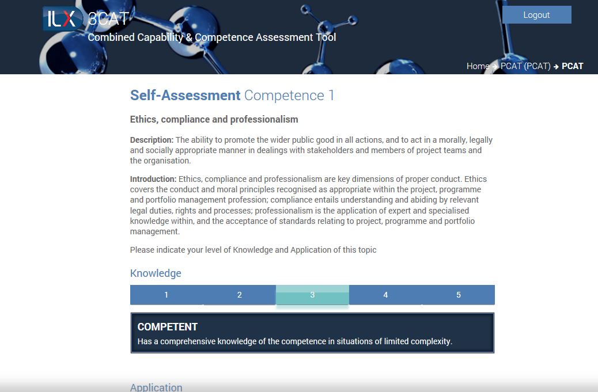
Individual Self-Assessment

Slide 14
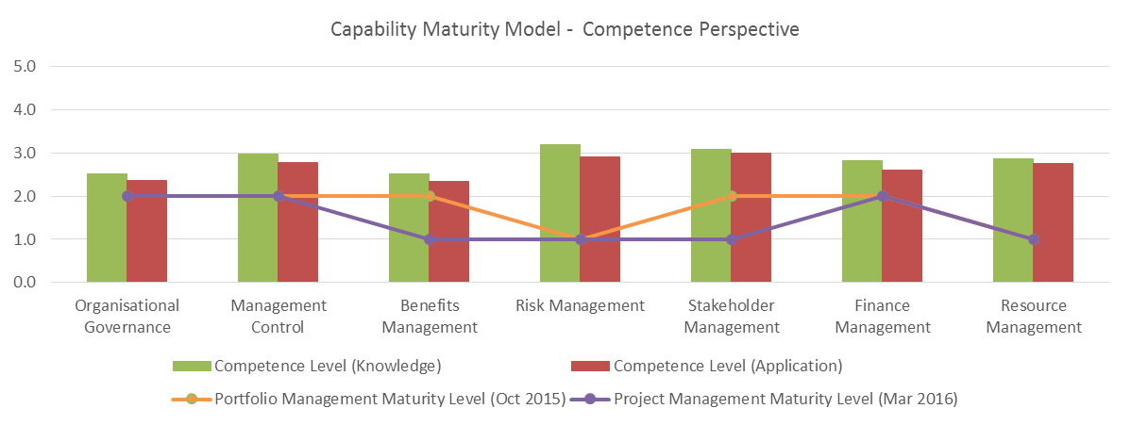
Combined Capability Analysis

Slide 15
How will Capability Modelling Evolve?
P3M3
Portfolio
Programme
Project
Complexity Mapping
Change Management
Complex Project Management
Risk Management
Contextual
Technical
Behavioural

Slide 16

Benefits of Combined Capability
Integrated findings from combined assessments – answers to multiple questions.
A clear focus for development – maximum ROI
An optimum sequence for development
A baseline for development – based on international standards

