Slide 1
Where do the best Project Control people come from?
As a client, where will I find them?
As a person, how do I become more valuable?
Simon Springate
CH2M European lead for Programme Controls
Simon.Springate@ch2m.com

Slide 2
Where do the best Project Control people come from?
I should say “Where are the best Project Control people going to come from?”
Most of todays senior control people started their careers when computers were still a novelty and Notebooks used paper!
Project Control Careers are rarely a straight line

Slide 3
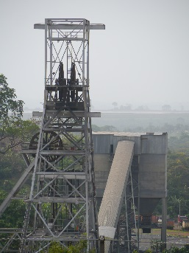
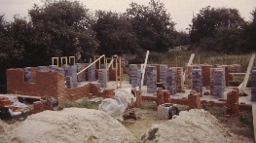
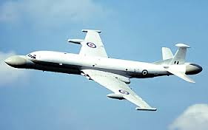
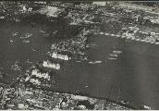
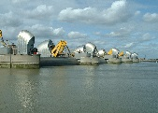
Simon Springate
Built House
2012 South Africa & Ghana Gold Mine
Trained to facilitate Value Management Workshops
(Turning Point)
Started work Trident Equipment
July 1977
Company goes bust
Cold war ends: joined London Underground
February 2014 CH2M
1978
1978
1982
1986
1990
1994
1998
2002
2006
2010
2014
2017
December 2010
Today
Became a Dad
Went overseas Director PC Qatar Rail
GEC Trained as planner
to build Dutch naval sonar
Planned escalator
replacement
2003
Project Controls in PPP
Project Engineer on 1st London Underground Windows based planning system
(Turning Point)
1st interest in Project Mgt. Saw graph of change vs. date. Nimrod would never finish! (Turning Point)
1977
2015
Supply lights to Thames Barrier construction
Consulted on scheduling Thames Barrier maintenance
Notes:
I am often asked ‘how do I get into Project Control?’ what qualifications are there, what experience do I need, how do I get your job? It is challenging to answer, when I started the job ‘Project Controller’ didn’t exist although I believe in hindsight I have over 35 years’ experience. With the advent of the Guild that answer is changing, now there is a career path you can follow and there is a route to taking my job on! This short presentation will give guidance on getting into and climbing up the profession of Project and Program Controls

Slide 4
The Program Control function – a personal view …
The Program Manager or Project Manager is the CEO
The Program Controller supports that role by;
Informing on what has happened
Predicting what will happen next – and in the longer term
Keeps the records and maintains trust by ONLY producing assured data

Slide 5
The Project and Programme Controller – a profile
3 Skills
Data Integration
Can communicate with real people
Understand function and capability of Project software
2 Attributes
Accuracy that people trust
Record Keeper – because no one else is interested
1 Deep Knowledge
Understand Project and Programme Management – read, listen, participate

Slide 6
How to grow
EXPLORE
Explore your business interests and passions.
Explore your strengths and areas for improvement.
Explore and seize every available opportunity.
PREPARE
Search for opportunities to grow and learn.
Identify people who can help and will invest in your career.
Tell 3 People what you want to do.
Engage in learning (courses, books, presentations, etc.).
ACT
Regular conversations with your supervisor, coach & mentor.
Create a liveable Development Plan.
Dare to be brave - volunteer for challenging opportunities.
Use the 70:20:10 Rule to constantly develop yourself.
Notes:
Simon
These 3 Steps are straight off the CH2M Career site
Explore – this is the best bit, this is what LinkedIn, Twitter, Yammer were built for.
Not a social media confident person? It pays to be, not to get bombarded with junk but to understand how to make it selective. Six great links a year that turn up something you find fascinating are worth 30 minutes a week skimming the results.
Prepare – The hardest thing to do, how do you know it’s the right route, what if I make a mistake. Accept it, you will make mistakes we all do but that is still learning. – it is not an excuse to stop trying.
But: take the risks you are ready for, young families and commitments mean risks may have to be small ones for now, but no risk is not living!
Act – Once you have something you are focused on you need to create awareness among your peers, if no one knows what you want they can’t help.!

Slide 7
Historically demonstrable experience was key – and that takes time
As a recruiter I am only interested in;
Experience
Personal knowledge
Recommendations
Qualifications didn’t help
Prince 2, APMP, MSP
Masters in Project Management
But now that is all going to change
Welcome to the Guild of Project Controls

Slide 8
Growing more rounded, capable and competent practitioners
We need to ensure that the practitioner Community has a standard set of Tools & Techniques
The Guild of Project Controls has been working with hundreds of junior and senior practitioners from all parts of the globe and all industry sectors to craft an initial Compendium and Reference (CAR) containing an initial “baseline set of Tools and Techniques”.
Available Free here… http://www.planningplanet.com/guild/GPCCAR/
These are not new, they are a collation from open-source, freely available practices, procedures, tools and techniques coming from practitioners and associated professional bodies.
These have been organised the Knowledge into 12 interconnected Process-Driven Modules:
01-Project Controls, 02-People, 03-Scope, 04-Risk, 05-Contracts, 06-Resources,
07-Planning, 08-Cost, 09-Progress, 10-Change, 11-Databases and 12-Claims
Open-source change process for ANYONE to suggest a change or improvement

Slide 9
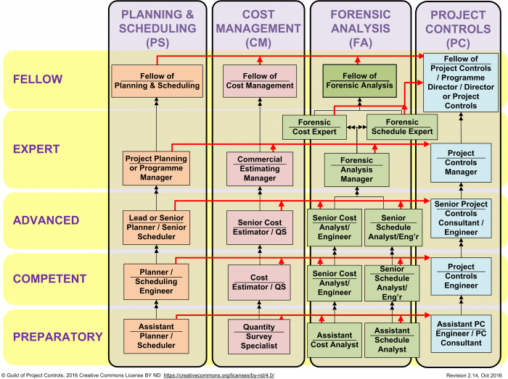
The Knowledge and our own Career Development…
FELLOW as a MENTOR, LEADER, ROLE MODEL
EXPERT - as a SUPERVISOR or MANAGER and MENTOR
ADVANCED - to ANALYZE, EVALUATE & CREATE relevant facts, concepts, procedures & critical thinking knowledge
COMPETENT - to APPLY and ANALYZE relevant facts, concepts, procedures and critical thinking knowledge
PREPARATORY - to REMEMBER & UNDERSTAND relevant facts, concepts, procedures & critical thinking knowledge

Slide 10
How do we Progress and Demonstrate our Growth
The Guild works with senior real-world, on-the-job practitioners (like you and me) who act as Assessors to help Certify that we know and understand and can DEMONSTRATE these varying degrees of Competency…
A computer based exam
A career path development plan
A formal virtual or face to face interview with a Guild Assessor
An experience profile demonstrating our experience and achievements
Supported by 360 Degree Capability References from our Peers, Supervisors and Clients
Coaching and Mentoring
Career Path Progression and Assistance…

Slide 11
And finally You don't know what you've got 'Till it's gone
So move …
Be prepared to be mobile – you work in the project business!
If you want to keep PC staff make sure you keep refreshing their posting

Slide 12
Don’t forget Your greatest asset …
Trust
Never underestimate how long ‘bad news’ sticks to you

Slide 13
Thank You
Simon.Springate@ch2m.com

