Slide 1
How to Simplify the Creation of your WBS with Mind Mapping technology, mind mapping & how they work together
Liam Pettit
MatchWare

Slide 2
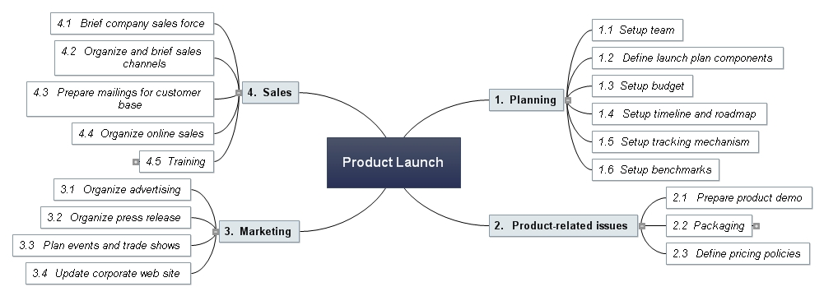
What is a Mind Map?
An organic way to display a work breakdown structure

Slide 3
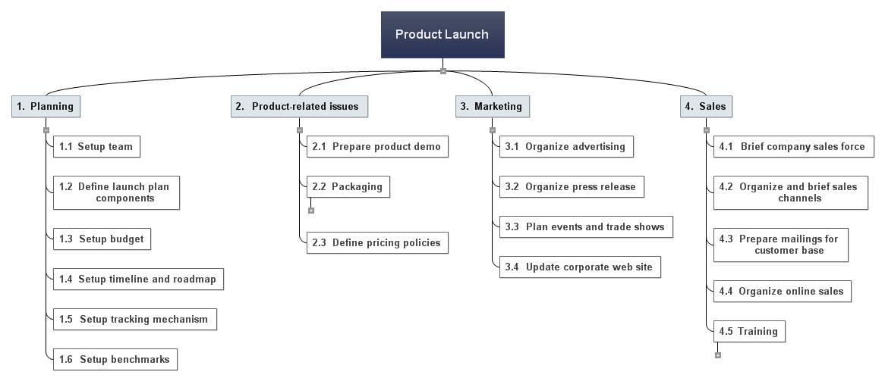
Work Breakdown Structure

Slide 4
Benefits of Mind Mapping
Increased Productivity (25%)
Better Communication
Enhanced Recall and Memory
Easier method of Organization
Utilizing Mind Maps
Project Management
Strategic Planning
Problem Solving
Note Taking
Brainstorming
Knowledge Management
Risk Management
Decision Making

Slide 5
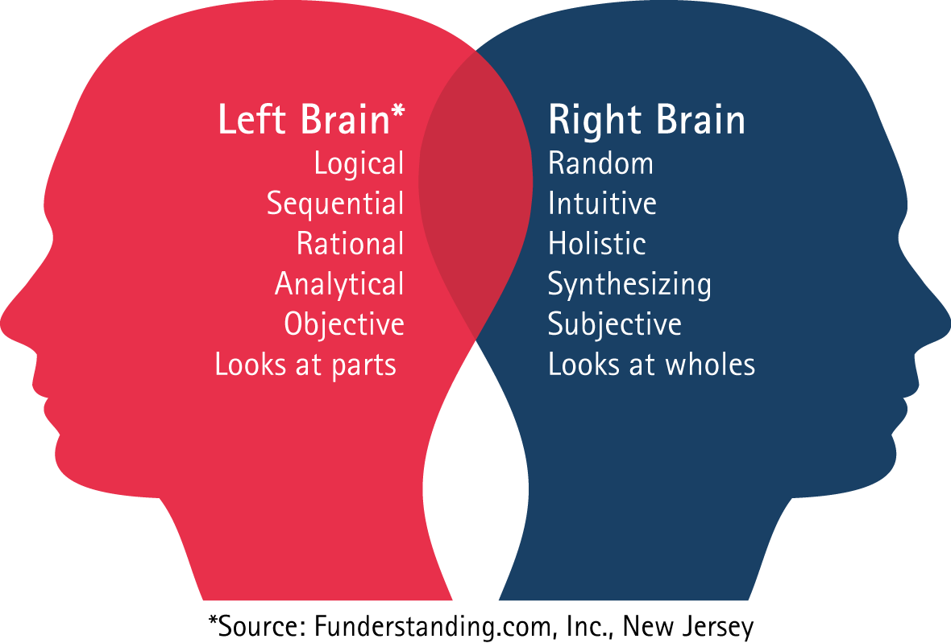

Slide 7
30
12
19
10
11
1
2
3
20
28
29
21
4
5
6
13
15
14
24
22
23
31
32
33
26
25
27
36
8
9
34
7
16
18
17
35

Slide 9
30
12
19
10
11
1
2
3
20
28
29
21
4
5
6
13
15
14
24
22
23
31
32
33
26
25
27
36
8
9
34
7
16
18
17
35

Slide 10
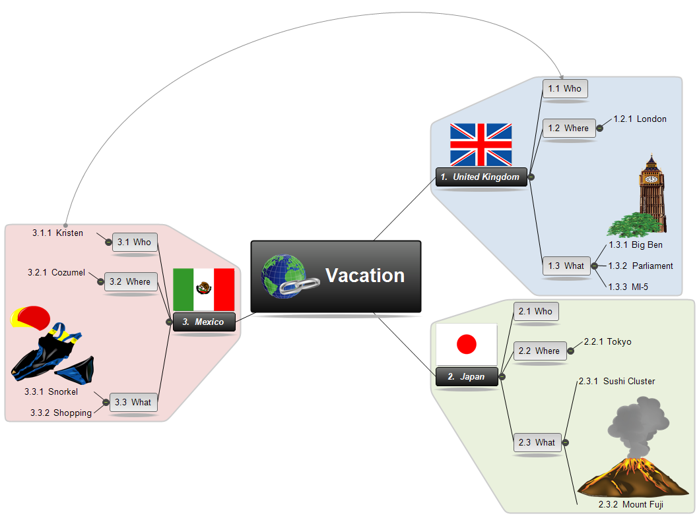

Slide 11
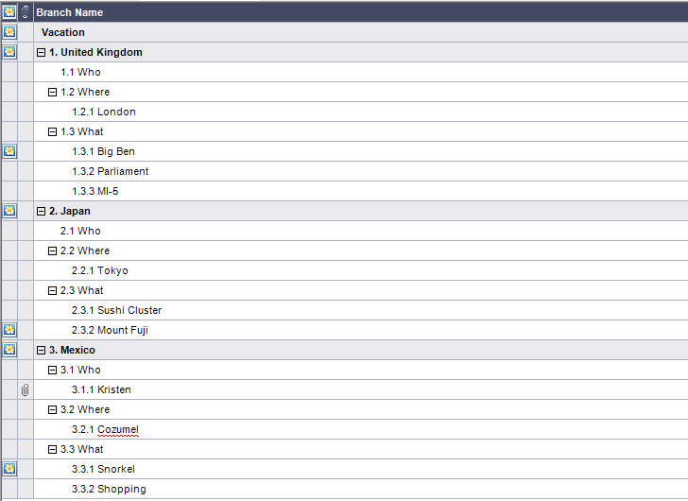

Slide 12
The Communication Breakdown
Organic vs. Linear
A study conducted by UNC indicated 65% of all mistakes in the work place where a result of miss communication.
The other 35%?

Slide 13
Consequences of Communication Breakdown
Different Expectations
Inaccurate Requirements Gathering
Missing Deadlines
Over Budget
Project Failure

Slide 14
Solution = Mind Mapping Technology

Slide 15
What Does Mind Mapping Do For You?
Enhance Brainstorming and Collaboration
Optimize the WBS Process
No Recreation of Data

