Slide 1
Can banks de-risk programmes?
Pindy Bhullar MSc (Oxon)

Slide 2
Contents
Introduction
Definition of programmes
Main risks in programmes
Technical causes
Psychological causes
Political causes
Case study
Findings - Complex stakeholders
Findings – Regulatory programmes
Recommendations

Slide 3


Introduction
Who am I?
Successful programmes
  Strong leadership
  Clear objectives
  Effective team
Un-successful programmes
  Runaway requirements
  Organisational changes
  Lack of buy in
MSc in Major Programme Management

Slide 4



Definition of programmes
Multi year projects, delivering change, influenced by complex internal and external stakeholders, requiring large budgets to provide benefits to private and/or public organisations.

Slide 5
Main risks in programmes
Cost Overruns
Schedule Delays
Benefits Shortfalls
365 oil and gas programmes across 6 continents – average cost overruns of 59% (EY, 2014).
252% cost overruns of Olympic projects and 135% for Summer/Winter Olympics (Flyvbjerg & Stewart, 2012).
In 2010, US Major Defence Acquisition Programmes reported 98 programmes collectively had $402bn of cost overruns (CSIS, 2011).
Sydney Opera House delivered 10 years after the planned end date.
33% of outsourced UK public sector ICT projects suffered major delays (Whitfield, 2007).
Airbus A380 was due be to released in 2002,instead the first customer received delivery in October 2007.
National Centre for Popular Music in Sheffield
The Channel Tunnel forecasted number of passengers fell short of actuals (Anguera, 2005)

Slide 6





Technical causes

Slide 7






Psychological causes
Explanations for the inaccuracies in forecasts

Slide 8


Political causes

Slide 9


Case study
One way to combat the causes of risks to programmes is to apply Reference Class Forecasting (RCF)
Do regulatory programmes experience the main risks?
Can the RCF be implemented using programme data within an organization?

Slide 10
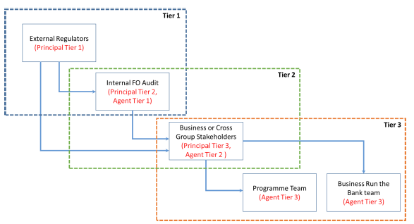
Findings - Complex stakeholders
Regulatory programmes have complex stakeholders
Principal Agent behaviours
Differing objectives
  Regulators – political agendas
  Stakeholders – business revenue and cost target
  Programme teams – operational tasks and regulatory deadlines

Slide 11

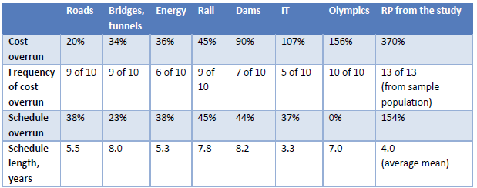
Findings - Regulatory programmes
Regulatory programmes experience
  Cost overruns
  Schedule delays
  Benefit shortfalls
Programme data is available in large organisations to implement RCF
  Categorisation and analysis of programme data
  Embedd method in the budgeting cycle
(Flyvbjerg et al. (2016, p.16) additions by Author (2016)

Slide 12

Recommendations
The case study highlighted and recommended:
Benchmarking – previous, peers and industry programmes
Due diligence – Scrutiny of planning process
Forecasting methods - RCF
  An opportunity to leverage systematic forecasting methods used in planning of infrastructure programmes to the service based industries
  Create programme reference database for banking
To deploy “Master Builders” on critical programmes

Slide 13
References
Anguera (2005). The Channel Tunnel – An Ex-Post Economic Evalulation, Strategic Rail Authority, London
Centre for Stategic & International Studies (2011), “Cost and Time overruns for Major Defence Acquisition Programs, Defence Industrial Initiatives Group”, http://csis.org/files/publication/110517_DIIG_MDAP_overruns.pdf
EY (2014), “Spotlight on oil and gas mega projects”, EYGM Limited, http://www.offshoreenergytoday.com/ey-oil-gas-megaprojects-exceed-budgets-cost-overruns-at-500b/
Flyvbjerg, B., Holm, M. & Buhl, S. (2002), ‘Underestimating Costs in Public Works Projects: Error or Lie?’, Journal of the American Planning Association, 68 (3), Summer, pp.279-95.
Flyvbjerg B., & Steward, A., (2012), “Olympic Proportions: Cost and Cost Overrun at the Olympics 1960 -2012”, Said Business School working papers, University of Oxford
Flyvbjerg, B., Budzier, A. and Stewart, A. (2016). The Oxford Olympics Study 2016: Cost and Cost Overrun at the Games, Working Paper, July 2016, University of Oxford, Said Business School.
Lovallo, D. and Kahneman, D. (2003). Delusions of success: how optimism undermines executives' decisions. Harvard Business Review, July, pp. 56–63.
Whitfield, D. (2007), “Cost overruns, delays and terminations: 105 outsourced public sector ICT projects”, European Services Strategy Unit, ESSU Research Report No. 3, 2007 http://www.european-services-strategy.org.uk/news/2007/ict-contract-chaos/105-ict-contracts.pdf

Slide 14


