Slide 1
Serious Games & Play to Improve Change Portfolio, Programme &
Project Capability
But Seriously ….!?
http://www.ambitiongroup.co.uk

Slide 2
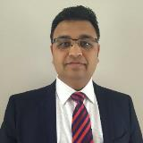
Parag Gogate
Managing Director, Ambition Group UK
11 yrs hospitality operations experience
11 yrs organisational change programme and projects
APM’s Enabling Change SIG – Innovation & Collaboration
Agile Business Consortium – Culture & Leadership
Co-author – Introduction to Managing Change Guide

Slide 3
About Ambition Group – Stand 94
Established for 10 years; boutique consultancy
Netherlands, Poland & UK
Pioneering the use of serious games and play techniques
Our Mission
To enhance change capability and maturity of organisations, teams and individuals through serious games and play

Slide 4
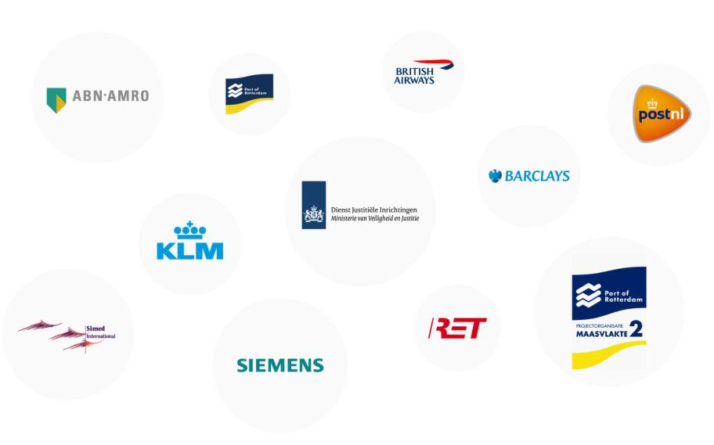
Some Of Our Clients
(past and current)

Slide 5
The range of what we think and do is limited by what we fail to notice;
and because we fail to notice that we fail to notice, there’s little that we can do to change;
until we notice how failing to notice changes our thoughts and deeds.
R.D. Laing

Slide 6
Games & Play – all around us

Slide 7
Games & Play
They share key characteristics
Goal oriented – mostly about winning
Rules for players
Feedback to the players
Competition amongst the players
Voluntary participation (sometimes)

Slide 8
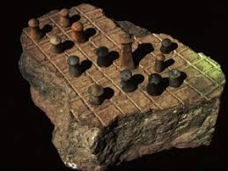
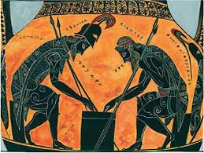
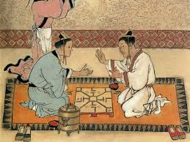
Games & Play
Ancient origins across various world civilisations
Playing is part of a game! – not always about winning
For fun, entertainment, leisure & enjoyment

Slide 9
Serious Games & Play – An oxymoron?
They share key characteristics
Goal oriented – towards affecting behavioural change, learning, solving problems etc
Rules for the players
Feedback for the players
Competition – sometimes; it is not always about winning
Mandatory participation

Slide 10
Serious Games & Play – An oxymoron?
Playing is part of the game!
Fun, entertainment, leisure and enjoyment is not the primary objective – it happens as players play the game
Use of digital as well as non-digital techniques
Serious games & play in organizational context – achieve an outcome

Slide 11
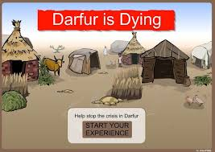
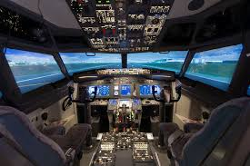
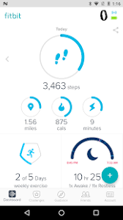
Serious Games & Play – all around us

Slide 12
3 case studies
Port of Rotterdam – Europe’s largest port
Automotive company in Poland
Arcus – UK based leading facilities management provider

Slide 13
Maasvklate 2 project - highlights
MV2 – 20% expansion of the port of Rotterdam
Project cost - € 2.7 billion (budget of € 2.9 billion)
Time frame – 10 yrs , completed in 2012
20,000 people involved
Complex supply chain, governance and regulatory requirements
Overall programme cost – € 9 billion

Slide 14
Maasvklate 2 project - successes
Standardisation and adaption of project management practices
Achieved Level 5 project management maturity over the duration of the project
Completed on time and within budget!
Standardising project management was a change programme!

Slide 15
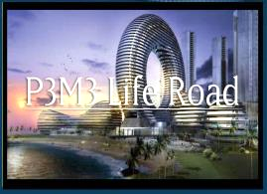
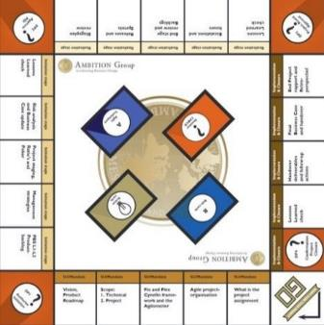
Maasvklate 2 project

Slide 16
Automative Company - Poland
Young fast growing company – employing 50 people
Specialises in design, construction & assembly of industrial production lines
Exporting to India, Germany, China, Mexico, USA, UK
Adapting and standardising project & risk management practices
20% improvement in efficiency and effectiveness of project management practices

Slide 17
Arcus – UK based
UK based fast growing company – employing 1000 people; £65 million turnover
Specialises in facilities management and service delivery
Enhancing collaboration – building a high performing project team
Strategic change - developing programme roadmap; clarifying governance for delivery of annual business plan
Balanced portfolio of projects

Slide 18
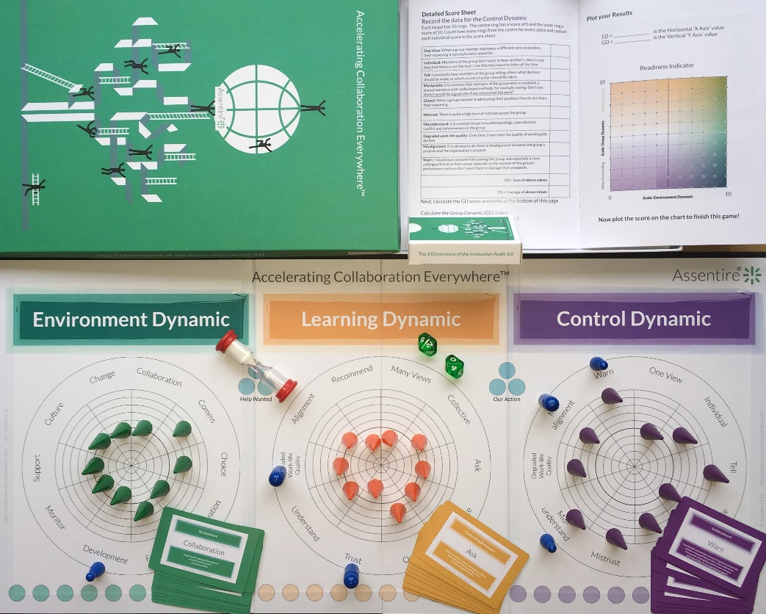
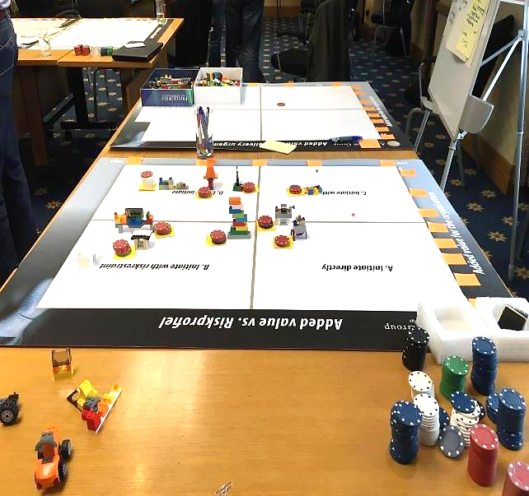
Arcus – UK based

Slide 19
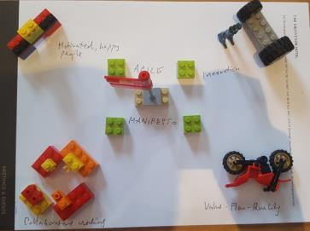
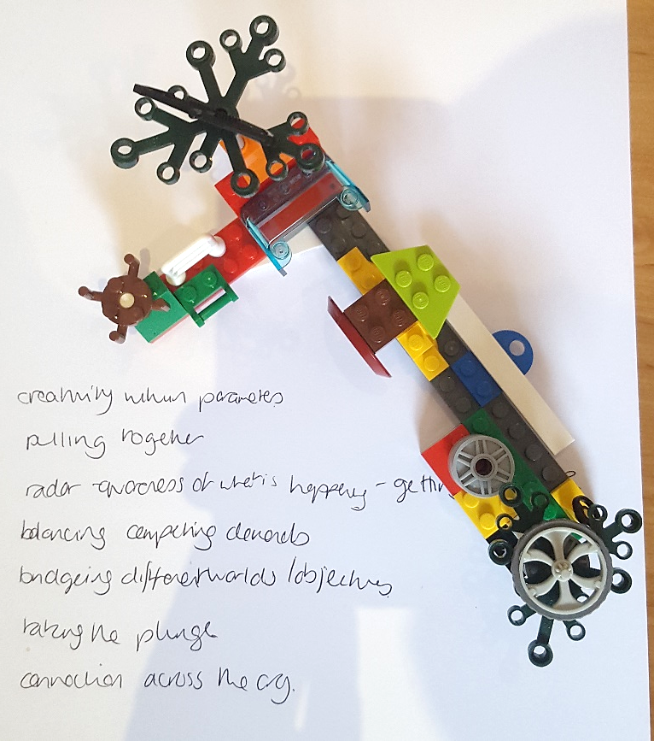
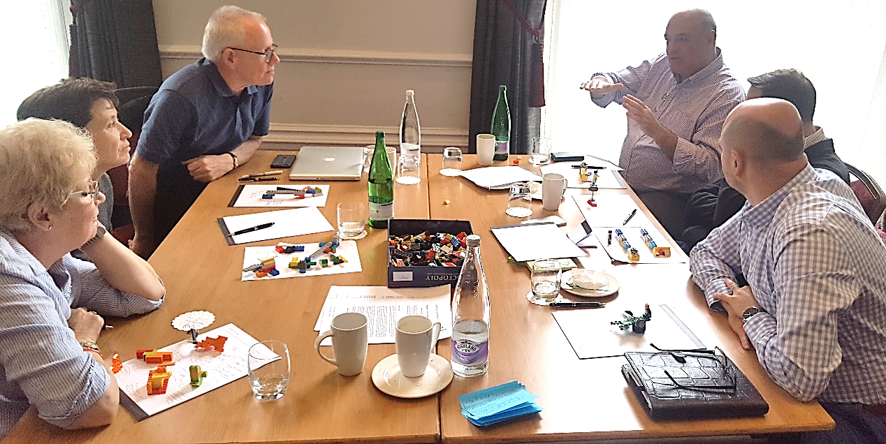
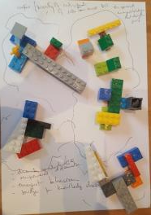
Agile Business Consortium – exploring Agile Culture !

Slide 20
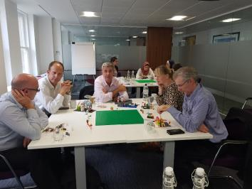
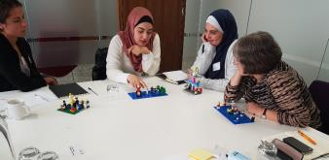
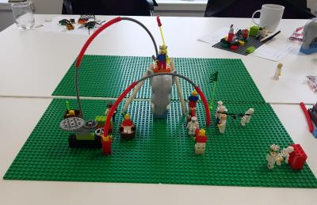
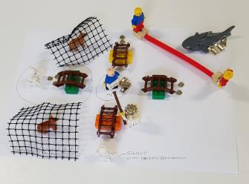
British Quality Foundation workshop – exploring Change Success Factors!

Slide 21
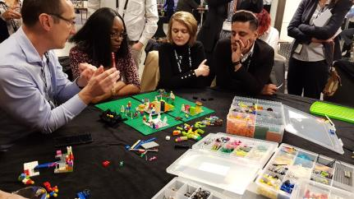
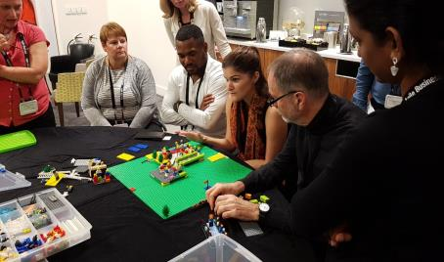
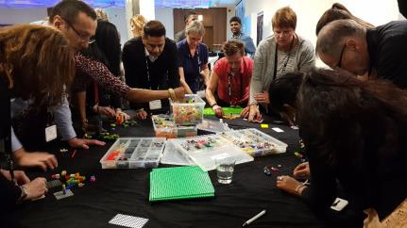
Agile Business Conference workshop – Building vision for post Brexit UK!

Slide 22
Why ‘Serious Games & Play’?
A great leveller, enabler & encourager
All human beings like to play!
Tactile, kinesthetic and action oriented
Provides a psychologically safe environment – builds trust and collaboration
Connects hands, heart and the head!
Draws out unspoken thoughts and unexpressed feelings
Cuts through complexity & ambiguity
Foundations in systems thinking, psychology, deep thinking, neuroscience, motivational theories & design thinking

Slide 23
Benefits
Clarity on governance & decision making
Achievement of project & programme outcomes
Improved risk management
Greater success on change initiatives
Engaged stakeholders & teams
Greater efficiencies on project & programme delivery
Enhanced internal change capability

Slide 24
Typical Serious Games & Play Applications
Project, Programme & Portfolio – Adapting & Standardising
Training & Development (Coaching)
Governance & Decision Making
Enabling Organisational Mindsets
Vision & Strategy Setting
Change Impact & Readiness
Enhancing Group Collaboration
Operating Model Design – ‘As Is’ vs ‘To Be’

Slide 25
Contact Us to Arrange a Demo (stand 94):
Parag Gogate
Managing Consultant
gogate@ambitiongroup.co.uk
07725652599
https://www.linkedin.com/in/paraggogate/
https://twitter.com/paraggogate
http://www.ambitiongroup.co.uk

