Slide 1
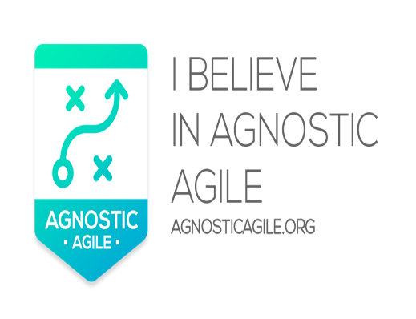
Agile Wars and How to Avoid Them
Barbara Roberts
Director for Professional Development

Slide 2

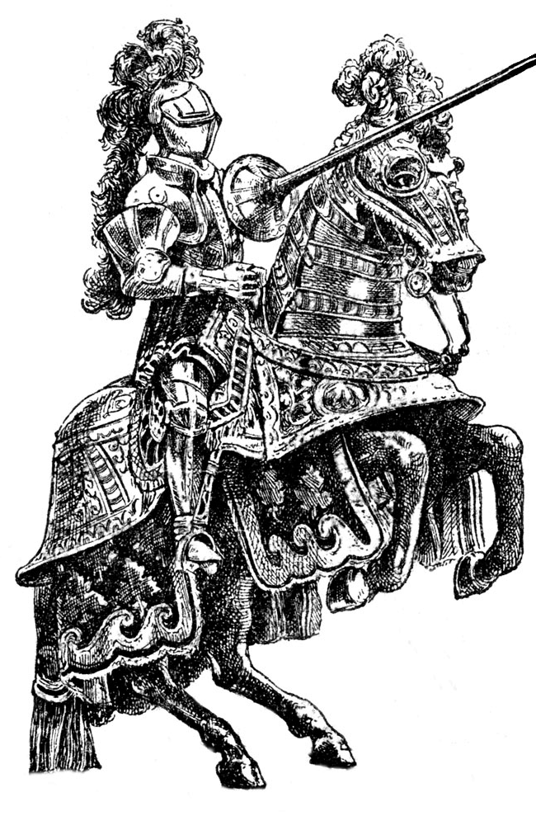
Agile
Agile - based on collaboration and cooperation
But…Historically has come across more like Agile Wars!
  “My agile approach is the one you need, not theirs”
This is not sensible
Starting point
  The need to understand what is on offer
  Then make the right choices

Slide 3
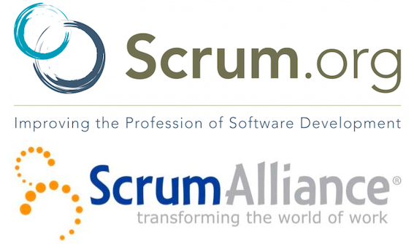
Agile Options - Scrum
The most well-known Agile approach
  For many people, Agile = Scrum
Defines Agile team management
  Brilliant at what it does
Typically used in an IT context
Scrum’s strength is simplicity
  Basic concepts can be explained on a single page
  This makes it easy to sell in
Scrum’s weakness is its simplicity
  No concept of “project”
    If you deliver projects, this guidance needs to be built on
  No guidance on getting to the starting point
    E.g. An assumption that Product Backlog is available.
    Reality is that this takes significant effort to create
  Product Owner role
    Finding a single person with all the knowledge and availability expected of them is a big ask

Slide 4

Agile Options – eXtreme Programming (XP)
Collection of (very good) software engineering practices
  E.g. Pair Programming
  Test Driven Development
  Continuous Integration
  Whole Team
  Design Improvement
  Planning game etc
Pure IT Focus (obviously)
XP’s weakness : it’s just for IT development
  It’s for tecchies
    Doesn’t talk senior management language
  No concept of “project”
  Based on the concept of “No design up front”
    This is impractical in a complex technical environment
Some XP practices have been fully embraced by Scrum
  To the point where some Scrum practitioners have forgotten where Scrum ends and XP starts

Slide 5
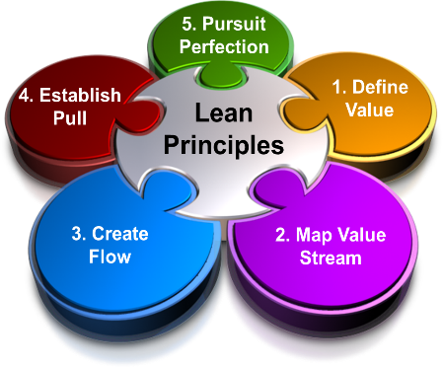
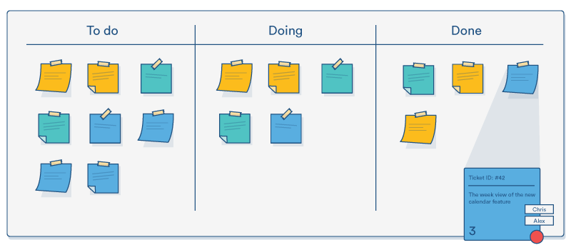
Agile Options – Lean (and Kanban)
Lean - More of a mindset than a “method”
  Evolved out of manufacturing environment
    Toyota the most well-known example
  Organising practices to minimise waste
Kanban the most well-used lean technique
  Visualisation of work flow, using cards or post-its
    Called “Team Board”, “Information Radiator” etc
  Underpins Agile value - Transparency
  Current position always visible to all
  Work (stories, tasks etc) moving from “Not started” through to “Done”
  Concept of “pulling” work, rather than pushing it
    E.g. A tester is now free and can see what is ready to be tested and pick it up
No specific weaknesses, just probably not enough on its own

Slide 6

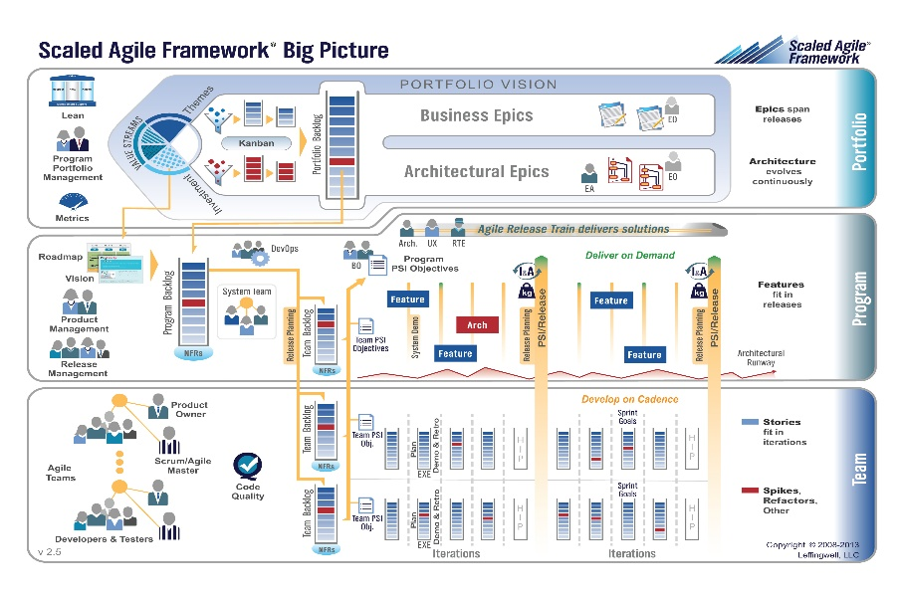
Agile Options – SAFe
Focus on technology
Great for coordinating complex technical work being delivered by large numbers of people across multiple teams
Defines 2-4 levels of working:
  “Team”
  “Program” (continuously delivering pipeline using an agile team-of-agile-teams
  + either / both “Large Solution” and “Portfolio”
SAFe’s weaknesses
  Pure technology focus, not suitable for non-technical work
  Very limited information around business engagement or business change
  Terms “Programme” and “Portfolio” used with a different meaning to standard usage

Slide 7
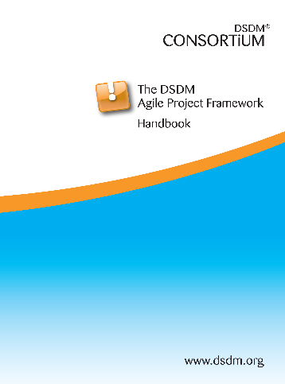
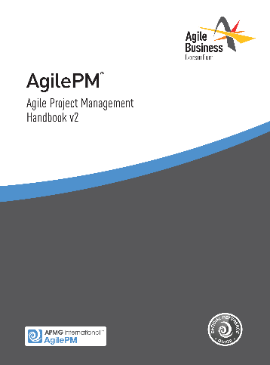
Agile Options – DSDM / AgilePM
DSDM – the first RAD / Agile method
  AgilePM = a subset of DSDM (the PM view)
Based around the delivery of projects
Applicable to all types of projects
  IT and business
Evolved in the complex corporate world – seen as “corporate strength” agile
  Works equally well for
    Small simple projects
    Large complex projects
  Enables Agile in highly regulated environments (e.g. Pharma, Finance, Military etc)
The only agile approach that is Project based
Weaknesses
  There is a lot in there!
  Harder to explain quickly

Slide 8
Blending Agile
The reality – each agile approach has strengths and weaknesses
  Why make choice a binary option?
  Why not choose best of breed and then blend them together?
So – how does this work?

Slide 9



Blending Agile – Some Real Examples
One of the largest global financial management companies
The false start
  The Head of Development decided XP was the answer to everything
  Decided to sack all Project managers, since “There is no PM role in XP” !!!!!
Luckily (for organisation and PMs) I joined as Transformation coach before PM cull started
The restart
  XP stays – it’s a great basis for good software development
  Add DSDM on top, to provide
    The project level guidance
    The interface between developers and management (both sides very happy about this)
  Lean thinking and Kanban built in
  Some extra complexity to deal with
    On-shore / Off-shore development the “norm” (often 3-5 sites, and time zones from GMT -12h to GMT +12h
    Some areas used Prince2 – DSDM interfaces easily with this
    Formal quality procedures a Must Have
      DSDM interfaced comfortably with CMMI Level 5
      And passed a full CMMI Level 5 audit with a few minor tweaks (changes to some documents)
The result
  It worked!

Slide 10
Blending Agile – Some Real Examples
A global phone manufacturing company
  Chose SAFe
  But… needed the concept of Project and Project Management built on
  With a constraint “We don’t want DSDM” (!!)
The result
  We built in almost all of DSDM to provide the Project Management element
  We just didn’t tell them it was DSDM
They loved it, it worked very well
  (We never told them about the DSDM bit!)

Slide 11
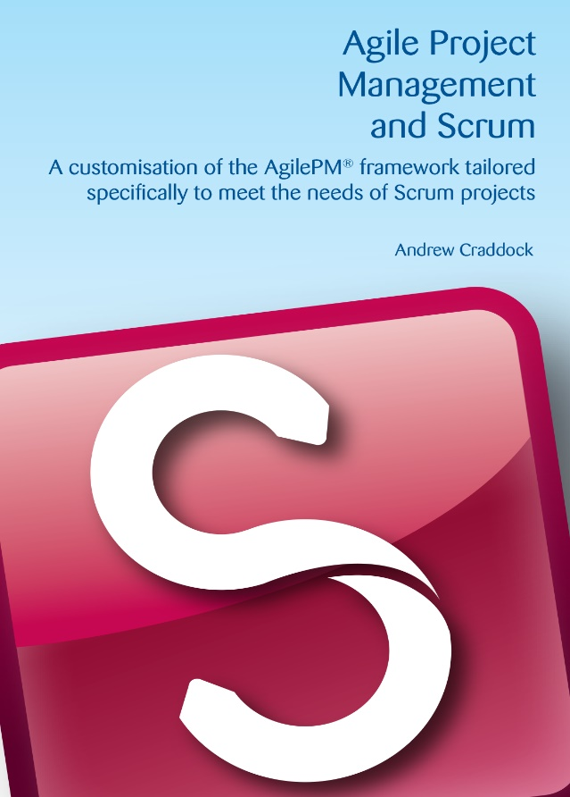
AgilePM and Scrum
An organisation fully committed to Scrum
  Used by all development teams
  Large budget already spent on Scrum training
  But… having problems
The result
  Keep Scrum
    Why get rid of something that is working OK ? (at the base level)
  Add AgilePM on top
    Tried and tested combination
  Keeps the simplicity of the team process
  Adds the project level concepts
  Enhances the roles
  Adds the project products, especially around planning

Slide 12
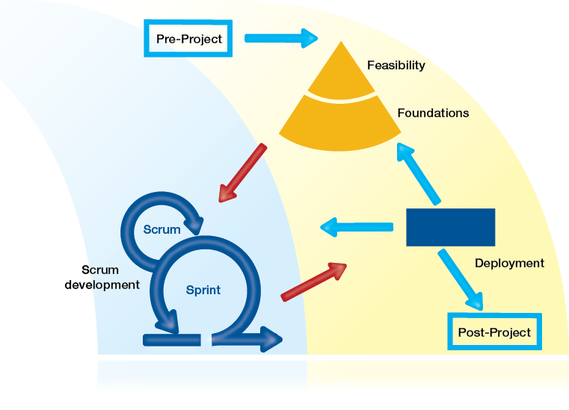
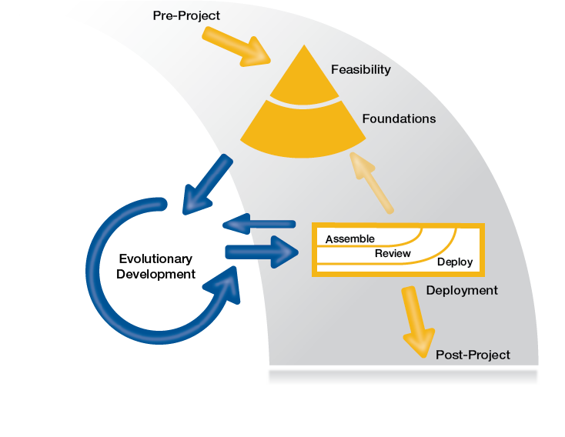
AgilePM and Scrum – Combined process

Slide 13
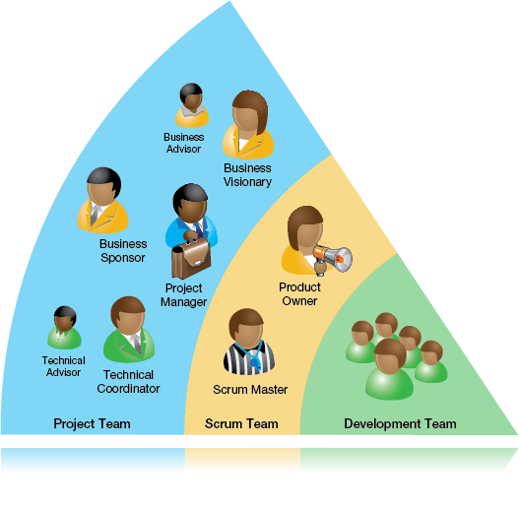
AgilePM and Scrum – Enhanced Roles

Slide 14
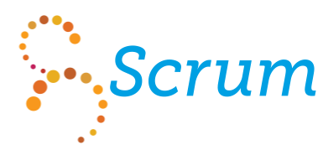
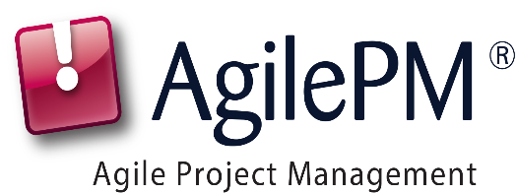
Blending Agile
Sometimes there is no need – a single agile approach is enough
or or
Sometimes choosing and blending “best of breed” from several approaches provides the best of all worlds
It’s your choice

Slide 15

Questions
A pdf of these slides will be available at www.projchallenge.com after this event
A white paper on this topic is also available at the Agile Business Consortium stand

