Slide 1
PPM tools to answer business needs including forecasting
Phil Howe
March 2017
Our continuing journey

Slide 2

Who am I ?
34 Years with in the Controls industry for Commercial Buildings
34 Years with Honeywell
In last 12 years have been part of the Project Operations Function previously directly involved in projects managing many large projects e.g. Terminal 5, Wembley Stadium and Olympic Games LV Systems packages
Broad knowledge of PM methodologies policies, systems and processes within Honeywell and external controls e.g. SOX
Hobbies are comedy, films, music and tracing my family history

Slide 3
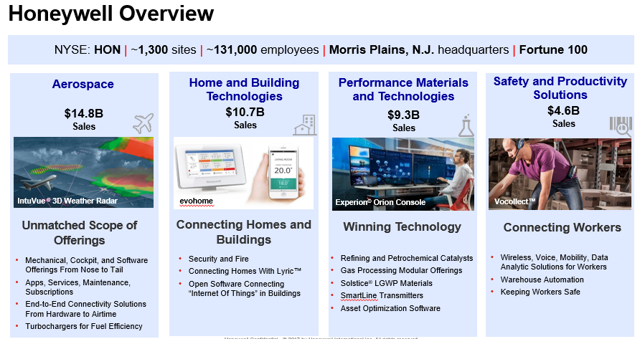

Slide 4


Slide 5
The Problem
We had lots of systems …
Lots of
Duplication of entry
Excel Spreadsheets widely used
Sources of information
Possibilities for misinterpretation / error
Missed opportunities to “see” early warnings
Time taken to update systems and report, rather than work on the project
Costs associated with maintaining those systems
Notes:
Currently Project Managers use a variety of tools and forms across all project phases that need the same information (job name, job number, district etc) completed each time

Slide 6











The problem we are solving
Platform for driving Projects business,
Incorporating PM methodology, key policies & procedures
Reduction of
Duplication of entry
Excel Spreadsheets
Sources of information
Possibilities for misinterpretation / error
Missed opportunities to “see” early warnings
Time taken to update systems and report, rather than work on the project
Costs associated with maintaining those systems
Single tool for Project Managers to manage the execution of their project portfolio with single data entry, better visibility and control linked to other business apps.

Slide 7
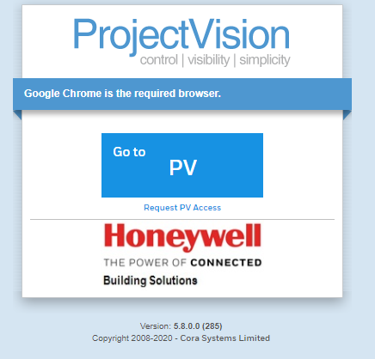
What we have

Slide 8
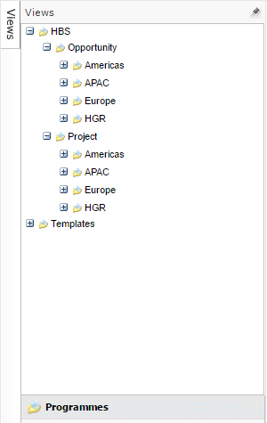
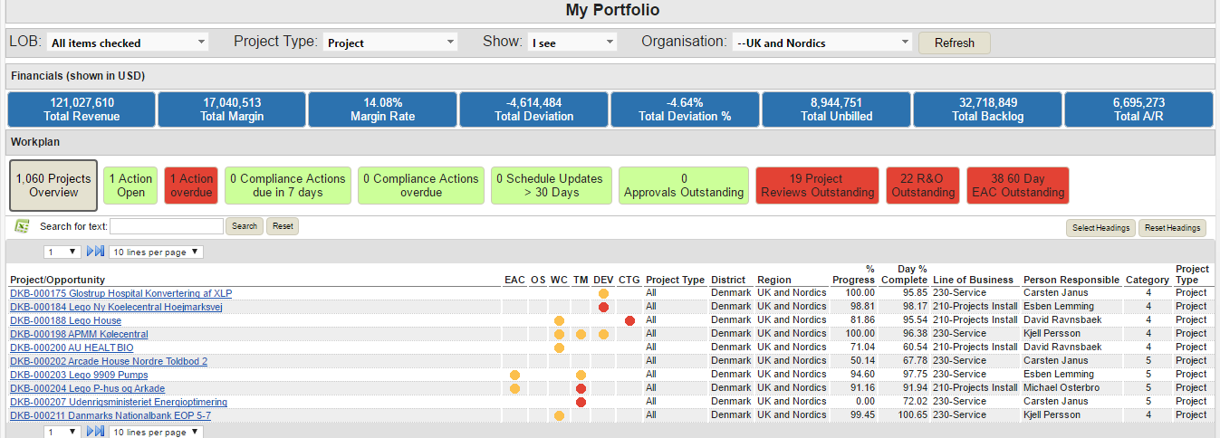
How it looks
Repeatable Project Management in every country for every project
Portfolio visibility and control

Slide 9
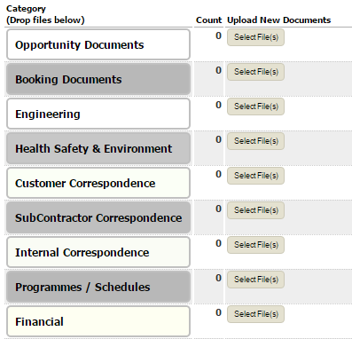

Cloud based
Document Storage….
We now have
Store common project documentation – e.g. Contractual Documents
Ability to integrate forms, templates and common project lists
Configurable Registers for detailed information storage
Elimination of team members storing documents on laptops, network drives etc.

Slide 10
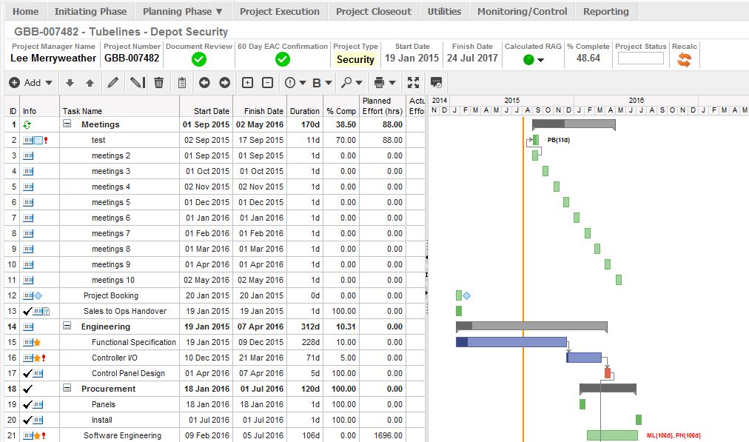
Project Management Functionality
Planning Functionality (Gantt)

Slide 11

Embedding
Project Management Training is now supported by a standard application available to all – PMI PMBok is the basis of our menus
Policy requirements are embedded in the process so the rules are applied automatically
Repeatable Project Management in every country for every project
Reporting is a subset of running the project rather than a separate activity

Slide 12
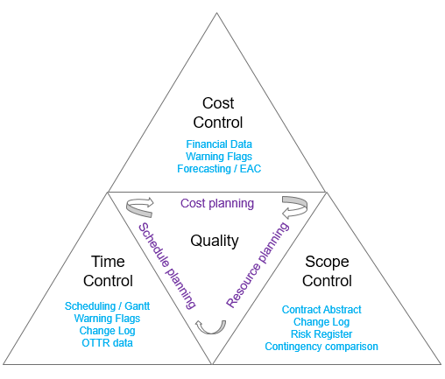
What we have achieved
Answering the Triple Constraint with PV

Slide 13
What do we mean by Forecasting?
As a NSE listed company we advise Wall Street each year and each quarter our Revenue targets and expected profit targets and our free cash flow, and our progress against those targets.
This is based on the roll up of the AOP / results of each business unit in Honeywell Inc.
For us in Project Operations we forecast our projects based on our predicted cost incurred each month in accordance with each Programme of Works.
The cost incurred generates revenue when multiplied by the gross margin.
The total for each Project and then each Portfolio rolls up to the total of the business showing our progress towards our commitment per each quarter and each year.

Slide 14
What have developed
We had 3 different forecasting “tools” in HBS that needed to be pulled together into one global standard process taking the best of each and improving the overall functionality and performance.
Working with Cora Systems in a workshop we demonstrated our existing systems, explained our requirements and applicable policy requirements and standard operating procedures.
A wire frame and prototype was developed and user feedback taken to improve the final design.
We launched in October 2017 and have added further enhancements since following wider user feedback.
We also solved the problem of PMs maintaining separate Excel sheets to maintain a bottom-up EAC.

Slide 15
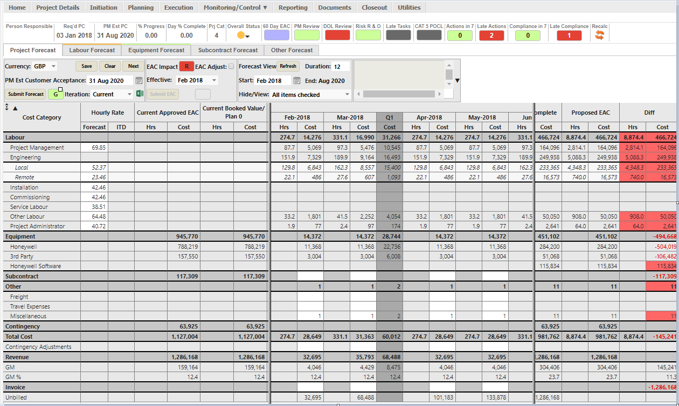
Forecasting
Main Project Forecast Tab

Slide 16
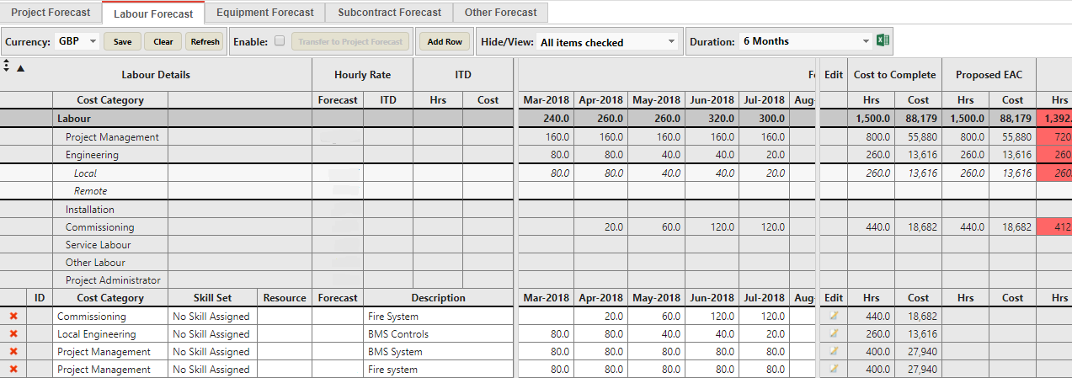
Forecasting
Labour Details Forecast Tab

Slide 17
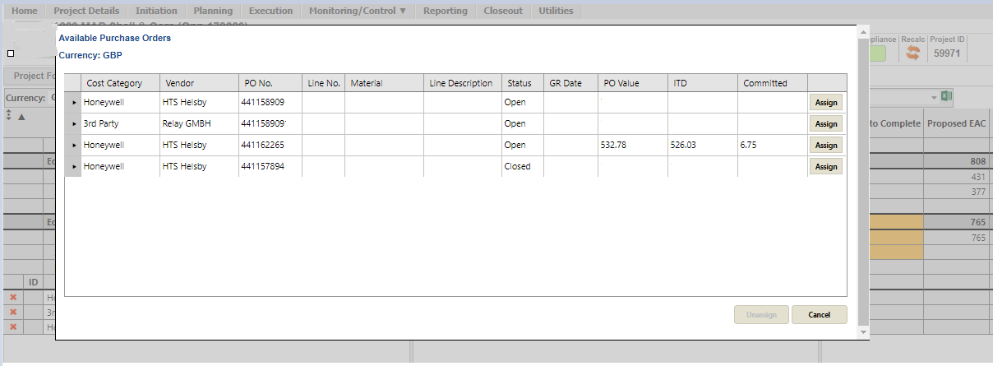
Forecasting
Assigning a Purchase Order

Slide 18
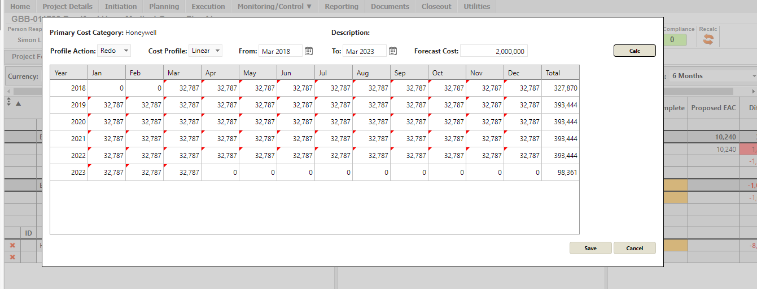
Forecasting
Profiling cost over a long period

Slide 19
Adoption
It is all well and good putting a new application in place that the deployment team promote and believe in and business leaders decree but what actually causes the teams to use them?
We have shutdown the old systems
We drive our project reviews now directly out of PV
The embedding of the monthly forecasting process is now forcing even the most sceptical PM to use PV
More and more functions within the business are now seeing PV as a vehicle to launch new or re-launch old failed processes
We now issue a “Tip of the Week” from a dedicated PV Support email address
We have developed and are continuing to develop on-line e-books (Digi-Books) for our training modules

Slide 20

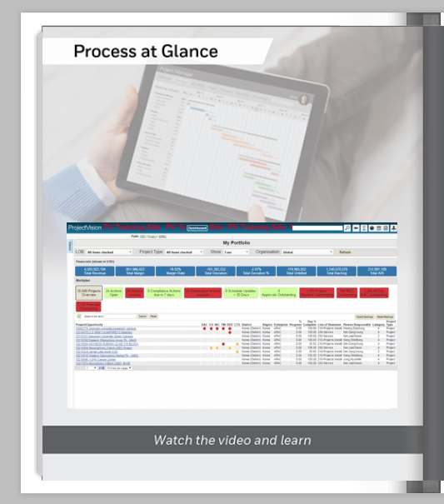
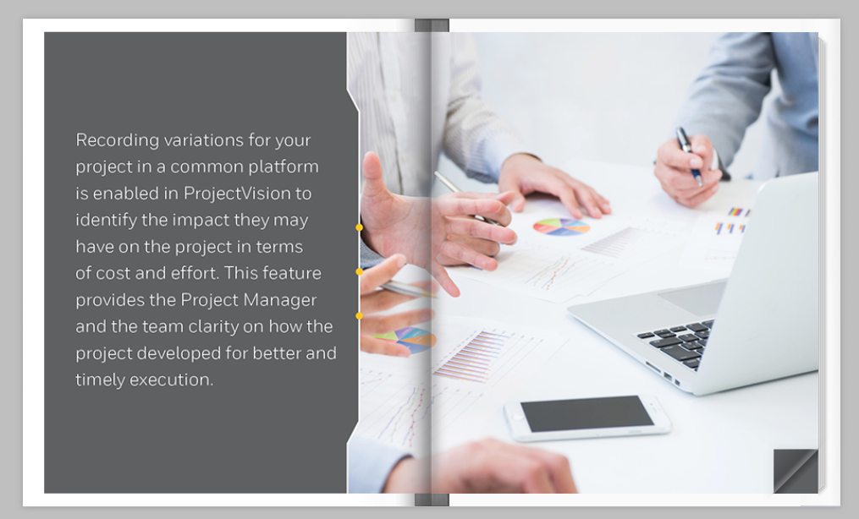
Digi-Books

Slide 21



Need to ask any questions?
Thank you !

