Slide 1
Not sure? Tuck in and try… A Smörgåsbord of Project Approaches
Want to know more?
Register on stand 111 for free e-learning for
PRINCE2®, MSP®, APM, PRINCE2 Agile®, AgilePM® and ITIL®

Slide 2
A traditional smörgåsbord doesn't have to be complicated. It is, in essence, the Nordic version of a buffet, so as long as you follow a few traditional rules and know when to eat which bit, you won't go wrong.
www.scandikitchen.co.uk

Slide 3
Agenda
Portfolio, Programme and Project
Management Best Practice
Overview of partner organisations in the PPM community
Portfolio, Programme and Project Management (PPM) Framework
How other methods and approaches interact with PPM
Notes:
This is what will be happening during the exams!
Describe the examination formats and arrangements to delegates.
Explain Registration by attending this event; Certification by passing the Practitioner exam.
Delegates must pass the Foundation Exam in order to sit the Practitioner Exam. Delegates need 50% to pass (38/75 Foundation Questions; 75/150 marks in the Practitioner exam.

Slide 4
Who’s Who
Method Owners
Accreditation and Exams
Accreditation and Exams
Accreditation and Exams
Accreditation and Exams
Accreditation and Exams
Accredited Training
Notes:
This is what will be happening during the exams!
Describe the examination formats and arrangements to delegates.
Explain Registration by attending this event; Certification by passing the Practitioner exam.
Delegates must pass the Foundation Exam in order to sit the Practitioner Exam. Delegates need 50% to pass (38/75 Foundation Questions; 75/150 marks in the Practitioner exam.

Slide 5
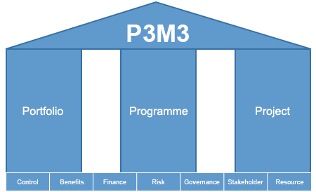
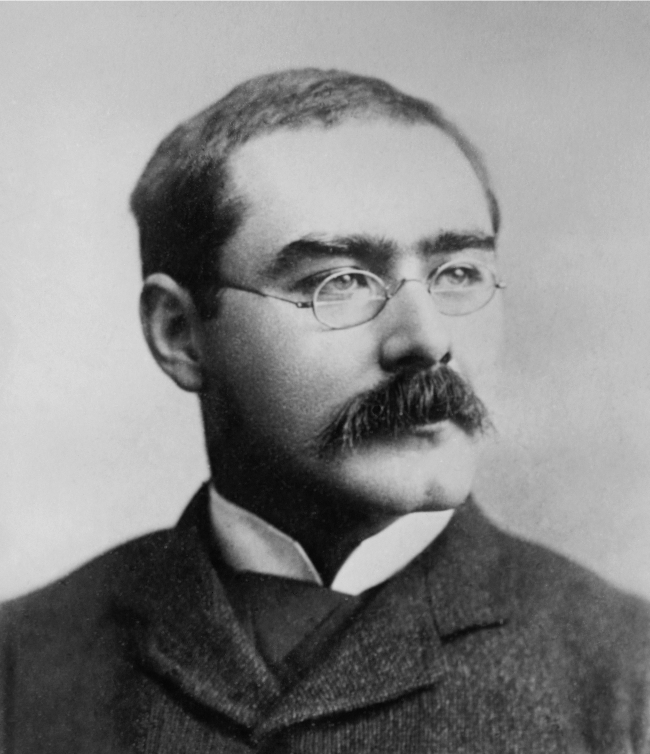
Portfolio, Programme & Project Best Management Practice
Portfolio management addresses the fundamental questions:
Are we doing the right things?
Are we doing these things right?
Most significantly, are we realising all the benefits in terms of more effective services and efficiency savings from the changes we are implementing?
MoV®
Management of Value®
M_o_R®
Management of Risk®
Change
Management
P3O®
Programme & Project Offices ®
BBC®
Better Business Cases
MoP® - Portfolio Management
Programme Management enables you to align and co-ordinate projects within a programme of business change so that you can effectively support specific business strategies.
MSP® - Programme Management
PRINCE2® - Project Management
Project Management is the application of processes, methods, knowledge, skills and experience to deliver outputs in order to achieve the project objectives.
APM / PMI / IPMA
Project Management Body of Knowledge (techniques)
PRINCE2 Agile®
Agile - (development)
Scrum, DSDM, Kanban, Lean, etc.
AgilePM (PM Development)

Slide 6
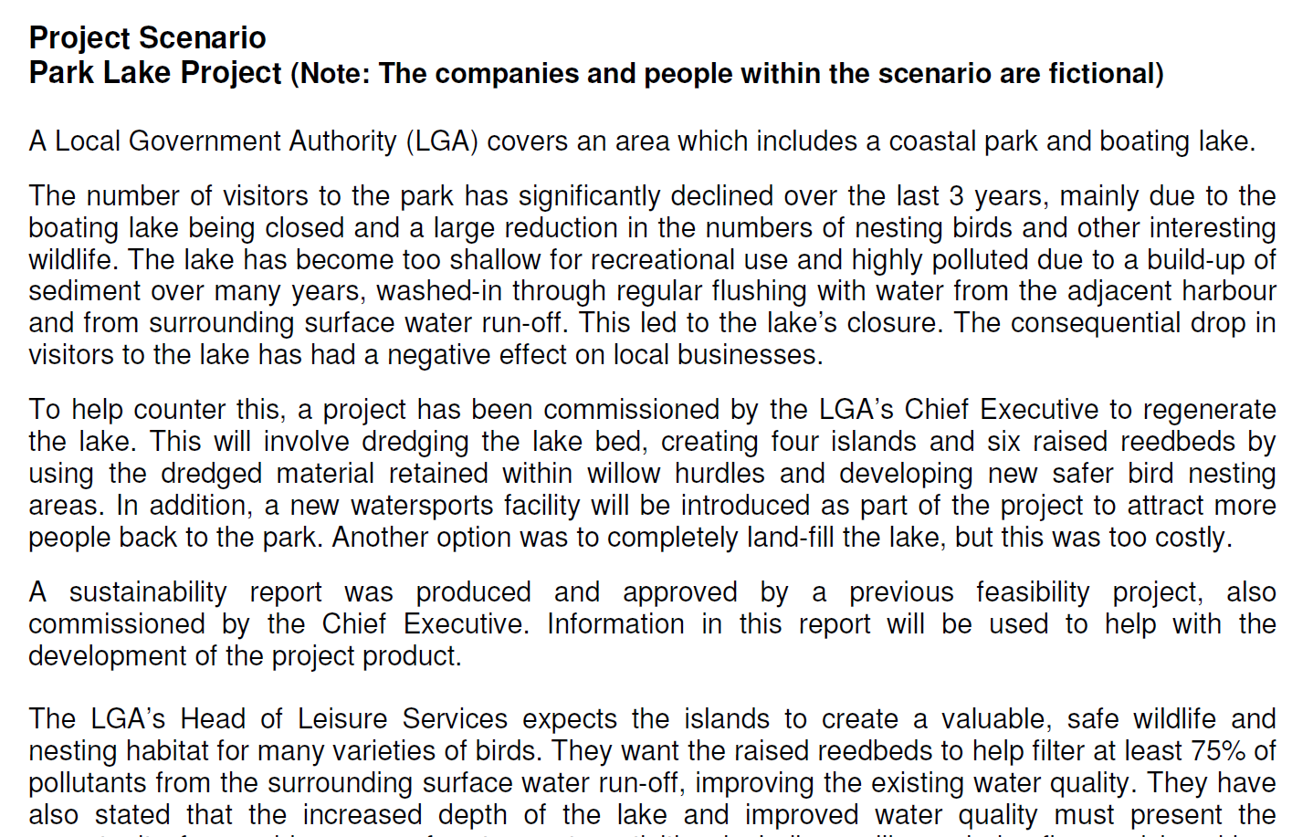
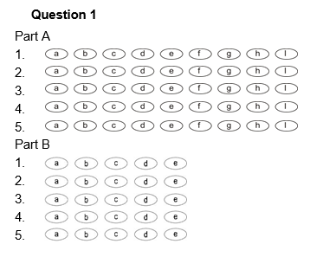
Foundation and Practitioner Exams
FOUNDATION EXAM … Closed Book
To test understanding and basic comprehension of the method.
Multiple Choice questions - Pass mark usually 50-55%
PRACTITIONER EXAM … ‘Objective Test’
Open Book (Official Manual Only)
To test ability to apply the principles to a given scenario.
Pass mark usually 50-55%
Free AXELOS Membership with Practitioner Exam
3 year lifecycle
www.ONLIVE.training
Flexible | Convenient | Interactive | Successful | Accredited
© Copyright 2018 SPOCE Project Management Limited

Slide 7
Classroom Training
Foundation: 2-3 Days available as public or client event
Public courses scheduled at 30 locations. Or we can come to you.
Exam taken during the course.
Practitioner - 5 Days available as public or client event
Take the full 5 days, or split your Foundation and Practitioner into two parts.
Safe Hands Guarantee free resit if required (Subject to terms and conditions).
Foundation
Practitioner
Exam Preparation
Day 1
Day 2
Day 3
Day 4
Day 5
Foundation & Practitioner Combined
www.ONLIVE.training
Flexible | Convenient | Interactive | Successful | Accredited
© Copyright 2018 SPOCE Project Management Limited
Notes:
This is what will be happening during the exams!
Describe the examination formats and arrangements to delegates.
Explain Registration by attending this event; Certification by passing the Practitioner exam.
Delegates must pass the Foundation Exam in order to sit the Practitioner Exam. Delegates need 50% to pass (38/75 Foundation Questions; 75/150 marks in the Practitioner exam.

Slide 8
e-Learning Options
Foundation e-Learning Options
Split the cost by studying first, then purchase exams later.
Exams can be taken online or in exam centres across the UK.
Practitioner e-Learning Options
E-Learning & Blended options. One-off purchase or a monthly subscription.
Study for Practitioner level with the e-learning, in the classroom or ONLIVE
Passport Foundation/Practitioner
Revision, Exam Prep and Exams
20-40 hours self-study
Revision & Exam Prep in Classroom or ONLIVE
Exams can be taken in a centre, or online
Passport Plus Blended Approach
www.ONLIVE.training
Flexible | Convenient | Interactive | Successful | Accredited
© Copyright 2018 SPOCE Project Management Limited

Slide 9
ONLIVE Virtual Classroom
Virtual Classroom – delivered live by our trainers
Foundation and Practitioner levels available.
Morning, Daytime and Evening sessions available.
ONLIVE ANYTIME –All sessions for complete flexibility.
The classroom experience at your desk.
PRINCE2® ONLIVE courses are scheduled to start on the following dates:
5th March 2018
9th April 2018
14th May 2018
11th June 2018
2nd July 2018
3rd September 2018
ONLIVE MORNING | Week1 |  |  |  |  | Week2
 | Mon | Tue | Wed | Thu | Fri | Mon | Tue | Wed | Thu | Fri
09:00 - 10:45 | PRC | ORG | QUA | BUS | PRG |  | EX1 | EX3
11:15 - 12:45 | PRC | RSK | PLA | CHG |  |  | EX2 | EX4
PRINCE2® ONLIVE
Virtual Classroom
Sessions Key:
ONLIVE DAYTIME | Week1
 | Mon | Tue | Wed | Thu
09:00 - 10:45 | PRC | ORG | QUA
11:15 - 12:45 | PRC | RSK | PLA
14:00 - 15:30 | BUS | CHG | PRG | EX3
16:00 - 17:30 |  | EX1 | EX2 | EX4
Foundation Sessions
PRC=Processes
ORG=Organization
BUS=Business Case
RSK=Risk
QUA=Quality
PLA=Plans
CHA=Change
PRG=Progress
ONLIVE ANYTIME - Access to all sessions
 | Week1 |  |  |  |  | Week2
ONLIVE EVENING 18:00 – 21:00 | Mon | Tue | Wed | Thu | Fri | Mon | Tue | Wed | Thu | Fri
 | PRC |  | ORG BUS | RSK QUA |  | CHG |  | PLA | PRG
Practitioner Sessions
EX=Exam Preparation
www.ONLIVE.training
Flexible | Convenient | Interactive | Successful | Accredited
© Copyright 2018 SPOCE Project Management Limited
Notes:
This is what will be happening during the exams!
Describe the examination formats and arrangements to delegates.
Explain Registration by attending this event; Certification by passing the Practitioner exam.
Delegates must pass the Foundation Exam in order to sit the Practitioner Exam. Delegates need 50% to pass (38/75 Foundation Questions; 75/150 marks in the Practitioner exam.

Slide 10
Why SPOCE?
Of the most influential and respected training companies in the industry.
1st to be accredited for PRINCE2®
1st to run a PRINCE2® course
1st to run an MSP ® course
1st PRINCE2 ® and MSP ® Practitioner e-learning
1st to run a PRINCE2 Agile® course
1st AXELOS PPM Approved Courseware Provider
1st AXELOS Strategic Partner
1st PRINCE2 Agile® e-learning
True enthusiasts! We deliver our events like it’s the first time, every time!

Slide 11
The SPOCE Team are here to help!
www.spoce.com

