Slide 1
Building your Agile Competence … in an Agile Way!
Project Challenge - 6th March 2018
Phil Stirpé – Director of Agile and Projects
Ian Clarkson – Head of Organisational Consultancy

Slide 2
Building your Agile Competence … in an Agile Way!
Project Challenge - 6th March 2018
Phil Stirpé – Director of Agile and Projects
Ian Clarkson – Head of Organisational Consultancy

Slide 3
Developing an Agile Proficiency Framework
Project Challenge - 6th March 2018
Phil Stirpé – Director of Agile and Projects
Ian Clarkson – Head of Organisational Consultancy

Slide 4
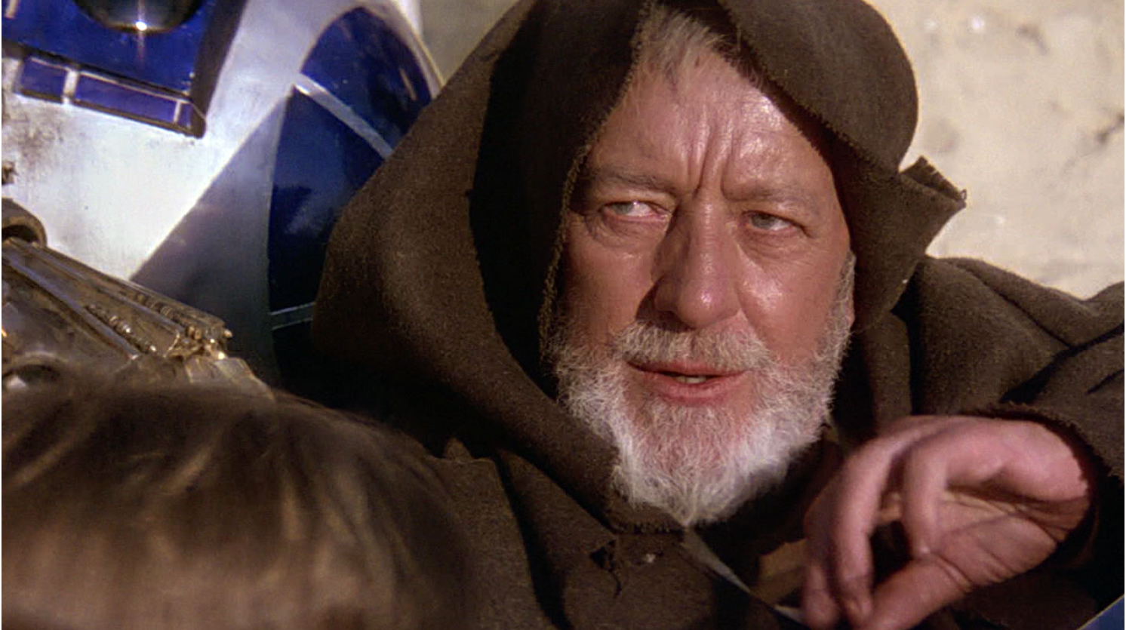
“These aren’t the competencies you’re looking for”
Ian
Phil
Image Source: www.starwars.com

Slide 5
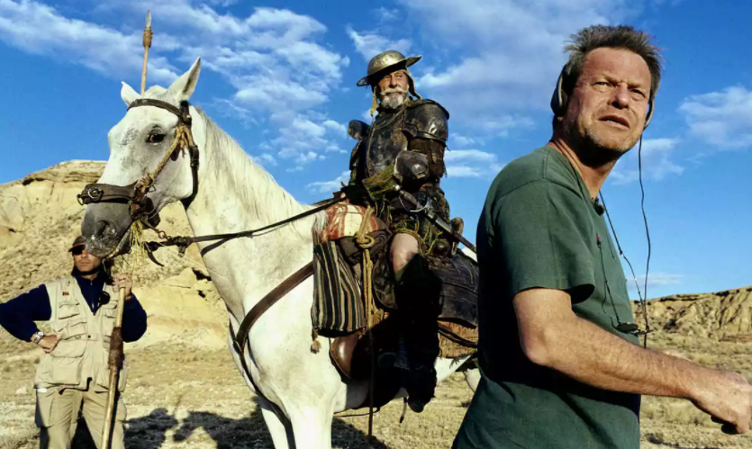
Notes:
The journey from a proposed Agile Project Management Competency Framework to an Agile Proficiency Framework reminds me of the story of how Terry Gilliam tried to make a movie about Don Quixote which turned into a disaster and in the end he made a documentary about it called lost in La Mancha

Slide 6
Objectives of this Session
Rationalise why a traditional competence approach is unlikely to be effective in developing people for Agile working
Explain why taking a “cultivation” approach to people development may be more effective
Convey why the style of motivation needs to be different in a cultivation culture
Understand there is no single way of working or method in Agile, only acknowledgement of what needs to be done and why it is needed
Accept that what needs to be done can be shared by many individuals with varying depth of knowledge depending on context
Comprehend how the Agile Proficiency Framework can be rationalised from the above
Call to Action – call for volunteers to help evolve the work done thus far!

Slide 7
Evolve Over Define
Cultivation Over Competence

Slide 8
Four Values of the Agile Manifesto
Author’s of Agile Manifesto believed that software could not be implemented by defining work up front. Alternatively they believed that an adaptive approach based on feedback was more appropriate.
This was articulated by the values of the Agile Manifesto
Source: http://agilemanifesto.org

Slide 9
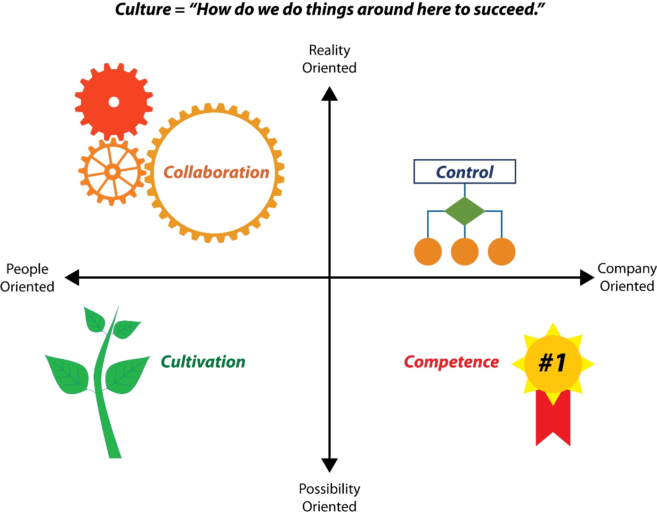
Schneider’s Cultural Model
People making decisions re day-to-day work
The degree to which people focus on the present or future
The degree to which people make decisions
Company makes decisions re day-to-day work
People making decisions to achieve goals
Company makes decisions to achieve goals
Source: 'The Reengineering Alternative,' William Schneider, 2010

Slide 10
Agile Culture
 | Reality vs Possibility | People vs Company
Empowers teams of people to solve complex problems | Reality + Possibility | People
Agile produces working software to obtain regular feedback | Reality | People + Company
Agile requires working with the customer throughout | Reality | People
Planning is an empirical process performed by the people doing the work | Reality | People

Slide 11
A Traditional Competency Framework
 | Reality vs Possibility | People vs Company
A process and tool for identifying an individual’s future development to improve role performance | Possibility | Company
A competency framework is a well documented articulation of what skills are required of a role | Reality | Company
A competency framework can be considered a contract to be met in reward for higher accreditation or ability to be assigned work | Reality + Possibility | Company
A competency framework is rarely changed and is used to define a long term career path for an individual | Possibility | Company

Slide 12
Schneider’s Cultural Model
Agile
Synergy
Opposites
A framework that allows people to decide how best to meet the Agile possibility?
Traditional Competence Framework
Synergy
Source: 'The Reengineering Alternative,' William Schneider, 2010
Notes:
Both Cultivation and Competence are about forward thinking (Possibilities).
Collaboration is all about people but we want them to develop. So perhaps cultivation

Slide 13
A Cultivation Culture Based Framework
 | Reality vs Possibility | People vs Company
Allow people to determine the best way they can develop themselves to meet possibilities | Possibility | People
An articulation of what skills are required within a domain but letting people decide how to do them | Possibility | People
A collaborative process to develop the individual based on shared aspirations | Possibility | People
Appropriate interaction driven by expressed need whilst aligning with long-term vision of organisation | Reality + Possibility | People

Slide 14
Trust Over Targets
Leadership Over Management

Slide 15
Schneider’s View
Control
“prizes objectivity”
”order and predictability as well as maintaining stability”
Competence
“... man’s need to ‘compete against a standard of excellence’”
“The need to achieve has to do more with and doing better than others”

Slide 16
Schneider’s View
Collaboration
“Springs from the family”
“Charge [team] with fully utilising each other as resources”
Cultivation
“One of faith”
“Trusts unquestioningly in success, in its people and its organisation”

Slide 17
Cultivation is based on Trust, Skill and Purpose
Trust people to determine the best way to improve ways of working
Autonomy
Purpose
Mastery
A framework so people work on the edge of (not within or outside) their comfort zones
Motivation
Align framework outcomes with an Org/group vision they believe in
Source: 'Drive: The Surprising Truth About What Motivates Us,' Dan Pink, 2012

Slide 18
What Over How
Capabilities Over Method

Slide 19
Agile is for Complex Problem Solving
Cannot assume that a good solution can be specified up-front
Assumes that a good solution can be specified up-front
Disorder
Complex
Probe
Complicated
Analyse
Chaos
Act
Simple
Categorise
Notes:
Cynefin framework

Slide 20
Method vs Capability
Simple and Complicated
Can design system i.e.
Roles
Process
Artefacts
Practices
A single way of working
Complex
Can only identify the system i.e.
What
Why
A Capability
Many possible ways of working
The way of working is only important in terms of achieving the desired outcome

Slide 21
Empirical Approach for Change Initiatives
Goals
Outputs
Outcomes
Value
Reconsider
Assessed
for
Direct
Create

Slide 22
Capability Decomposition and Assessments
A Change Initiative Capability can be decomposed into:
Prioritisation
Change control
Goal management
Proficiency development
Resource management
Maintainability
Quality Management
Procurement
These can be used to identify “what” is to be assessed independent of method
External policy
Internal policy
Deployment management
Risk and Issue management
Planning and estimation
Stakeholder management
Justification
Outcome assessment
Notes:
16 capabilities identified

Slide 23
Agile Capability
Why: | The reason for the capability
What it is: | A paragraph describing the capability from an Agile perspective

Slide 24
Stakeholder Management
Why: | To ensure stakeholders understand and buy into the goals to achieve the expected value from the change initiative
What it is: | The ongoing identification, assessment and approach for rich communication that promote expected individual and group behaviour

Slide 25
Groups Over Individuals
Collaboration Over Roles

Slide 26
Generalising Specialists
Goal management
Prioritisation
A Person
Deployment
Procurement
For a Change Initiative to be successful all the Capabilities must be effective for the Change Initiative to be optimal.
In a complex environment the allocation of responsibility for Capabilities to someone and say how they should do it, up-front, will not guarantee success.
Risk management
Instead Agile relies on a Collaboration culture where the group provide the Capabilities together with shared accountability.
However not everyone can be highly proficient in all Capabilities. Often only a general level of proficiency is required for a Capability.
Generalising specialists are required to lead in areas of speciality and contribute in areas of generality.
Stakeholder management
Planning
Internal policy

Slide 27
Assessment Must be in Context of Group
As proficiencies levels required are dependent on group then assessment needs to be in context of group and vision
This requires assessing people’s and teams’ proficiency at working together to achieve vision
Assessment level
Team
Team
Lower level
Team
Capabilities are self-similar for each level. Assessment applicable to any level of context re group and vision
Project
Project
External/higher level
Programme
Notes:
Capabilities are “Self-similar”

Slide 28
Group Behaviour
Why: | To ensure groups of people work together in the most productive way to maximise expected value
What it is: | Two or more people collaborating to maximise value to create win-win solutions based on reasoned arguments, options and known facts whilst accepting ambiguity. Demonstrating transparency and willing to change direction based on evidence. Displays shifting leadership and servant leader leadership based on context.
Notes:
Not a capability
APM has “Behaviour” capability

Slide 29
The Agile Proficiency Framework
Notes:
We have been talking about capabilities.
But this isn’t a Capability framework
It’s a Proficiency framework

Slide 30
Principles
Needs are best determined by the people who do the work, not by an assessor
Lead people to develop proficiencies, not manage through performance
Collaborate to ensure mutual goals are met, not an individual’s wish list
Facilitate a conversation, not a score sheet
Use driven by employee/group need, not supporting reviews
Motivate through self-development, not through reward
Assess effectiveness and adapt if necessary, do not assume success

Slide 31
Illustrative Cycle
Raise need
Collaborative Assessment
Provide Guidance
Assess success
Take action

Slide 32
Proficiency Assessment
Proficiency | Assessment Criteria
Unaware | No awareness of proficiency
Aware | Aware of one or more dominant forms* but not practicing
Follows | Improves through practice of single dominant form on feedback and context <1 year in Agile environment interacting with teams using the same dominant form
Adapts | Adapts dominant form from other forms on feedback and context More than one year interacting with teams that are using different dominant forms and/or learning other forms
Creates | Creates forms not recognisable as the dominant or other forms and adapts on feedback and context 10 years Agile experience
*Dominant form of the proficiency is a well-known approach taken in the Agile community or the accepted internal approach

Slide 33
Collaborative Assessment for Prioritisation
Why: | To maximise benefit within tolerances and protect quality
What it is: | Assigning relative expected values to goals consistent with the appropriate level of decomposition i.e. the longer the planning timeframe the less decomposition required.
The Proficiency Assessment drives a conversation:
Do you understand what is described here?
Are you doing it?
How are you doing it?
What experience do you have in doing it?
What problems are you facing?
Does the way of doing it integrate well with group’s way of working?
How best could you be helped?
What level of proficiencies are required in what areas?
Who is the best person, people or group to develop to improve situation?
Guidance

Slide 34
Provide Guidance
Proficiency | Consider | Example guidance
Unaware | General knowledge based training | Foundation including Prioritisation
Aware | General knowledge or practitioner based training covering one or many forms | Practitioner including prioritisation
Follows | Coaching or specialised learning in dominant form | Get coaching in use of MOSCOW
Adapts | Encouragement to improve over dominant form, through experimentation based on learning new approaches, previous experience using other forms or from learning from people who work differently | Interact with groups using alternative prioritisation techniques to move to MOSCOW+
Creates | Encourage improving technique from use Consider for thought-leadership. | Continue use of unique technique and adapt from feedback.
Notes:
Example guidance for “Prioritsation” capability

Slide 35
In Summary
Evolve Over Define
Trust Over Targets
What Over How
Groups Over Individuals

Slide 36
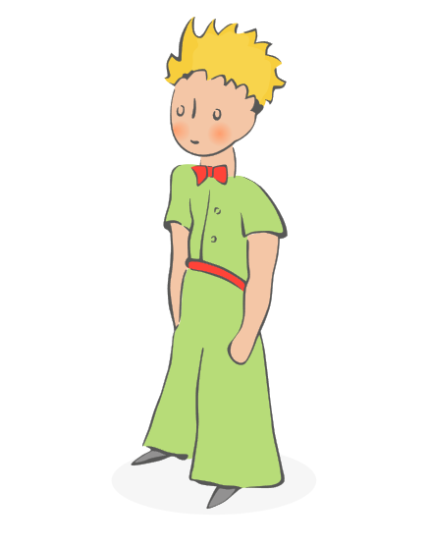
Call to Action
“Perfection is achieved, not when there is nothing more to add, but when there is nothing left to take away” – Antoine de Saint-Exupéry
We need your help to perfect our Agile Proficiency Framework
“A Goal Without a Plan is Just a Wish” – Antoine de Saint-Exupéry
If you are interested in being part of a working group to help us achieve our goal of developing an Agile Proficiency Framework, come and see Phil and Ian at Stand 114 (the QA just behind you)
Image Source: www.thelittleprince.com

Slide 37
Developing an Agile Proficiency Framework
Project Challenge - 6th March 2018
Phil Stirpé – Director of Agile and Projects
Ian Clarkson – Head of Organisational Consultancy

