Slide 1

Understanding Your Value in the PM Market
John Thorpe, Arras People
6th March 2018 - 12:15pm

Slide 2
Understanding Your Value in the PM Market
John Thorpe, Arras People
2018 PMBR Highlights
Recruitment Challenges
Ready for Change?

Slide 3
Arras People:
Project Management Recruitment and Career Specialists
Established 2002
Arras People are the UK’s Specialists in Project & Programme Management Recruitment. We are 100% focused on the recruitment of Programme and Project Management (PPM) practitioners across the UK and across all industry sectors.
Find out more at: www.arraspeople.co.uk

Slide 4

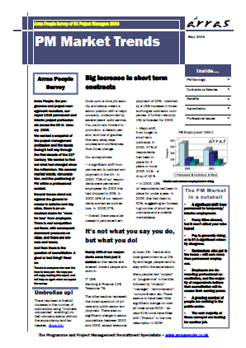

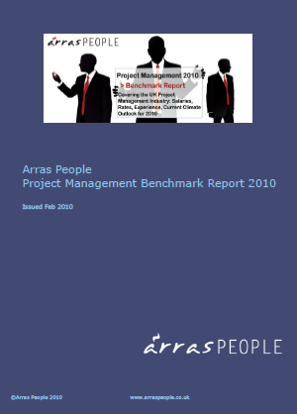
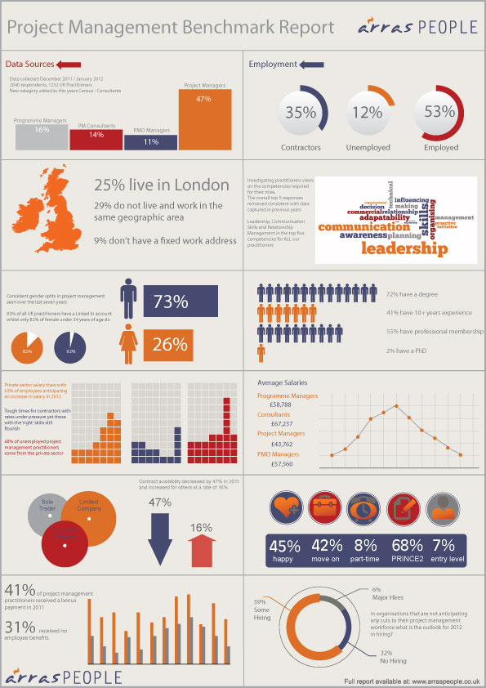


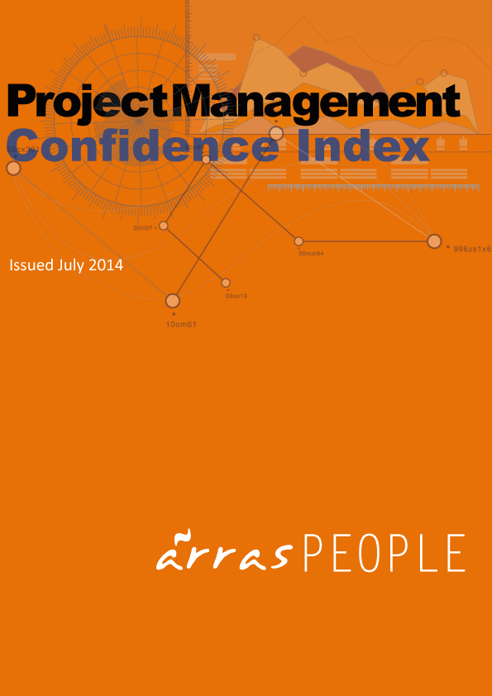






Arras People Project Management Benchmark Report
The 2018 PMBR is the 13th annual report on the Project Management domain, taking in the views and experience of Practitioners and those who support / employ them.
https://www.arraspeople.co.uk/the-project-management-benchmark-report-from-arras-people/pmbr-2018/

Slide 5
2018 PMBR – Some points of note
Employers:
55% of organisations did not fill all open PM roles in 2017
33% were recruiting to replace leaving staff
80% indicated a degree of challenge in finding suitable PM practitioners
Employees:
23% with current employer less than 1 year
32% of employees happy in current role
92% see that securing a decent pay rise in 2018 will be a challenge
Freelancers:
32% of Freelancers/Contractors said they were between assignments
19% headed into 2018 with contracts for more than 6 months
Significant numbers are concerned that “Off-Payroll Legislation” (IR35) will impact their wealth

Slide 6
2018 PMBR – PM Qualifications
16% of PM Practitioners have no PM Qualifications
PRINCE2 still has the highest take-up rate amongst PM Practitioners
Agile qualifications are still not mainstream amongst PM Practitioners

Slide 7
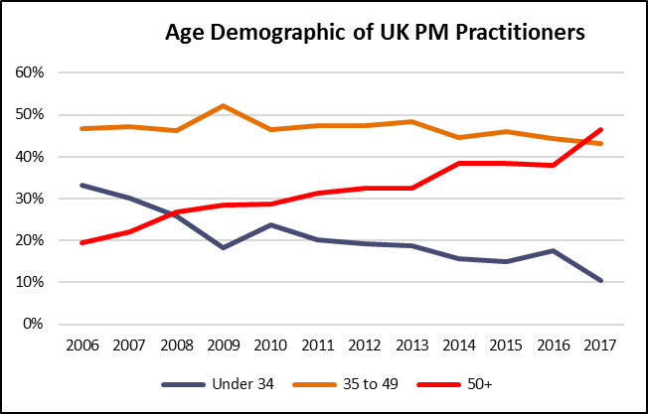
2018 PMBR – Ageing Demographic of PM Practitioners
2017 Marks a tipping point?
Ageing profile of UK PM Practitioners will add significantly to the UK PLC skills challenges
Price will be paid by organisations for their lack of investment in developing PM Practitioners

Slide 8
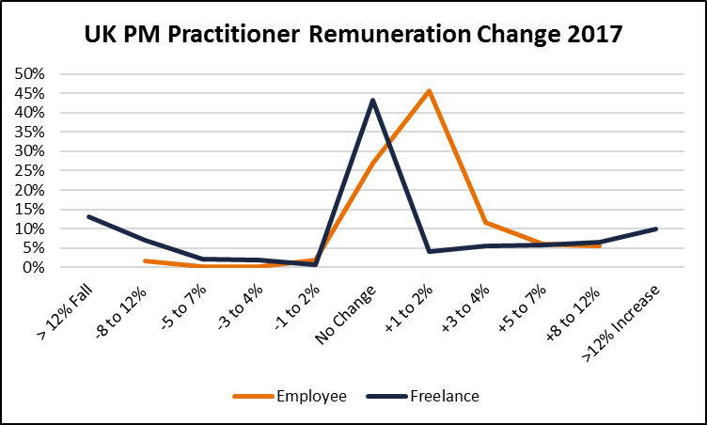
2018 PMBR – Remuneration Change
28% of Freelancers and 23% of Employees saw remuneration increase >2%
43% of Freelancers and 27% of Employees saw their remuneration remain the same in 2017
25% of Freelancers and 4% of Employees saw their remuneration fall in 2017

Slide 9
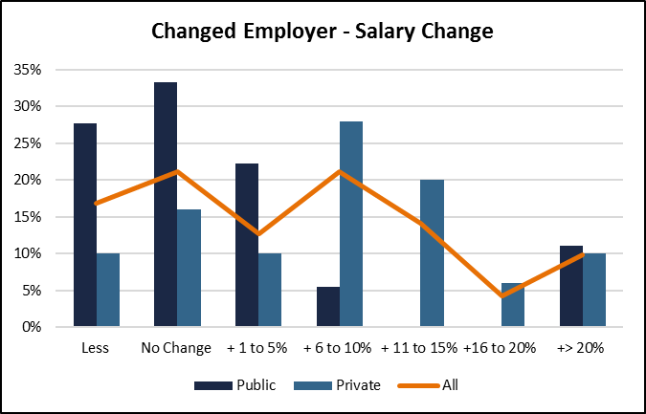
2018 PMBR – Salary Changed Employer in 2017
49% achieved an inflation busting increase of >5%
In the Private sector 64% achieved an inflation busting increase of >5%
More challenging for those PM Practitioners in the Public sector

Slide 10

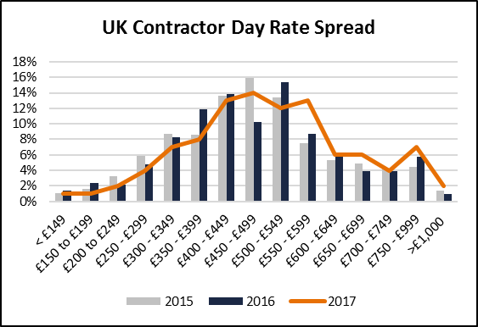
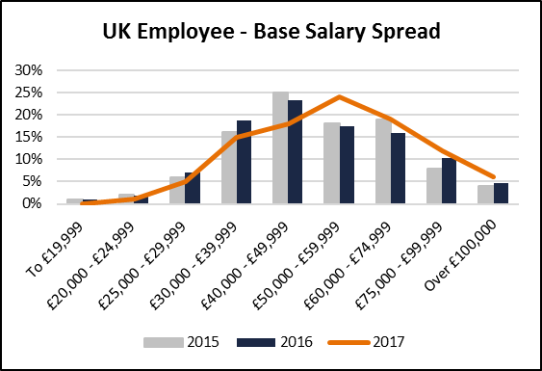
PM Practitioners Still Relatively Well Remunerated
Average Weekly UK Earnings - regular pay, December 2017 - £481 (£25,012 per Annum)
Source – ONS 21/02/2018

Slide 11
PM Employees – Snapshot of 2017 Salary Levels
Source: Arras People 2018 PMBR – 77% of PM Respondents left actual current salary details.

Slide 12
PM Freelancers – Snapshot of 2017 Day Rate Levels
Source: Arras People 2018 PMBR – 64% of PM Respondents left actual current day rate details.

Slide 13
Changing Market Conditions
Recession
Recovery
Boom
High Availability of People
Depressed Remuneration
Looking for 110% Fit
No Training Budgets
Low Churn
Reduced Availability of People
Looking for 100% Fit
No Training Budgets
Churn Increasing
Attract with Remuneration
Low Availability of People
Increasing Remuneration
Looking for 80% Fit
Training Budgets
Potential for Churn
Use
Steal
Invest

Slide 14
What are Clients Looking For?
PM Experience
Education &
PM Qualifications
Personality
& Style
Domain
Experience

Slide 15
Changing Candidate Conditions
Recession
Recovery
Boom
High New to Market
Desperate for work
Poor CV
Low Interview Expertise
Low Risk – Keep Job
Risk Averse
Some takers of Opportunity
CV not maintained
Low interview Experience
Rewarded for Risk
Low Risk Environment
Increased Opportunity
Less Challenge to Move
Development Opportunity
Lower Loyalty
Stick
Twist
Experiment

Slide 16
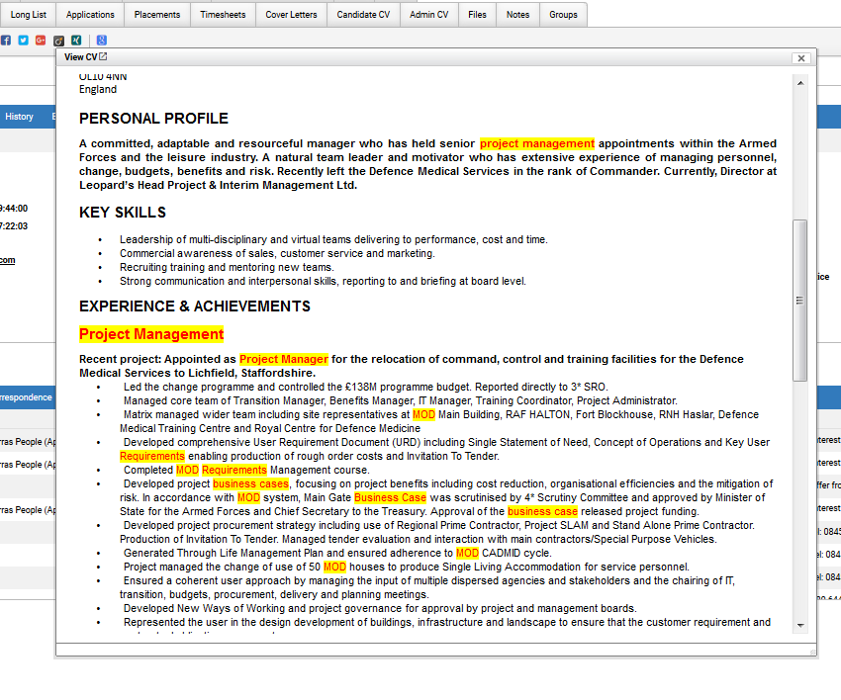
Do You Have What Clients are Looking For?
Does Your CV Paint the Picture?
Education - Factual
PM Qualifications - Factual
Domain Experience – Yes/No
Personality & Style - Challenging
PM Experience – Should be Straightforward

Slide 17
Closing Thought:
Your CV is generally a way to get a foot in the door.
It needs to be effective when being read by a machine
and also when read by another human being.
Make the most of the few seconds that a recruiter will
generally give you!
Any Questions?

Slide 18
Thank you
Arras People:
Project Management Recruitment and Career Specialists
Find out more at: www.arraspeople.co.uk
Download the 2018 PMBR:
https://www.arraspeople.co.uk/the-project-management-benchmark-report-from-arras-people/pmbr-2018/

