Slide 2
The Importance of the Project Board
Introducing the new
“DIRECTING SUCCESSFUL PROJECTS with PRINCE2”
The essential guide for project board members
Notes:
Good afternoon everyone and welcome to this AXELOS session which focuses on the importance of the project board and features our planned and updated “ Directing Successful projects with PRINCE2” guide.
As the title suggests we consider it an essential guide for project board members and is designed to be used in conjunction with our 2017 Managing Successful Projects with PRINCE2 guidance.
Just to let you know there will be opportunities to ask questions at the end of the presentation.
The guidance is out for review with favourable comments received so far.

Slide 3
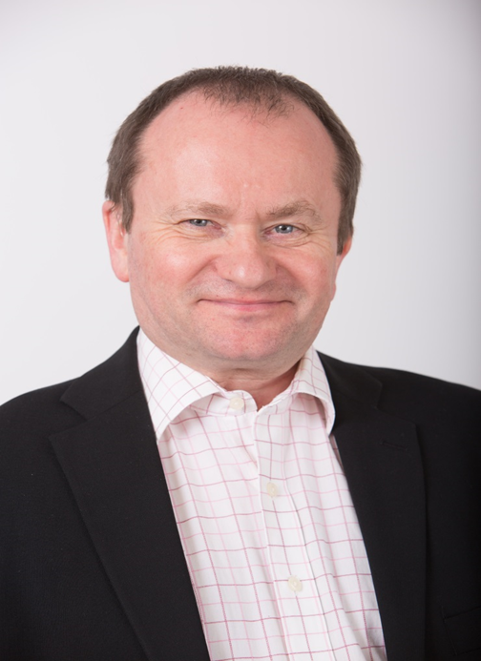
Who Am I?
Joined British Gas in 2000 as CRM Programme Manager
Joined BP in 2010 as Risk Programme Manager
Joined AXELOS May 2014
Over 20 years Programme Management Experience
Notes:
Before 2000 I was involved with the automotive industry specialising in process design and continuous improvement at both Nissan and Toyota. In this area I also became familiar with Lean design and Kanban process control approaches. At Toyota I gained the award of Lean Design Practitioner.

Slide 4
Who is AXELOS?
Founded in 2013
Joint venture between Capita plc. & UK The Cabinet Office
Over 1 million practitioners in over 150 countries
Launched RESILIA in June 2015
Launched PRINCE2 Agile also in June 2015
Membership in 2017
Updated PRINCE2 in 2017
Notes:
Before we get started you need to know about AXELOS who we are and what we do?
1st bullet and 2nd bullet read, 51% Capita and 49% Cabinet Office
3rd bullet is for PRINCE2
4th bullet is our Cyber Resilience product
5th bullet is our PRINCE2 product tailored for an agile environment on which I was programme manager
6th bullet more about that later
7th bullet, last year we updated PRINCE2. I developed the programme and was also SME Lead
On the right hand side you can see some of the other products and their associated trade marks.
Need to mention ITIL, MSP, P3M3, MoV, MoR, P3O and MoP

Slide 5
leadership
Notes:
Before we move forward can you let me know who in the audience has been or is currently involved on a Project Board whether as a PE, SU or SS.
Thank you that gives me a good context.
On the slide is one definition of Leadership, it is one of many but one I feel sums up the qualities involved.
Intelligent, they have the ability to know what they are doing. They have reached a senior position in the organisation which reflects this.
Honest, they must be trustworthy but not just with their peers but with the project team reporting to them in a project context.
Creative, they have the ability to contribute to and sometimes provide the solutions to issues being faced by the project team.
Confident, they must have the respect of the other project board members and the teams reporting to them. They must take the responsibility for making decisions and sticking with them. They must have a confident aura about them which the teams can look up to.
Driven, they must be the source of the drive and the guiding light for the project. They must keep this even if the going gets tough.
Courageous, they must be responsible and at certain times accountable. They must be able to make tough decisions and stick with them and not go missing when the going gets tough.
All in all a very demanding position.

Slide 6
Why have we developed the guide?
Notes:
The role of the project board is critical since it provides the correct direction to the PM
It covers the questions frequently asked by those people who sponsor or direct, more about that shortly
The new guidance needs to reflect the PRINCE2 2017 Update
Research from our ecosystem plus other sources of information e.g. PMI’s Pulse of the Profession 2017 which was covered in a presentation yesterday
We have endeavoured to give a better structure to the book so as to make it easier to use for the time pressed Project Board members whether they are new or experienced.

Slide 7
WHAT ARE THE QUESTIONS WE have Answered?
What is expected of me?
What should I expect of the project manager?
How do I know that the project manager is applying PRINCE2 appropriately?
How do I delegate authority to the project manager but keep control?
What decisions am I expected to make?
What information is required/available to help me make decisions?
How do we tailor the use of PRINCE2 for projects of differing scale or type
What does an effective project board look like?
Notes:
It covers the questions frequently asked by those people who sponsor or direct projects
1st bullet, as a PB member what am I supposed to do as the project proceeds through the project lifecycle.
2nd bullet, what will the PM deliver at this part of the process?
3rd bullet, there are specific checkpoints at each part of the guide which show this.
4th and 5th bullets these are contained in each section of the guidance as the project moves through the lifecycle
6th and 7th bullets the guidance has placed a special focus on these
8th bullet, this is woven through the book by focussing on the individual project board members on what they need to do, how they work effectively with one another and with the project manager

Slide 8
Why the directing role is important?
Ensures user involvement
Speed of decision making
Senior Management Commitment and drive
Senior Management Accountability
Building a facilitative culture
Supporting decentralized decision making and empowering teams
Making sure the right users are involved and used correctly
Notes:
Yesterday there was an excellent presentation by Caterina La Tona from PMI regarding the PMI’s 2017 “ Pulse of the Profession” which echoes why the directing role is important.
Ultimately it is about avoiding project failure and concentrates on the following points:
Without this there will be no buy in for the product being produced.
This tends to be quicker in a project environment since there are more decisions to be made as the project proceeds and with the level of uncertainty being greater with projects there is a need for speed to reduce this. This is particularly the case with an agile environment.
They are the leaders and must drive the project
They have to face and make difficult decisions usually under time constraints but they have to be aware that they are accountable for the decisions made
Not command and control but working together in tandem as one team
Top down bottom up working structure coupled with a governance structure in place. This fosters the PRINCE2 principle of managing by exception
This increases the chances of a successful output or outcome being delivered and hence a successful project.
Then read the quote from the “ Pulse of Profession 2017”
PMI’s Pulse of profession (2017): “Our research consistently shows that an actively engaged executive sponsor is the top driver of projects meeting their original goals and business intent.”

Slide 9
Why projects matter
Senior managers, are accountable for two aspects of an organization’s performance:
Maintaining current business operations
Improving business operations in order to survive and compete in the future through:
Developing new or improved products or service offerings
Notes:
Maintaining current business operations – profitability, service quality, customer relationships, brand loyalty, productivity, market confidence etc. Often called BAU or ‘business as usual’
Improving business operations in order to survive and compete in the future – looking forward and deciding how business change can be introduced to best effect for the organization (What we term as “the project environment”)
As the pace of change (technology, business, social, regulatory etc.) accelerates, and the penalties of failing to adapt to change become more evident, your focus of management attention is inevitably moving to achieve a balance between business as usual and business change.
Projects are the means by which we bring about change – and, while many of the skills required are the same, there are some crucial differences between directing business functions and directing project work

Slide 10
Wider project environment
Change
Temporary
Cross-functional
Unique
Uncertainty
Notes:
There are a number of characteristics of project work that distinguish it from business as usual:
Change Projects are the means by which we bring about change, they are usually too large to be accommodated by BAU processes
Temporary Projects are temporary in nature. Once the desired change has been implemented, business as usual resumes (in its new form) and the need for the project is removed. Projects should have a defined start and a defined end
Cross-functional Projects involve a team of people with different skills working together (on a temporary basis) to introduce a change that will impact others outside the team. Projects often cross the normal functional divisions within an organization and sometimes span entirely different organizations. This frequently causes stresses and strains both within organizations and between, for example, customers and suppliers. They have different perspectives and motivations for getting involved in the change.
Unique Every project is unique. An organization may undertake many similar projects, and establish a familiar, proven pattern of project activity, but each one will be unique in some way: a different team, a different customer, a different location. All these factors combine to make every project unique. Therefore, it is important that the Project Board is aware of any lessons learned from previous projects which are of a similar nature, are shared with the PM and the project team before work begins
Uncertainty Clearly, the characteristics already listed will introduce threats and opportunities over and above those we typically encounter in the course of business as usual.
Projects are riskier, the level of unknown is greater
Given that:
(1) projects are the means by which we bring about business change, and
(2) project work entails a higher degree of risk than other business activity, it follows that implementing a secure, well-proven project management method such as PRINCE2 is a valuable business investment. This being coupled with a Directing book for the Project Board to use produces an excellent combination for organisations to adopt.

Slide 11
WHAT IS INSIDE?
Chapter | Detail
1 | Introduction to the book and how to use it
2 | Provides an overview of PRINCE2 and introduces some key terms and concepts
3 | Explains the role of senior management in PRINCE2
4 | Duties and behaviours of senior management
5 | Overview of senior management activities
6-13 | Describe the project board activities, providing a route through the PRINCE2 project lifecycle from a project board perspective including their areas of focus
14 | Outlines the factors that should be considered in tailoring PRINCE2 for different types and sizes of project and outlines the adoption of PRINCE2 in an organizational environment
15 | Diagnosing and avoiding problems
Appendix A | Outlines the responsibilities for each PRINCE2 role
Appendix B | Provides checklists to support project board decision making
Appendix C | Deals with the programme and portfolio management context
Glossary | Contains a list and explanation of the terms used in the manual
Notes:
It is a supporting reference guide for senior managers involved in projects in a Project Board role. It covers the:
Behaviours
Responsibilities
Duties
Accountabilities expected.
This new edition of Directing Successful Projects with PRINCE2 is designed to support senior managers – whatever their level of experience – undertaking project board roles, be the project executive, senior user or senior supplier. Covering the duties, behaviours responsibilities and accountabilities expected of members of the project board, it can be used as a reference tool at any stage of the project to check what is required. It is intended to be used in conjunction with the latest edition of Managing Successful Projects with PRINCE2 (AXELOS, 2017).
This is based on the P2 2017 6TH Edition.
3, 4 and 5. This is the core of the guidance. It explains who does what, the behaviours expected and what needs to be done when.
6-14. Contains all the process steps summaries of what is involved including the purpose, what to expect from the PM including suggested project board agendas and tailoring guidelines. Also there is a checklist that should be completed by the Project Board member for each process step. This also includes guidance on agile delivery approaches, ways of working and techniques
15. The discussed problems in this chapter are clustered around actual project performance problems and problems with the organization’s overall performance and how this may affect the project.

Slide 12
Duties & behaviours of senior management
Be accountable for the project
Provide unified direction
Be a servant leader
Delegate effectively
Facilitate cross-functional integration
Commit resources
Ensure effective decision making
Support the project manager
Ensure effective communication takes place
Notes:
Be accountable for the project and make it a success by being accountable for the decisions made
Be able to make timely unified decisions and have the project board as the single source of truth
Think of the team as a whole not just the project board. The project will succeed as a team but fail as a group of individuals. This was a powerful concept introduced with P2A.
Don’t abdicate responsibility you need to steer and direct the team correctly
This needs to happen since projects are typically cross functional in nature across the organisation
Commit resources and make sure that they are the correct resources with the correct skill sets
Should be swift and clear in a project environment
Particularly if he is having issues
This means that we ensure that the frequency and method meet the needs of the project both from a project manager and project board perspective.

Slide 13
Suggested project board Agenda
Look back and where are we now
Look forward
Assess overall project viability
Make decisions.
Notes:
This is generic and mentioned throughout the book and keeps the project board on track
1st bullet e.g. review status
2nd bullet review where we are going
3rd bullet consider the current status of the business case, project plan and issues/risks. It answers the question, is the project still worthwhile?
4th Authorise current plan or if in exception authorise the exception plan. Request premature closure if the project is no l longer viable or desirable. This can include a GO /NO-GO decision taken by the project board.

Slide 14
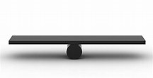
It’s all about balance
Notes:
The project board and the PM must work together to ensure that the project is a success it is ideally a 50:50 relationship.
The Project board needs to direct effectively and the PM needs to deliver the required end product and its components in the correct timescale(s) and cost(s) to inspire trust and confidence from the project board.

Slide 15
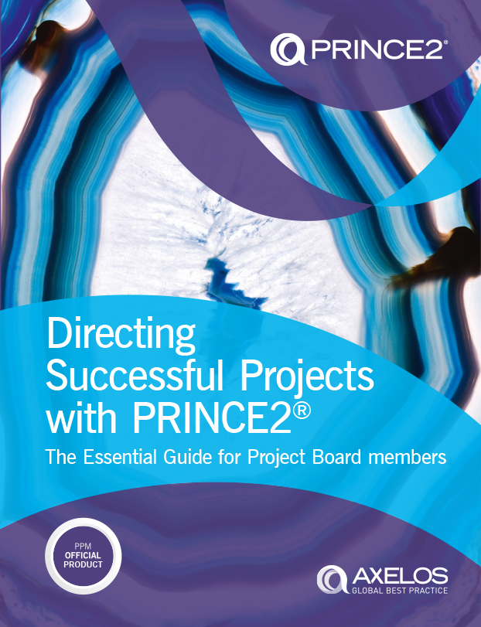
PUBLICATION DATE: SUMMER 2018
Notes:
No exam
English only at present

Slide 16
WHAT IS AXELOS Membership?
Designed for PPM and ITSM Professionals
Community
Digital badge
Maintaining your professional status
Notes:
1st bullet AXELOS Membership is designed to provide ITSM and PPM professionals with a wide range of content, templates, toolkits, online resources and best practice guidance to support them in their role.
2nd bullet a community of advocates and practitioners working across all industries and sectors, willing to share knowledge, experience and ideas which will help create an ever growing and authoritative body of best practice
3rd Members are also provided with access to a CPD recording tool and if they meet the CPD criteria they are able to apply for a digital badge which can be used to validate their certifications
4th bullet Subscribe to AXELOS Membership within 3 months of passing their exam
Claim their digital badge
Renew their membership each year
Maintain their digital badge by logging 15 CPD points each year
At the 3 year point if a candidate has a current membership and a digital
badge of 3 years duration they will be issued with a new certificate that
is valid for a further 3 years.
For further information please come to our stand.
A copy of the presentation will be made available in a PDF format from the show website after the event at www. Projectchallenge.com

