Slide 1
Get Ready for GDPR Compliance
Masterclass
Nicola McCoy
Director of Enterprise Architecture
Planview
Notes:
Project Challenge Spring Show 2018 – 6th March at 3.15pm, Masterclass Zone
The sessions last for 30 - 35 minutes with a further 5 minutes for questions, maximum 40 minutes

Slide 2
Introducing our Subject Matter Expert Nicola McCoy
Nicola McCoy has over 20 years’ experience working within information security, enterprise architecture, global technology and enterprise software roles. She has deep experience in helping organisations to understand their enterprise with particular focus in operational resilience, application and business portfolio management and information architecture.
Prior to working for Planview, Nicola was a key member of the Global IT Security and Global IT functions within PricewaterhouseCoopers where she was a thought leader in information security policy, strategy and standards.
Notes:
I’m delighted to introduce our speaker for today – I’ve had the opportunity to work with Nicola on developing Planview’s GDPR solution. It’s been great to be able to tap into her vast knowledge in this area gained through her 20 years of experience with many organizations to understand their enterprise, leveraging her focus in operational resilience, application and business portfolio management and information architecture.
And now – here’s Nicola
Peter Click

Slide 3
Single focus on work and resource management
Solutions spanning novice-to-black belt, team-to-enterprise
Recognized market leader by premier industry analysts
Serving more than 3,000 customers and one million users worldwide
Deep commitment to customer success
Notes:
We are unique in the market given our single focus and market presence (point #1, #2. #3)
We are unique in that we provide the broadest range of WRM solutions (point #3)
Our vision, products, and customers have established a leadership position for us in the market

Slide 4
Today’s Market Forces and Challenges
Higher stakes
and increased
complexity…
Increasing
Pace of
Innovation
(or Disruption)
Fundamental
Shifts in the
Workforce
Digital
Transformation
of Every Industry
Convergence
of Products
and Technology
…in connecting strategy and delivery
Notes:
Intro: Here are some of the common market forces and challenges our customers face.
Message:
How are these challenges impacting you?
Use this as an opportunity to tie these market forces back to the pain the prospect articulated during intros
Other suggestions:
I saw in your annual report, your CEO mentioned… How do those initiatives impact you? And how do you and your team deal with juggling these “new” strategic objectives?
Transition:
So when I talk about Eric and his ability to deliver in 4 months what used to take 12, how exactly did he do that? He did that by tying strategy to execution to maximize work and resources across his organization.

Slide 5
Business Impact of Work and Resource Management
Operationalize the execution
of your strategic plan
Accelerate your digital transformation
Embrace and
manage change
Strengthen every level
of your execution
Drive innovation and
improve your time-to-market
Ensure your limited
resources are on strategy
Advance the capabilities required to deliver your strategy
Optimize your
technology portfolio

Slide 6
Work and Resources are Core to Strategic Execution
STRATEGY
Portfolios
Strategic Planning
Financials
Agile/Lean
Projects
People
Locations
WORK
Products and Services
RESOURCES
Stage Gate
Collaborative Work
Technology
IoT
Roadmaps
Business Capabilities
Assets
DELIVERY
Notes:
Intro: So work and resource management is about connecting strategy and execution, where execution is defined by work and resources.
Message: Every company builds a strategic plan, the products and services you offer as an organization and the business capabilities you require to bring that strategy to life.
Whether it’s to drive innovation, improve customer experience or open new markets (…. Relate examples to the company per the annual report, the conversation with the prospect, which market forces they associated with, etc.) you need to maximize the Resources available, not just about People and Money, it’s about all the other resources your company has to leverage. Technology, Assets, and Locations, you need to put all of those resources to work in an optimized way. (Relate these to the resource types your prospect has identified, ask them which are key for them??)
On the work dimension, it’s work of every type. For Eric at Flowserve, it’s all about Stage-Gate and Roadmaps. For other customers it’s about Projects and Agile delivery (Relate these to what you have learned about your Prospect!!).
Transition: How do we bring this to life for you? We do that in the form of Solutions.

Slide 7
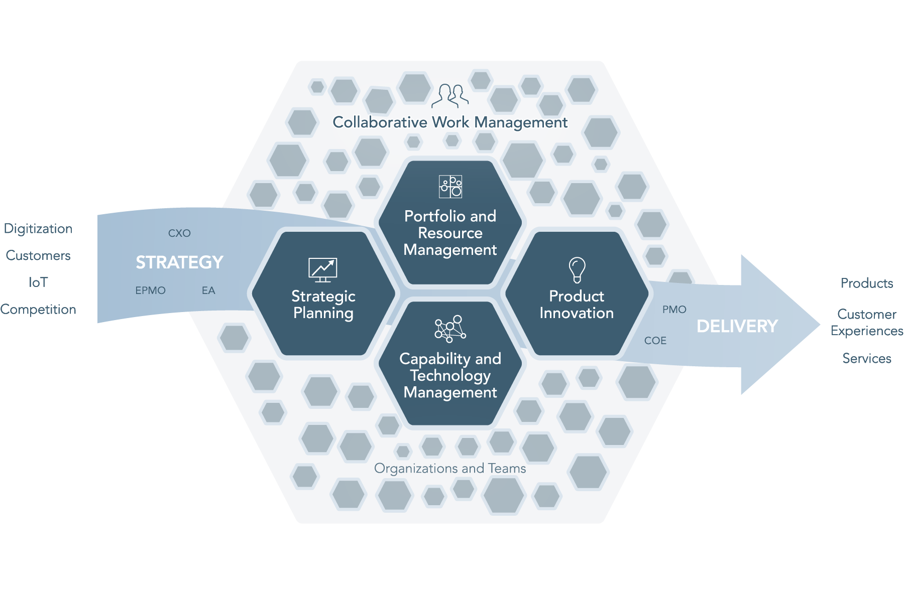
WRM Connects Strategy and Delivery Enterprise-Wide
Notes:
Operationalise Execution of strategic plans
Ensure limited resources are on strategy
Advance the capabilities required to deliver strategy
Optimise your technology portfolios
Strengthen execution from programmes to projects to teams, no matter how you work

Slide 8
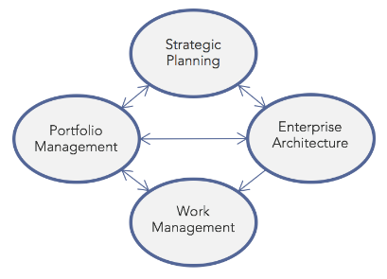
The Market is Evolving to WRM
“The PPM market continues to grow and expand to support a number of different use cases targeting different types of user groups with different goals and challenges.”
“Work and Resource Management looks at work that is assigned and conducted by resources that may be people-, technology- or asset-based and that that can be located anywhere in the organization or be geographically dispersed.”
“Strategy-To-Execution Market”
Notes:
Message: The latest Gartner research talks about the expanding use cases of PPM to include Collaborative Work Management. Forrester is talking about Strategic Portfolio Management and connecting strategy to execution. Ventana has embraced the category of WRM.
“The analysts are embracing the evolution of expanding traditional thinking into a bigger idea of the category of Work and Resource Management. My guess is you’ve reached out to one or more of these firms, which is probably why we are having this conversation.“
Transition: “To recap…”

Slide 9
GDPR Lets Recap
Effective May 25th 2018
Requires stronger consent mechanisms for PII
Stricter procedures for data breaches and penalties if they occur
Even if you have outsourced processing of information to a third party you are still responsible
Affects organisations outside the EU if they have customers within the EU
Notes:
GDPR is just around the around the corner, lets do a quick recap on why its important for those of you who were on our earlier webinar on GDPR and an introduction for those that are new to the topic
Peter Click
Four years in the making GDPR comes into force on 25th May 2018 two years and twenty days after it was approved by the EU Parliament.
Designed to harmonize the different privacy laws across Europe as well as make them more stringent some of the things it includes are:
Peter Click
Stronger consent mechanisms – particularly being able to demonstrate consent has been received for the use of information that is personal and sensitive in the context in which you are using it within your organisation
Peter Click
As you have seen one of the biggest changes GDPR brings is much greater penalties for non compliance and stricter requirements around reporting of data breaches
Peter Click
You cannot outsource your obligation – even if a third party is processing or handling the information on your behalf your organisation is still responsible for ensuring compliance to GDPR.
Peter Click
And this is not a problem specific to the EU, and in case your wondering if it will still apply to the UK post-brexit – yes the ICO has stated UK organisations should be preparing and indicated they will retain many of the principles of GDPR post-brexit. Similarly it also affects organisations that are based outside the EU – for example in the US – but operate and have customers / operations in Europe. If this is your organisation you are affected and need to be considering how you are responding to the requirements of GDPR as ultimately those penalties affect your global revenue not European revenue.
Peter Click

Slide 10
GDPR is a Company-Wide Initiative
Notes:
GDPR is a company-wide initiative – many different departments are effected. Because of this, a company’s GPDR team has representatives from several key areas – as shown here. Nicola will go into how these teams work together to answer GDPR compliance in more detail
Peter Click

Slide 11
Establish a Cross Functional Team
Legal & Data Privacy
Marketing & EPMO
EA & IT Security / Compliance

Slide 12
Different Stakeholders, Different Questions, One Goal
What documents support GDPR Activities?
What is the status of the GDPR team’s activities?
What is the status of the GDPR assessments?
Where do I need to focus our attention first in terms of non-compliance?
Legal & Data Privacy

Slide 13
Different Stakeholders, Different Questions, One Goal
What investments are necessary to support GDPR Compliance?
How is my team’s activities impacted by GDPR compliance?
What is the status of the GDPR program, are we on track?
What resources do we need to support the GDPR program and ongoing BAU activity?
Marketing & EPMO

Slide 14
Different Stakeholders, Different Questions, One Goal
Which applications process privacy relevant data?
Where is data processed outside the EU?
How secure are the applications that have access to privacy protected data?
What is the compliance status of assets that are supporting GDPR?
EA, IT Security, Compliance

Slide 15
GDRP Compliance Journey
“I need to know we can report on this on an ongoing basis”
“I want to get regular updates on tasks”
“I need to identify risks associated with GDPR information”
Plan
Schedule
Collaborate
Map Information
Assess
Information
Gap Analysis
Remediation Plan
Establish
BAU
Create Program
Impact
Assessment
Store
Documents
Business Process
Compliance
Gaps
Scenario
Analysis
Cross-Border
Governance
Identify
Resources
Task
Management
Information Usage
Stewardship
Prioritize
Risk Indicators
Data Gaps
Plan Approval
“We need to identify gaps between our current and target state”
“I need to create a remediation plan”
"We need to create a program to manage GDPR Compliance”
“I want to identify key resources”
“I need to know which processes support critical information”

Slide 16
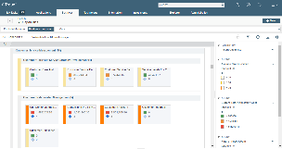
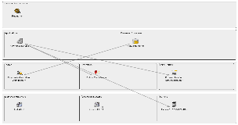
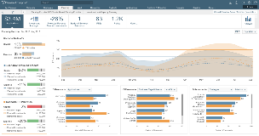
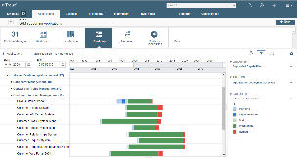
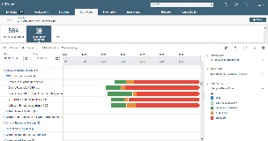
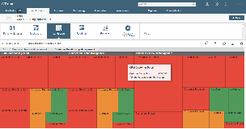
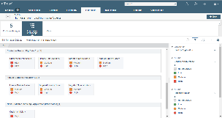
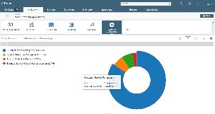
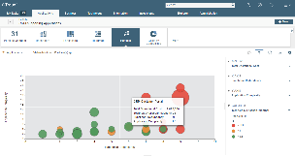
A Business Outcome Based Approach to Decision Making
What are the most important business capabilities?
What processes, third-parties, applications and technologies are supporting a capability?
What business goals are best supported by a scenario of projects?
What are the cross dependencies between projects working on IT assets?
UNDERSTANDING THE BUSINESS
STRATEGIC PLANNING
What is the roadmap of IT support by business area?
IT ROADMAPPING
MANAGING PRIVACY & RISK
What is the technology risk by application and capability?
OPTIMIZING IT COSTS
How do target IT states compare with current states?
What is the scope of a privacy impact assessment?
What is the total OPEX cost by capability?
What applications should be decommissioned to reduce OPEX?

Slide 17
Planview: Supporting your GDPR Compliance Goals
We can enable cross-functional teams to organise and get the work of compliance done more effectively
We can support EA teams to create a clear line of sight of how information is being used within your organisation
We can provide insight that enables IT Security and Compliance to understand how secure information is within applications and technology
We can support the EPMO to plan GDPR project roadmaps, link them to execution, and manage resources and implementation

Slide 18
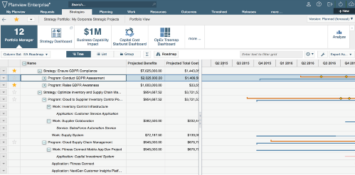
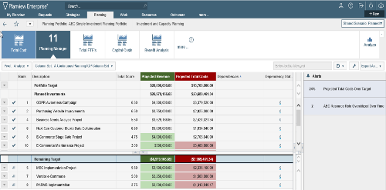
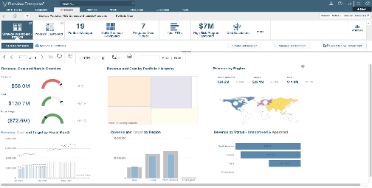
GDPR Program Management
What are the investments necessary to achieve GDPR compliance?
What is the impact on other priorities?
What is the status of our GDPR program? Are we on track?

Slide 19
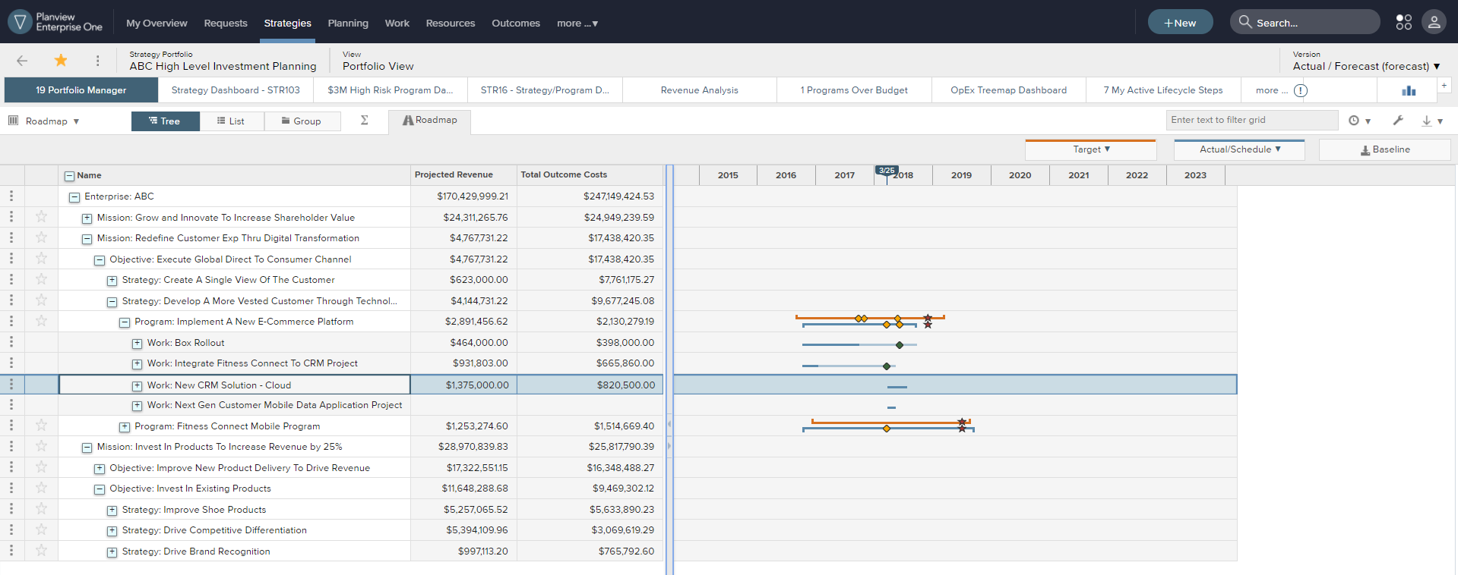
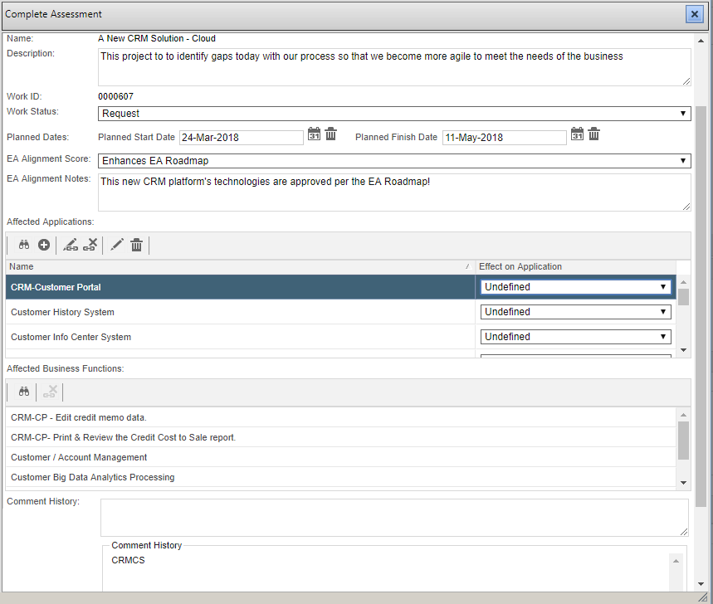
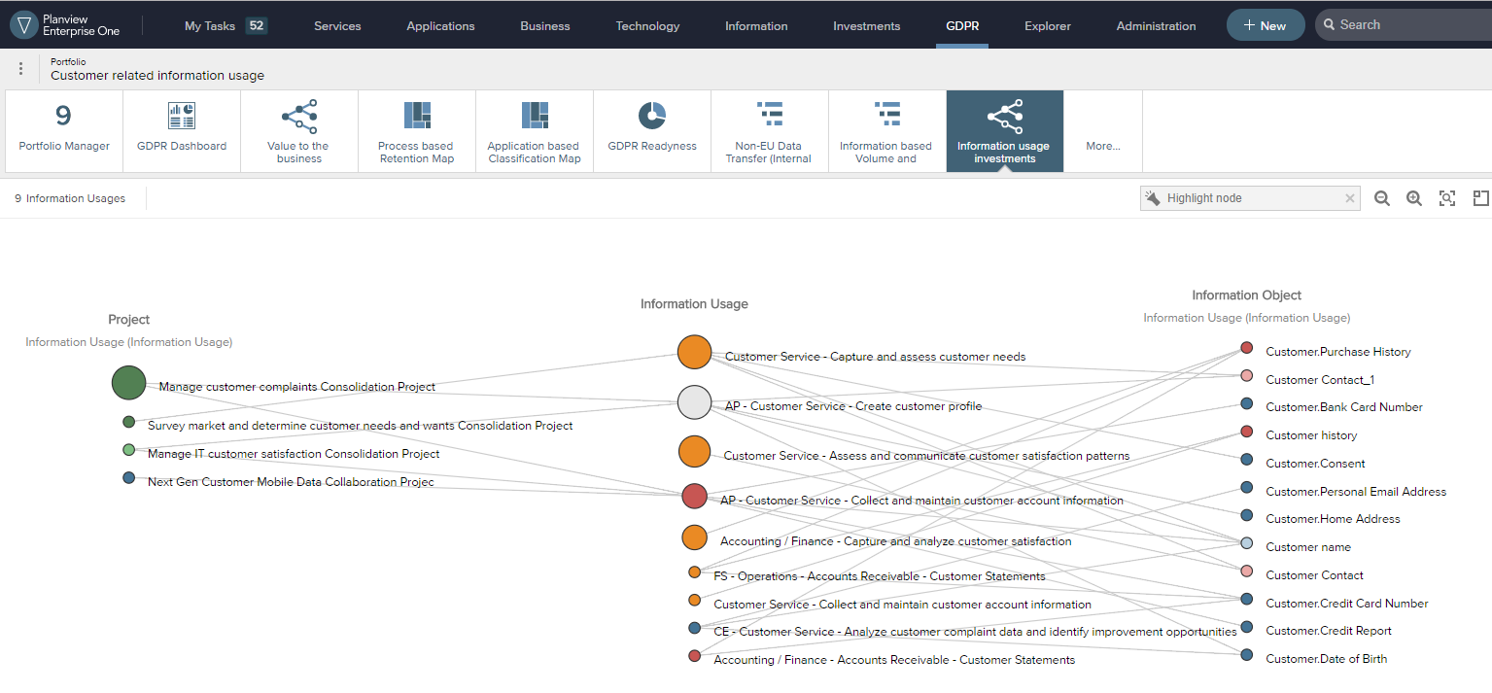
Plan your program and set privacy by design General Data Protection Regulation
Your GDPR program, will create a lot of IT initiatives from data consolidation, through system integration and new services offering.
Plan your projects in relation with their outcomes, execute your projects and make sure you will achieve your objectives with a WRM (Work and Resource Mgt) approach.
Make sure the privacy by design is followed, integrating systematically in your Project Mgt Process the information assessment through our governance workflow.

Slide 20
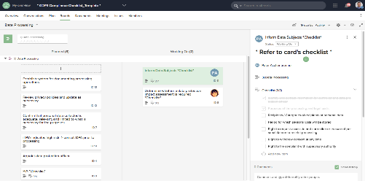
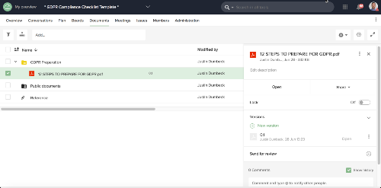
Organize GDPR Teams with Collaborative Work Management
What activities support the GDPR implementation timeline?
What is the status of the GDPR team’s activities?
What documents support GDPR activities?
Notes:
Organize cross-functional teams to more effectively collaborate and drive your GDPR initiative

Slide 21
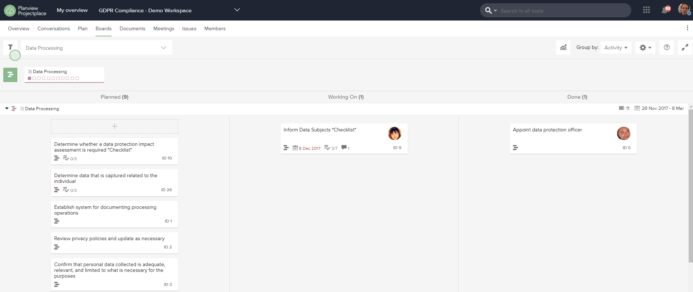
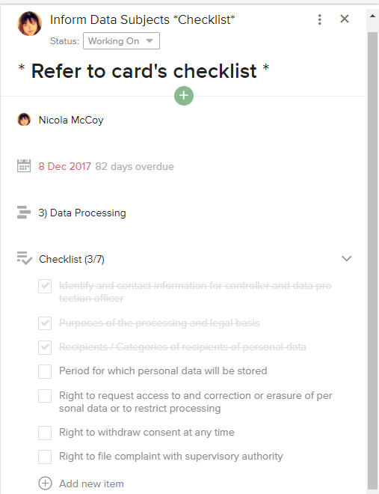
Simply track and organize your GDPR team actions General Data Protection Regulation
Project place is a collaborative portal where you can assign people to tasks and use a simple Kanban approach to get things done.
Showed here is a task assigned, which has a check list with all the information your company must provide to a subject regarding his data.
You’d better get prepared to be able to provide these!

Slide 22
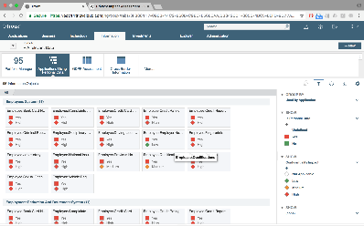
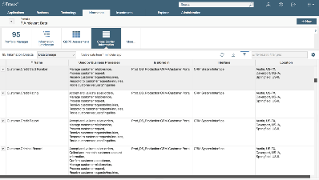
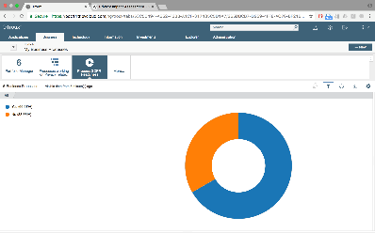
GDPR Data Mapping & Categorization
What business processes involve privacy relevant data and where is the data processed?
Which applications process privacy protected data elements?
Where is privacy relevant data stored and processed? Stored / shared outside the EU?
How many business processes have been assessed for GDPR compliance?
Notes:
2. Map and categorize GDPR-related information

Slide 23
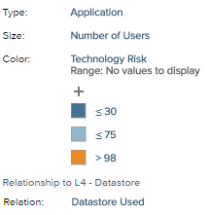
Logical data interdependencies Information rationalization use case – Physical layer
Where is the data stored?
As a first indication to consolidate your information assets, get to understand where the data is physically. How important are these physical data assets for the application landscape?
In this example, we can see each logical data are used by different applications. The size of the application shows the number of users. This can help for instance to understand which logical data is the most needed by the company.

Slide 24
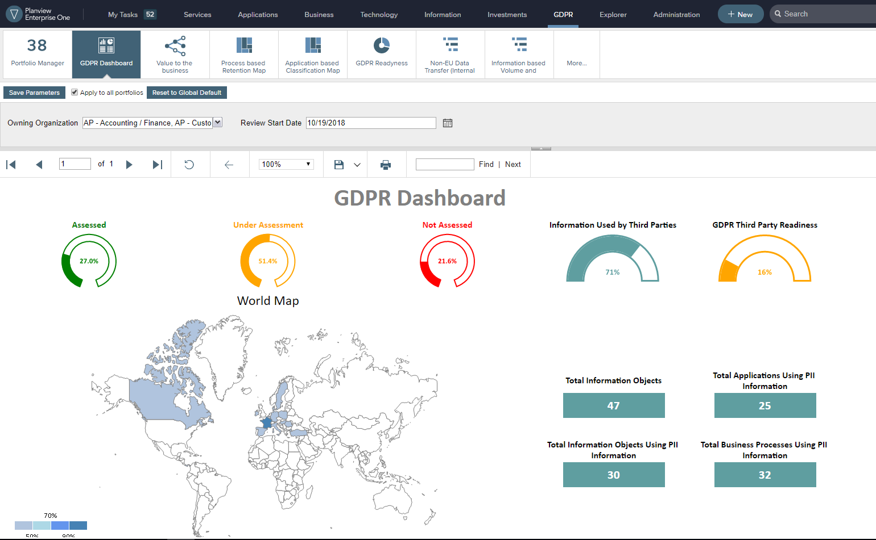
GDPR reporting General Data Protection Regulation
Get a quick report to share with your auditor on how compliant you are with the General Data Protection Regulation.
This preconfigured dynamic report gives you a global insight , but also per country on your maturity and some critical indicators on the private information your company is processing.
It is exportable in various format of document to be shared outside the system.

Slide 25
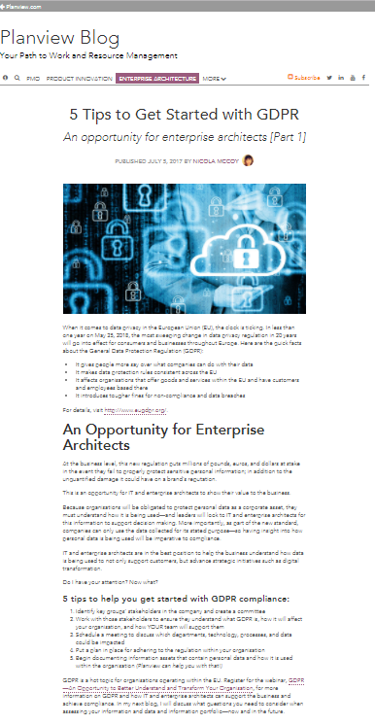
Next Steps . . .
Visit us at Planview Stand #42 at Project Challenge to find out more information on how we can help you
Get the Solution Brief on Get Ready for GDPR Compliance
Read: Planview Blog – 5 Tips to Get Started with GDPR
Visit: http://www.planview.com/articles/gdpr-compliance/
Notes:
Thank you Nicola ….. Great presentation.
So before we go into Q&A - and to give you a few minutes to send in your questions. I would like to talk about next steps for you to learn more about Planview solutions.
Visit Planview.com for more info and resources
Read Nicola’s blog on - 5 tips to get started with GDPR (part 1 in the series)
Any questions, email Esther Porter-Quinn at epquinn@planview.com
So now its time for some questions.

Slide 26
Thank You for Listening
Nicola McCoy
www.planview.com
infouk@planview.com

