Slide 1
Agile Project Management Why has it become so popular? How can you get the most from it!
Keith Richards (CEO)
www.agilekrc.com

Slide 2
Presentation Structure
Introductions
‘Agile Project’ is what exactly
Advantages and disadvantages
Things to get right
Risk areas
Further information
Close and questions.

Slide 3
Introductions
CEO of agileKRC
20 years of experience with agile
agileKRC is a pioneering company at the forefront of agile thinking
Specialising in all things agile (PRINCE2 Agile, Scrum, Kanban, Lean Startup, DSDM, AgilePM, everything!)
Training, Consultancy, Coaching and People
Lead author for the PRINCE2 Agile product from AXELOS
‘Lead author’ for DSDM (now known as AgilePM)
IAF Accredited / APMG Certified Facilitator
Author of ‘Agile Project Management’ (TSO)
Voted ‘Most Valuable Agile Player’ UK Agile Awards.

Slide 4
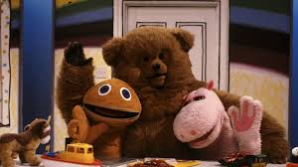
Is ‘Agile Project’ an oxymoron?
This may seem pedantic, but…
…do ‘Agile Projects’ exist?
Binary thinking is not helpful here
See it as a spectrum
Always think ‘how much’?
…and not ‘yes’ or ‘no’
‘not waterfall’
‘Projects in an agile context’
Agile Project Manager?
#agilepm

Slide 5
Agile operates in different contexts
Project Environment
Product Environment
Strategic Vision/Programme
Project Governance
Project Management
???
Projects
Complicated/Difficult
Unique(ish)
Temporary
Requires management
Scrum = can’t do it all
BAU
Routine
Enhancements
Simple
Scrum = very good

Slide 6
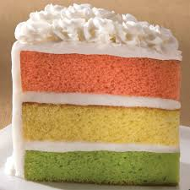
The best form of integration
‘Blend and weave’
Do not ‘bolt it on’
Use words like:
Configure
Tailor
Integrate
The ‘orange and yellow stuff’ needs to be agile too!
Does the Sponsor understand agile?
This is different, but not that different!
#agilepm

Slide 7
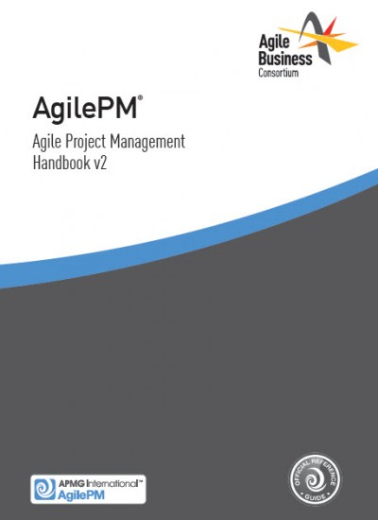
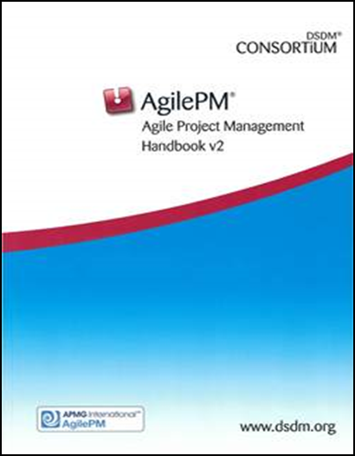
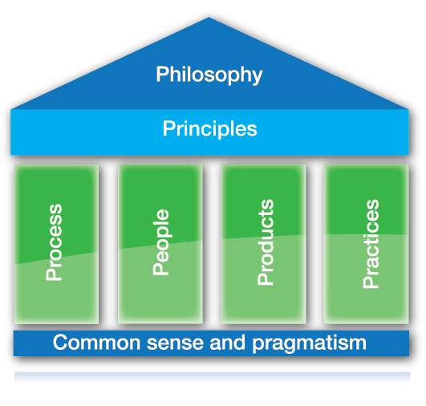
AgilePM/DSDM - basics
Created in 1995
Revived in 2006
16,000+ exams in 2017
Accredited by APMG
DSDM Consortium is now the Agile Business Consortium (ABC)
Blue is behaviour
Green is mechanics
www.agilebusiness.org

Slide 8
Why is it popular? How to get the most from it!
Satisfies a need
We need agile projects
We need a brand/product we can trust
Use it carefully
Stick to the basics
Avoid the ‘magical stuff’
Think holistically.
#agilepm

Slide 9
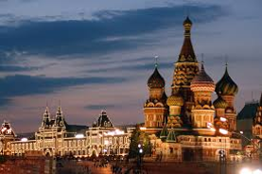
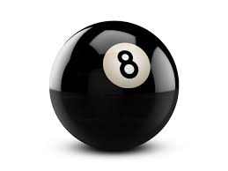
AgilePM/DSDM - advantages
In 1995 it was so far ahead of its time!
Timeboxing and MoSCoW (Dai Clegg)
Roles and Responsibilities
Great coverage of the customer roles
The 8 Principles
The 2 triangles
Three views of the project
Business, Technical and Management
Naturally references the delivery teams.

Slide 10
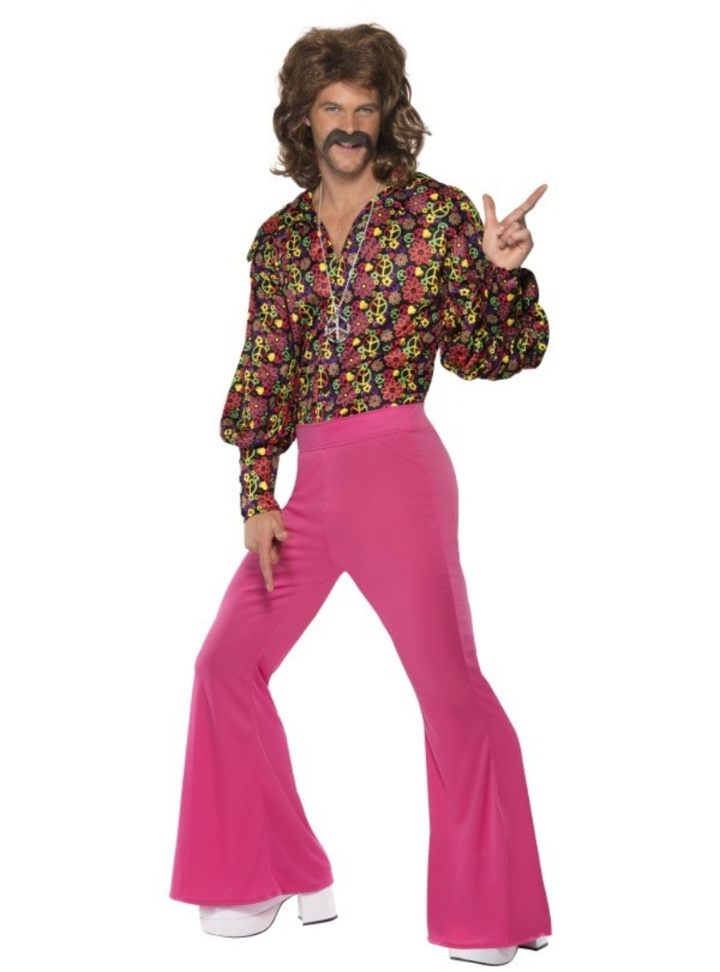
AgilePM/DSDM - disadvantages
Somewhat dated
Light on agile techniques
Products guidance is indecisive
Some legacy issues
Structured timebox
Aimed at Business Systems
Lifecycle diagram
Updated version on the way!
#agilepm

Slide 11
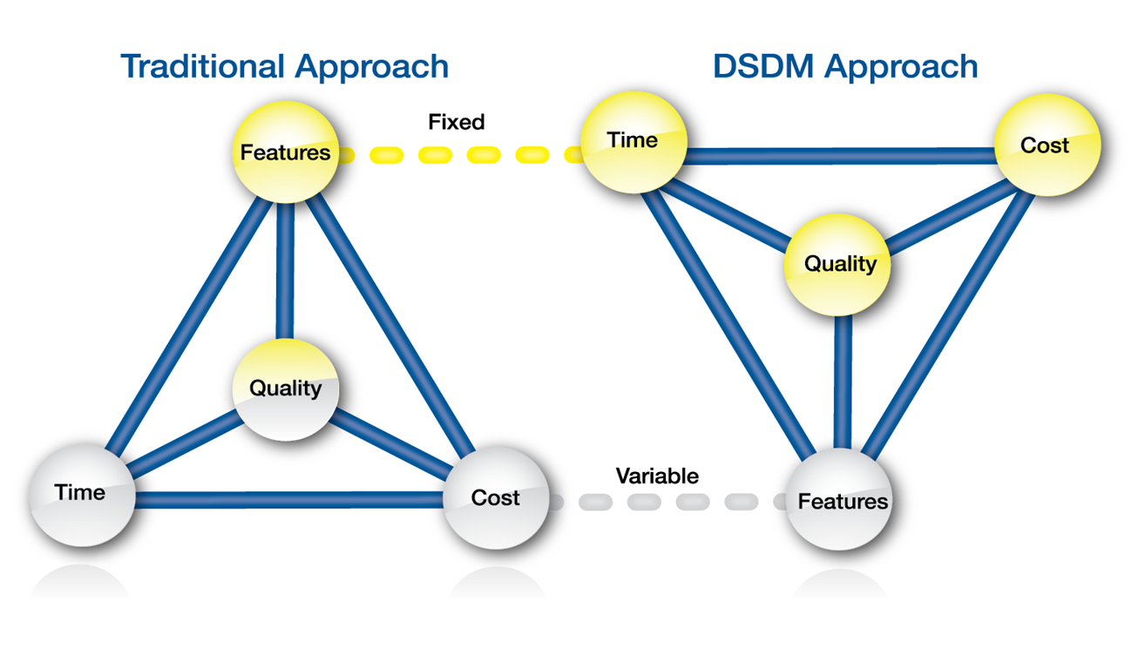
AgilePM/DSDM – what to get right
Business roles and engagement
Timeboxing – an art and a science
MoSCoW in the real world
Behaviours
PM basics
Enough and no more!
Is it safe to move on?
Do you get the
idea behind TQCS?
#agilepm

Slide 12
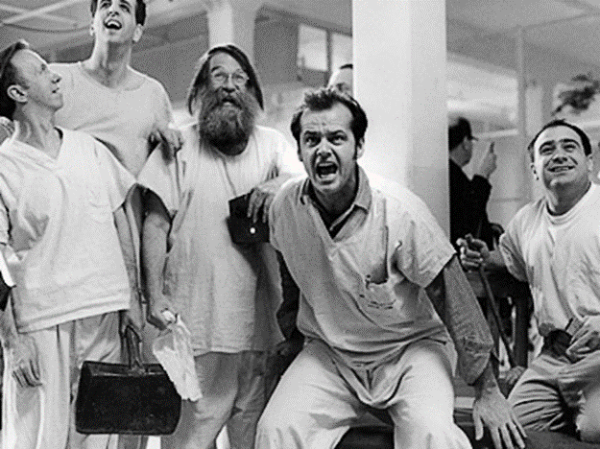
AgilePM/DSDM – the risk areas
The 8 principles
Zealots and tree-huggers
Misunderstanding the word ‘control’
Rushing the start
Governance of the wrong thing!
Lack of discipline
The tail wagging the dog!
#agilepm

Slide 13
The perfect marriage?
Agility, Governance and Control

Slide 14
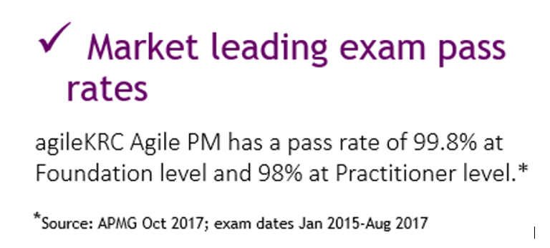
agileKRC can help you!
Quick commercial!
Long running AgilePM schedule
We have supporting collateral
How to pass the AgilePM exam (FREE)
Send us your email and we will send you the information – mention Project Challenge.
#agilepm

Slide 15
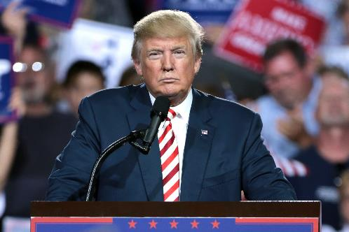
Further Information / Next Steps
Visit www.agilekrc.com for free RESOURCES and our BLOG
Home of the very popular ‘Agile’s Fake News’ Blog
Visit our YouTube channel ‘agileKRC’
Join ‘The Agile Projects Forum’ on LinkedIn
Follow us on Twitter @agilekrc
Link with me on LinkedIn
Next AgilePM courses: 5th and 19th November 2018 (London)
10% and 20% Early bird discounts in place
We limit our courses to 12 delegates
For groups – contact us for in-house prices.

Slide 16
Agile Project Management Any questions?
k.richards@agilekrc.com
www.agilekrc.com
#agilepm

