Slide 1
MSP it’s not just ‘big’ project management
John Edmonds
PPM Portfolio Development Manager

Slide 2
SETTING THE SCENE
Programmes – and MSP
What I think they are…
…and another view
Benefits of MSP

Slide 3
A QUICK POLL
Practitioner plus
Little bit of knowledge
MSP?

Slide 4
PORTFOLIOS, PROGRAMMES, PROJECTS
The PPM Portfolio
MoP Managing the Portfolio
MSP Managing Programmes
PRINCE2 Managing Projects

Slide 5
PROGRAMMES – THE MSP VIEW
Delivering outcomes and benefits
Co-ordinating projects/activities
Related to
Strategic objectives

Slide 6
PROGRAMMES – ANOTHER VIEW
“The practice of grouping and coordinating related projects”

Slide 7
OUR RESEARCH
Testing the hypothesis that:
Programme management is seen as the management of many related projects
“…is the process of managing several related projects…”

Slide 8
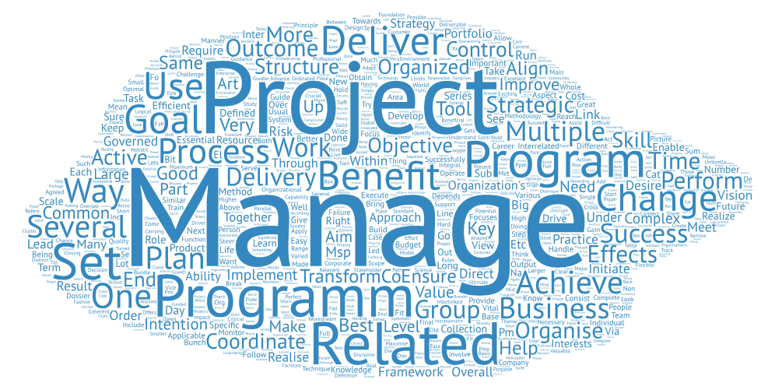
KEY PERCEPTIONS
projects
management
managing
related
programme
program
change
project
multiple
business

Slide 9
KEY PERCEPTIONS
Program management or programme management is the process of managing several related projects
A programme is made up of a specific set of projects
Participants will also be able to coordinate the projects of a programme to ensure the correct application of resources and risk, issue and change management.
provides a structured framework to co-ordinate, direct and implement the projects

Slide 10
THE PATH TO VALUE
Project Outputs
Capabilities
enable
build
Outcomes
trigger
Organizational Changes
enable
realize
Benefits
helps achieve
Corporate Objectives and Value

Slide 11
BUT THERE’S MORE…
What if we consider a programme to be more, far more?

Slide 12
TRANSFORMATIONAL CHANGE
It’s about delivering successful, transformational change
Most organizations are looking to transform their business – KPMGs global study, “Succeeding in Disruptive Times” in 2016 found that 96% of organizations are in some phase of transformation

Slide 13
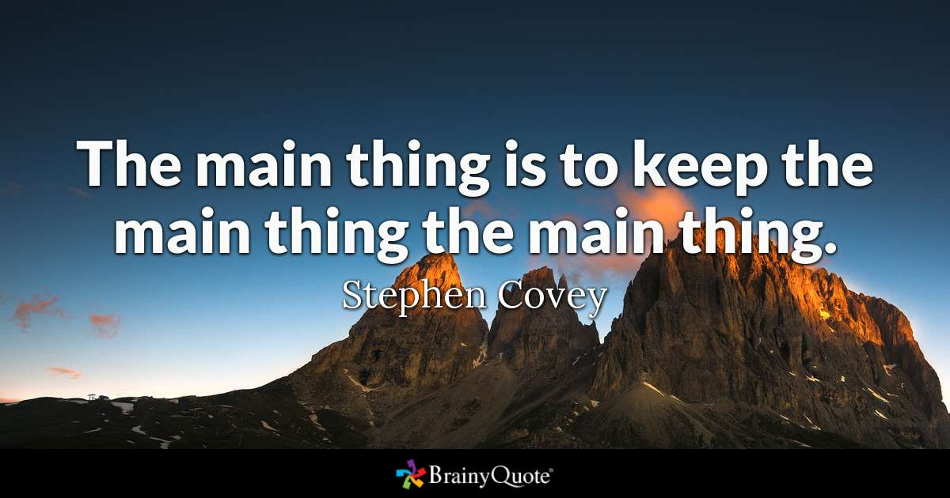
BENEFIT REALIZATION

Slide 14
VISION AND BLUEPRINT
Vision Statement: communicates the End Goal
Blueprint: a model of the future organisation

Slide 15
THE BUSINESS CHANGE MANAGER ROLE
A key role that goes ‘beyond’ the programme
Real organizational ‘ownership’
The antidote to ‘old world’ project management

Slide 16
LEADERSHIP & STAKEHOLDER ENGAGEMENT
Engaging stakeholders – everyone says they do it…
The essential role of leadership in transformation

Slide 17
SUMMARY
MSP – proven good practice in programme management and delivering successful transformation
Programmes are not fully understood
MSP not fully utilised
Only 47% of executives say they will achieve value from business transformation.
Some sources suggest as many as 84% of organizations fail at transformations

Slide 18
MSP: it’s not just ‘big’ project management QUESTIONS
john.edmonds@axelos.com

