Slide 1
Neither shaken, nor stirred… ‘The perfect cocktail for project professionals’
Want to know more?
Register on stand 111 for free e-learning for
PRINCE2®, MSP®, APM, PRINCE2 Agile®, AgilePM® and ITIL®

Slide 2
Agenda
Portfolio, Programme and Project
Management Best Practice
Overview of partner organisations in the PPM community
Portfolio, Programme and Project Management (PPM) Framework
How other methods and approaches interact with PPM

Slide 3
Who’s Who
Method Owners
Accreditation and Exams
Accreditation and Exams
Accreditation and Exams
Accreditation and Exams
Accreditation and Exams
Accredited Training

Slide 4
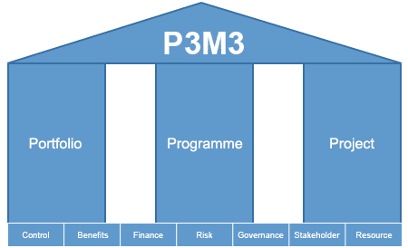
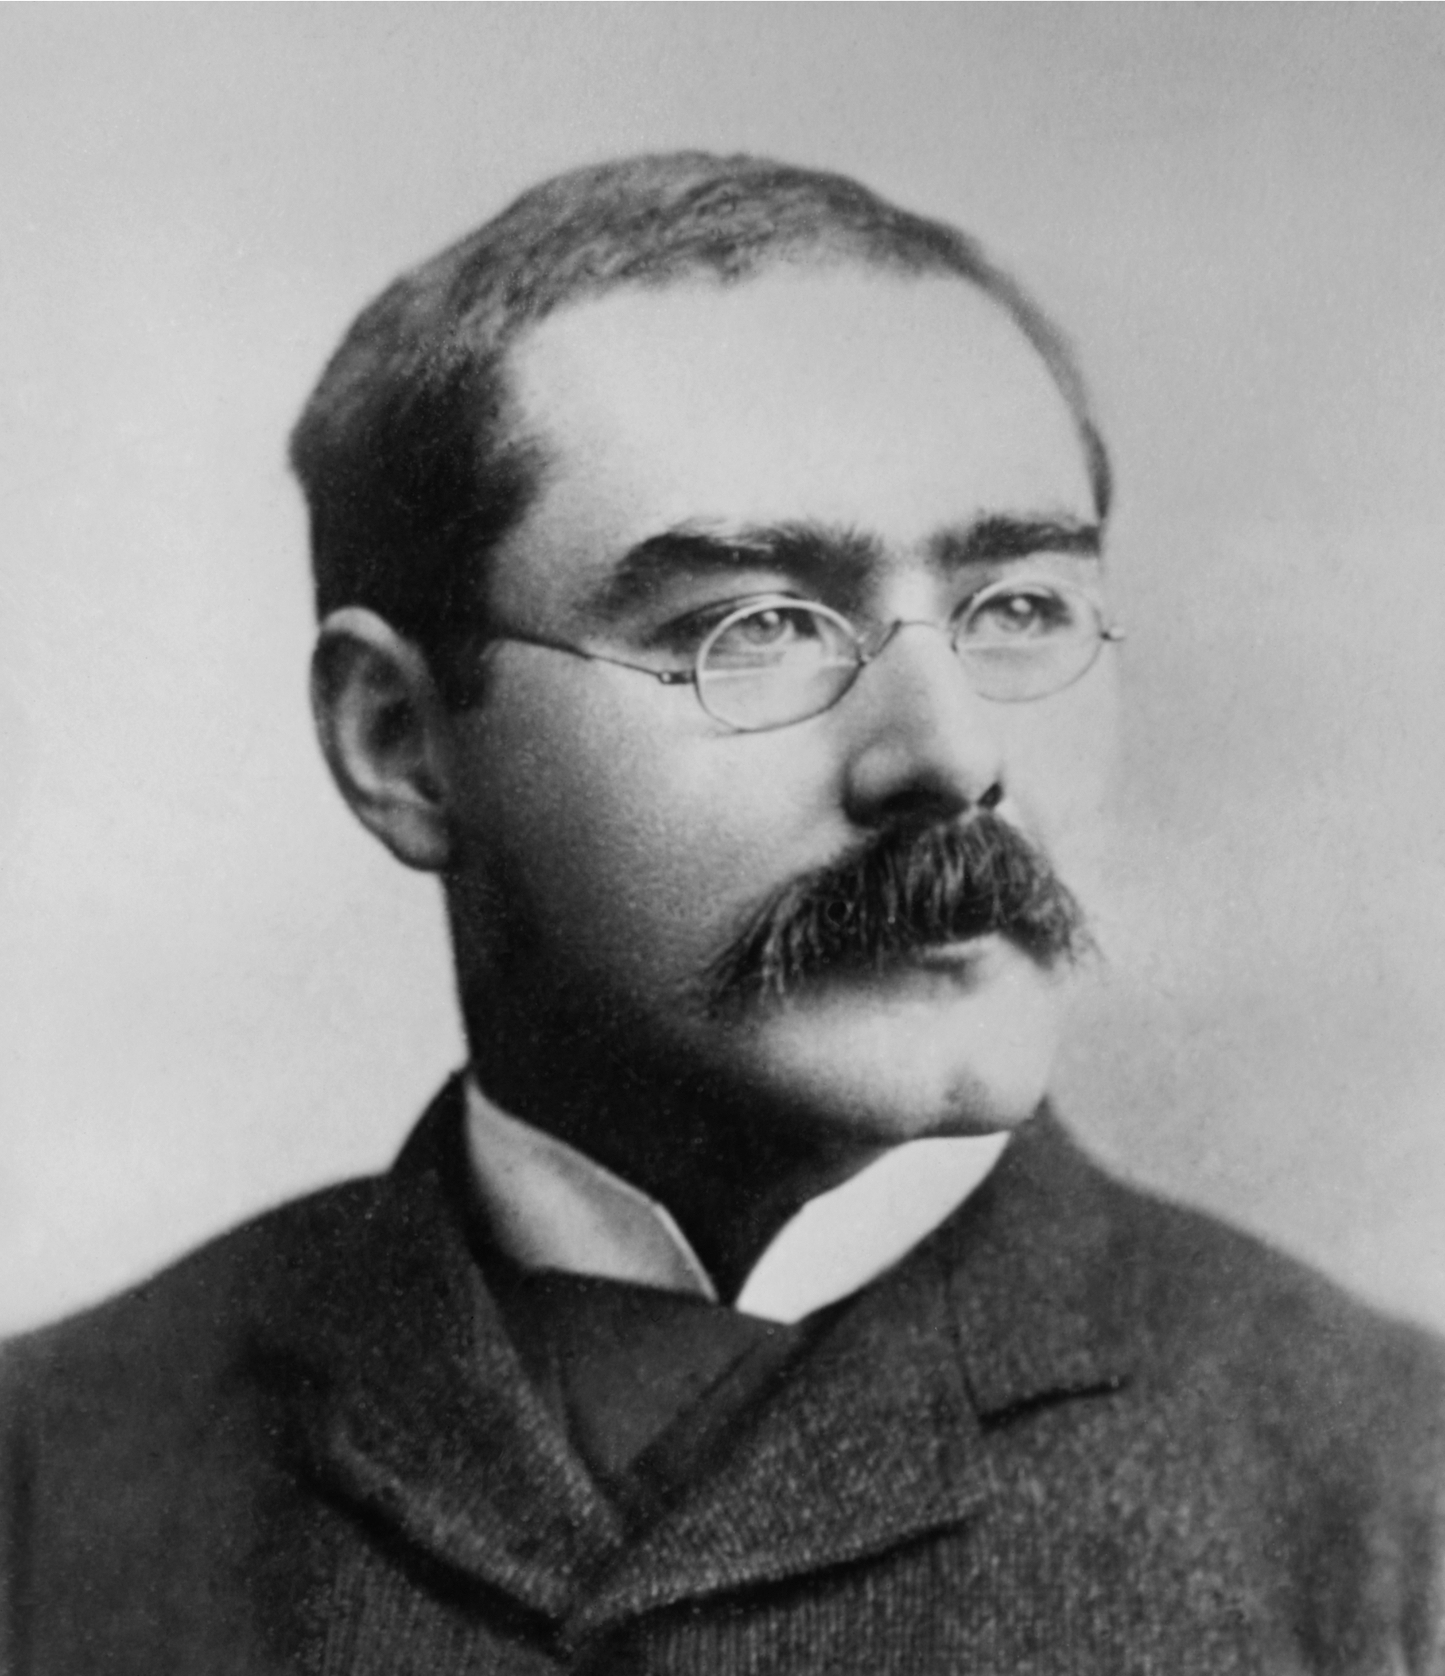
Portfolio, Programme & Project Best Management Practice
Portfolio management addresses the fundamental questions:
Are we doing the right things?
Are we doing these things right?
Most significantly, are we realising all the benefits in terms of more effective services and efficiency savings from the changes we are implementing?
MoV®
Management of Value®
M_o_R®
Management of Risk®
Change
Management
P3O®
Programme & Project Offices ®
BBC®
Better Business Cases
MoP® - Portfolio Management
Programme Management enables you to align and co-ordinate projects within a programme of business change so that you can effectively support specific business strategies.
MSP® - Programme Management
PRINCE2® - Project Management
Project Management is the application of processes, methods, knowledge, skills and experience to deliver outputs in order to achieve the project objectives.
APM / PMI / IPMA
Project Management Body of Knowledge (techniques)
PRINCE2 Agile®
Agile - (development)
Scrum, DSDM, Kanban, Lean, etc.
AgilePM (PM Development)

Slide 5
Why SPOCE?
Of the most influential and respected training companies in the industry.
1st to be accredited for PRINCE2®
1st to run a PRINCE2® course
1st to run an MSP ® course
1st PRINCE2 ® and MSP ® Practitioner e-learning
1st to run a PRINCE2 Agile® course
1st AXELOS PPM Approved Courseware Provider
1st AXELOS Strategic Partner
1st PRINCE2 Agile® e-learning
True enthusiasts! We deliver our events like it’s the first time, every time!

Slide 6
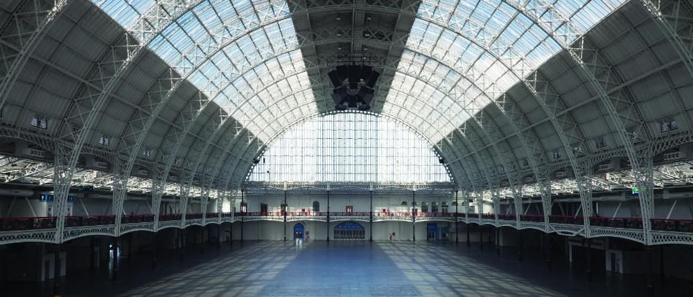
The SPOCE Team are here to help!
www.spoce.com

