Slide 1
Introduction to Agile Change Management
Presenter: Melanie Franklin

Slide 2
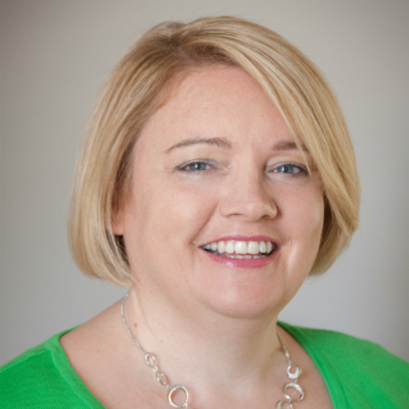
About Melanie…
Track record of excellence in project, programme and
portfolio planning and delivery.
In recent years, Mel has focused on moving organizations
from waterfall to agile approaches in project management.
APMG accredited AgilePM and Change Management trainer
Certified Scrum Master, Certified SAFe 4.0 Practitioner and Lean Kanban Practitioner
Director of Agile Change Management (www.agilechangemanagement.co.uk)
Co-Chair of the Change Management Institute UK chapter
(www.change-management-institute.com)

Slide 3
Business, not project or change professional
Integration and collaboration
Change management professional
Project/Programme professional

Slide 4
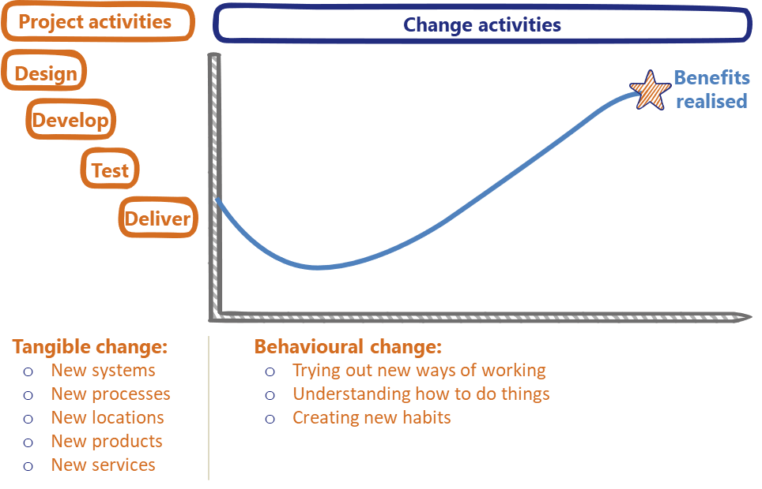
Ideal content of plans: Delivery and Implementation

Slide 5
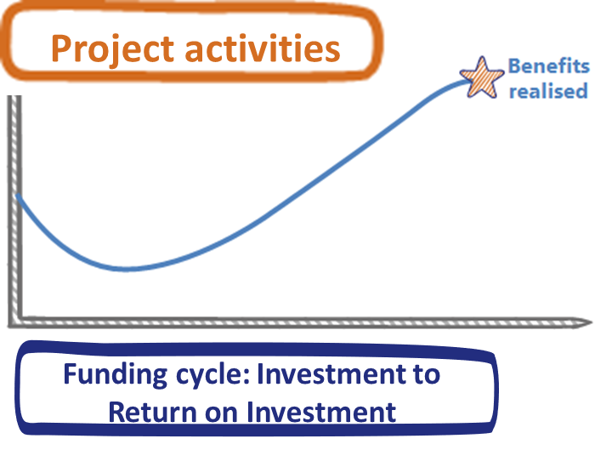
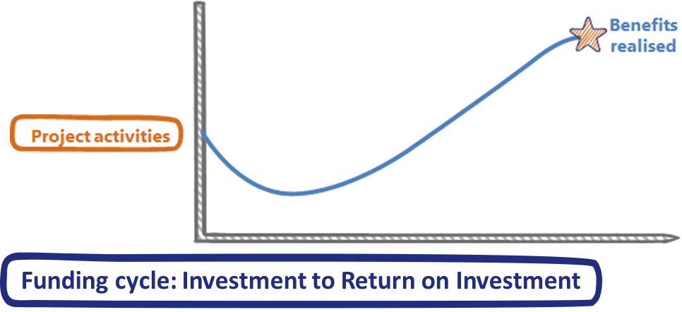
Reduce the funding cycle

Slide 6
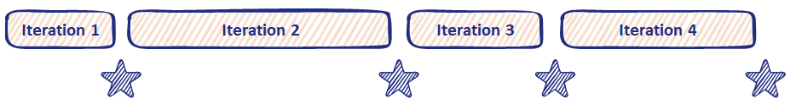




Manage the impact on the business

Slide 7
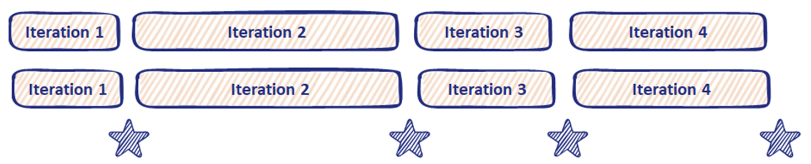
Manage the impact on the business

Slide 8
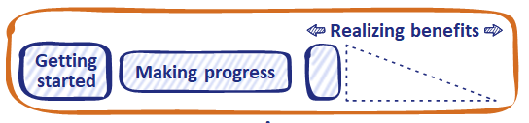
Delivery in isolation from the business leads to pressure
Iteration 2
Iteration 3
Iteration 4

Slide 9
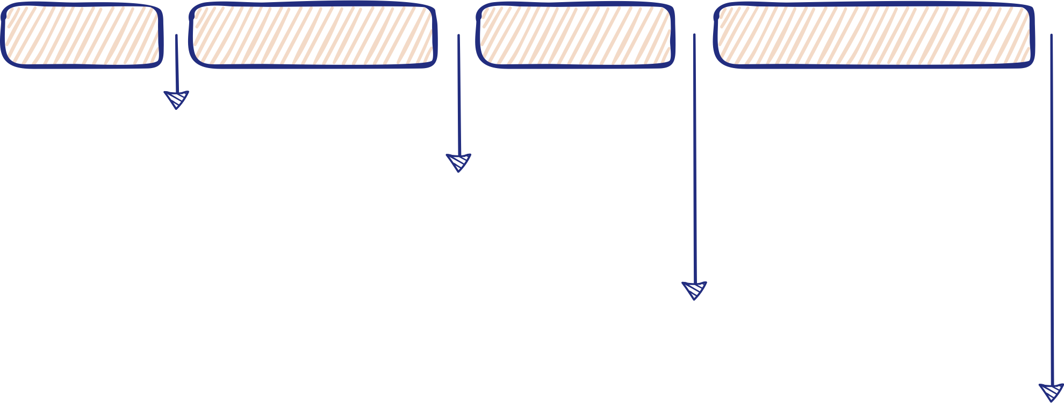
Delivery + Implementation = New way of working
Iteration 1
Iteration 2
Iteration 3
Iteration 4
Agreement on how the change will be managed
New way of working
New way of working adding changes from Iteration 4 to those implemented at the end of Iteration 3
New way of working, building on the approach at the end of Iteration 2 and adding in changes created in Iteration 3

Slide 10

Importance of on-time delivery
5 weeks
10 weeks
15 weeks
20 weeks
25 weeks
It. 1
Iteration 2
Iteration 3
Iteration 4
Iteration 5
Milestone:
Scope agreed
High level plan
Milestone:
Data transfer plan
Process identified
Milestone:
Transfer data
Create new processes
Milestone:
Roll-out
1st wave
Milestone:
Roll-out across
whole organization

Slide 11
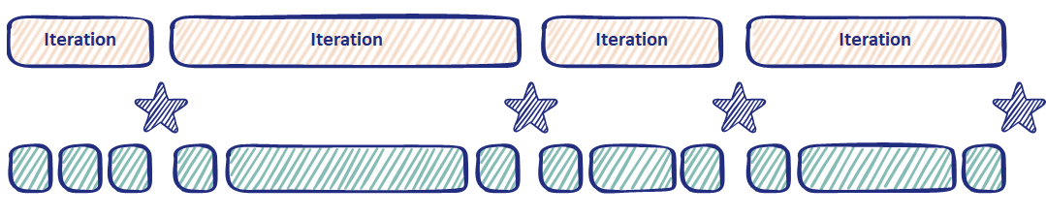


Simple, repeatable plan
Getting Started
Making Progress
Realising Benefits
Milestone

Slide 12


Simple, intuitive structure
Getting Started
Making Progress
Realising Benefits
  Getting started – 10–20 per cent of the timeframe
  Making progress – 60 per cent of the timeframe
  Realising benefits – 10–20 per cent of the timeframe

Slide 13
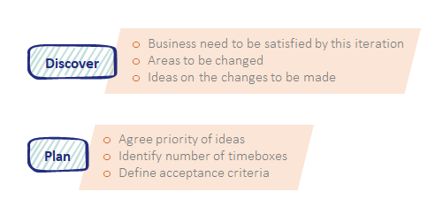
Getting started

Slide 14
Making progress

Slide 15
Realising Benefits

Slide 16
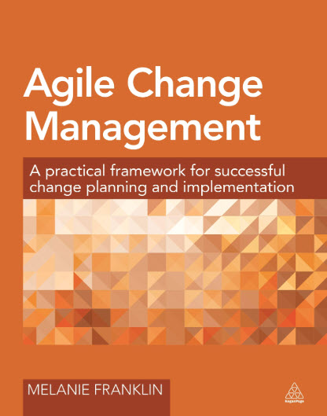

Find out more….
https://apmg-international.com/product/agile-change-agent

Slide 17



Further resources
melanie@agilechangemanagement.co.uk
https://www.linkedin.com/in/melaniefranklin1
@AgileMelanie

