Slide 1
Real-time control of project performance from the front-line to the Board
Sean Blencowe, Sylvia Sciuchetti
26-Sep-2019

Slide 2







Achievements
Elapsed time to build the monthly Board report pack reduced from 10 days to 1 day
Sustainable savings of over £4m pa from Project Excellence
Effort to maintain data quality and build reports reduced by 97%
Data integration & Reporting from requirements analysis to globally live in 35 countries with full engagement in <4 months
Began with 100 projects, on route to >2,000
Gains unlocked without expensive & risky disruption. Cross-functional governance moved to real-time

Slide 3
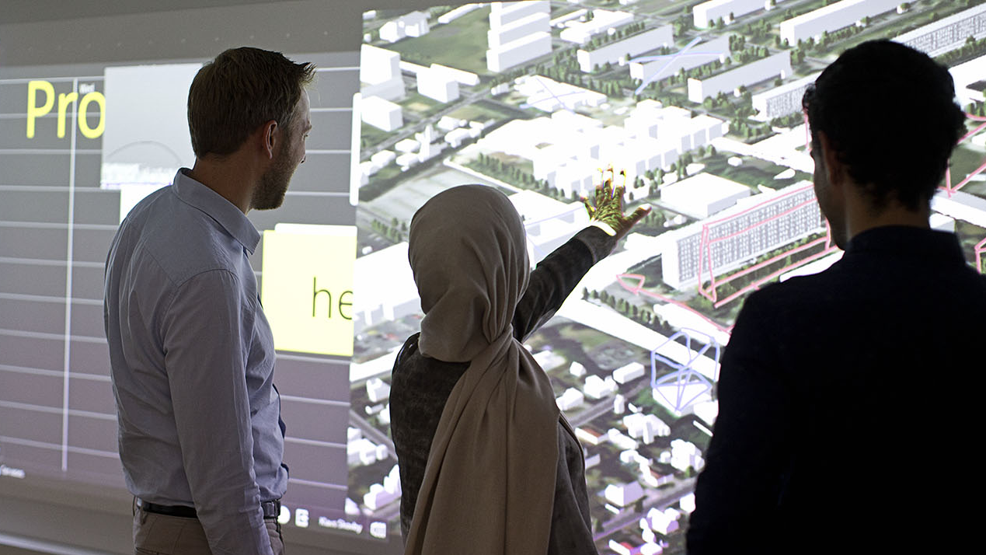
Ramboll in brief
  Independent engineering and design consultancy and provider of project management consultancy
  Founded 1945 in Denmark
  15,000 experts
  Close to 300 offices in 35 countries
  Particularly strong presence in the Nordics, the UK, North America, Continental Europe, Middle East and Asia Pacific
  EUR 1.5 billion revenue
  Owned by Rambøll Fonden – The Ramboll Foundation
Notes:
Ramboll in brief
Ramboll is an international engineering and design consultancy and provider of management consultancy to both the public and the private sector.
Ramboll was founded in 1945 in Denmark
We employ 15,000 experts and work from more than 300 offices in 35 countries
Global presence with a particularly strong presence in the Nordics, the UK, North America, Continental Europe, Middle East and Asia-Pacific.
Our turnover in 2018 was approx. 1.5 billion EUR
We are owned by the Ramboll fonden. This means that our activities are independent of any external or personal interests. We have no ownership or financial ties with contractors or suppliers.

Slide 4
Markets
BUILDINGS | TRANSPORT | WATER | ENVIRONMENT & HEALTH | ENERGY | MANAGEMENT CONSULTING
Revenue ‘18: 496.6 m€ Employees: (FTEE) 4,499 | Revenue ‘18: 351.4 m€ Employees: (FTEE) 2,853 | Revenue ‘18: 84.4 m€ Employees (Jan ’19): (FTEE) 940 | Revenue ‘18: 365.7 m€ Employees (Jan ’19): (FTEE) 2,443 | Revenue ‘18: 162.9 m€ Employees (Jan ’19): (FTEE) 1,821 | Revenue ‘18: 62.7 m€ Employees: (FTEE) 436
PLANNING & URBAN DESIGN
Revenue and employee numbers included in the other markets
Notes:
Markets
We provide services across the seven markets: Buildings, Transport, Planning & Urban Design, Water, Environment & Health, Energy and Management Consulting.
When we work on projects, we combine our capabilities in whichever way benefits the project result.
*NB: this overview shows the number of employees in FTEE (Full Time Employee Equivalents), and does not reflect the actual head count.

Slide 5
Ramboll’s Mission with Major Projects
Successful projects
Increase customer satisfaction and repeat business
Attract and retain key talent

Slide 6
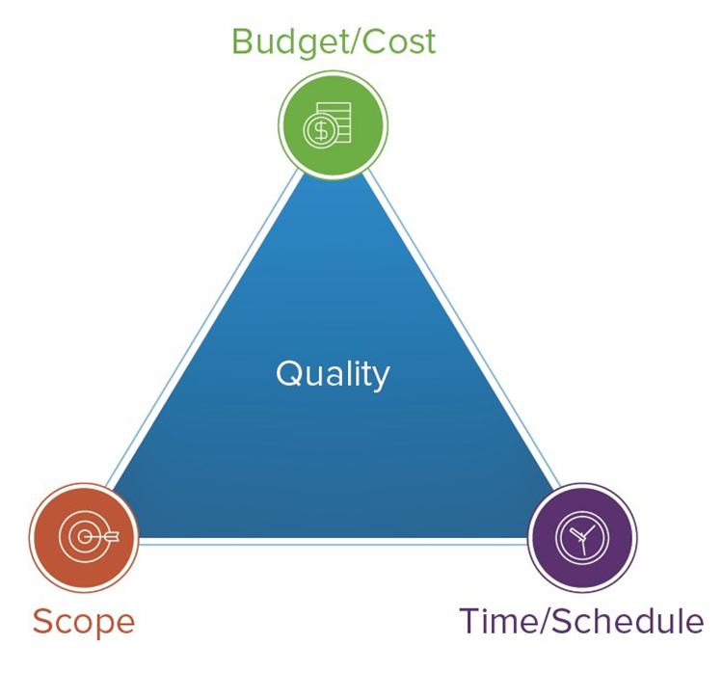
But things go wrong
Project is late
Project does not get completed
Project does not achieve benefits
Project is over budget
Health, safety environment issues
Stakeholder issues
Reputational issues
A high % of large projects fail

Slide 7
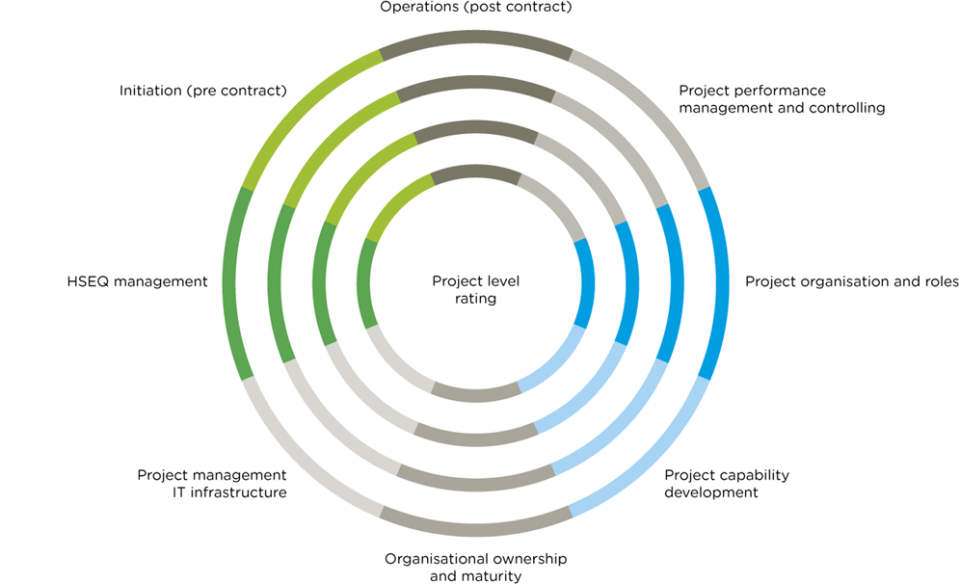
Project Excellence

Slide 8
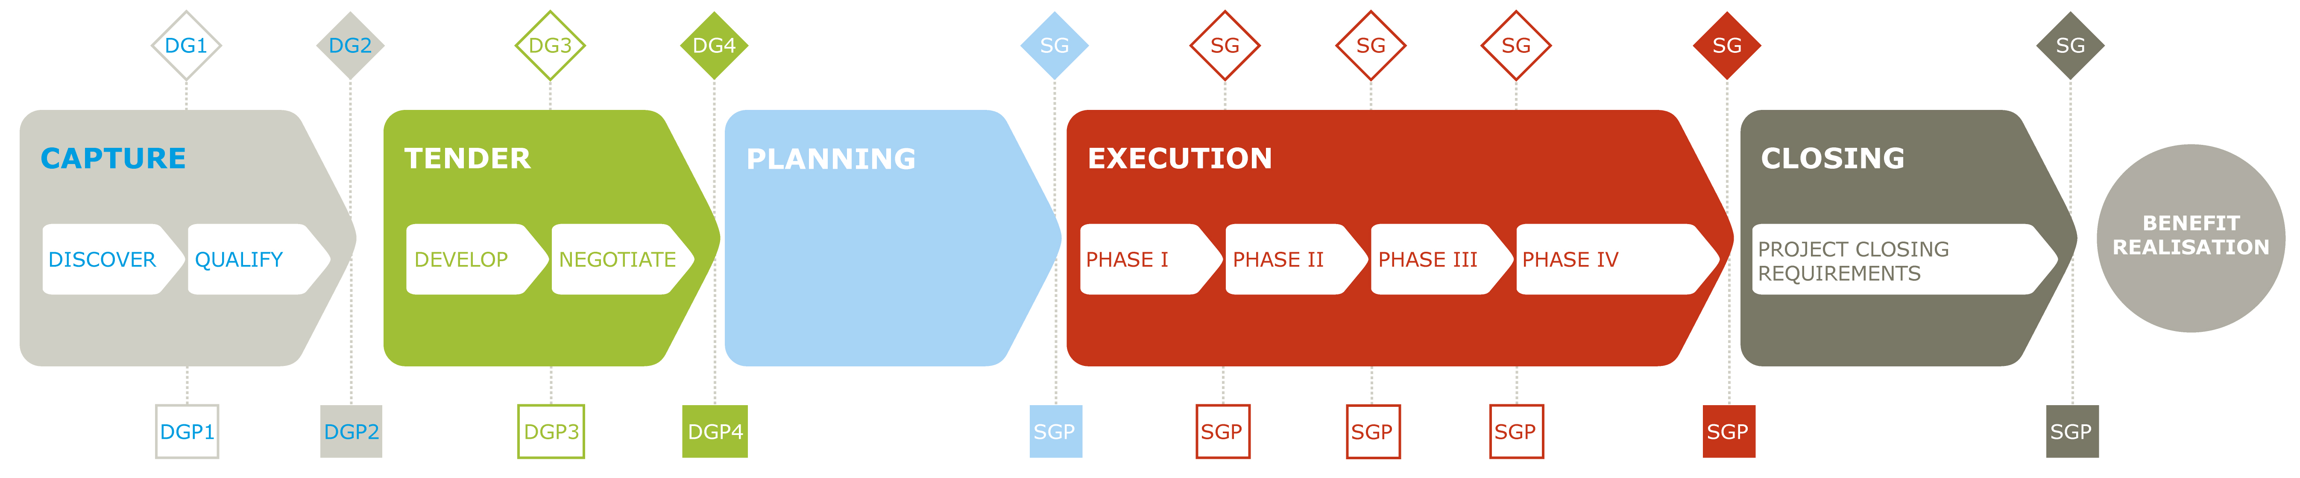
Project Lifecycle

Slide 9
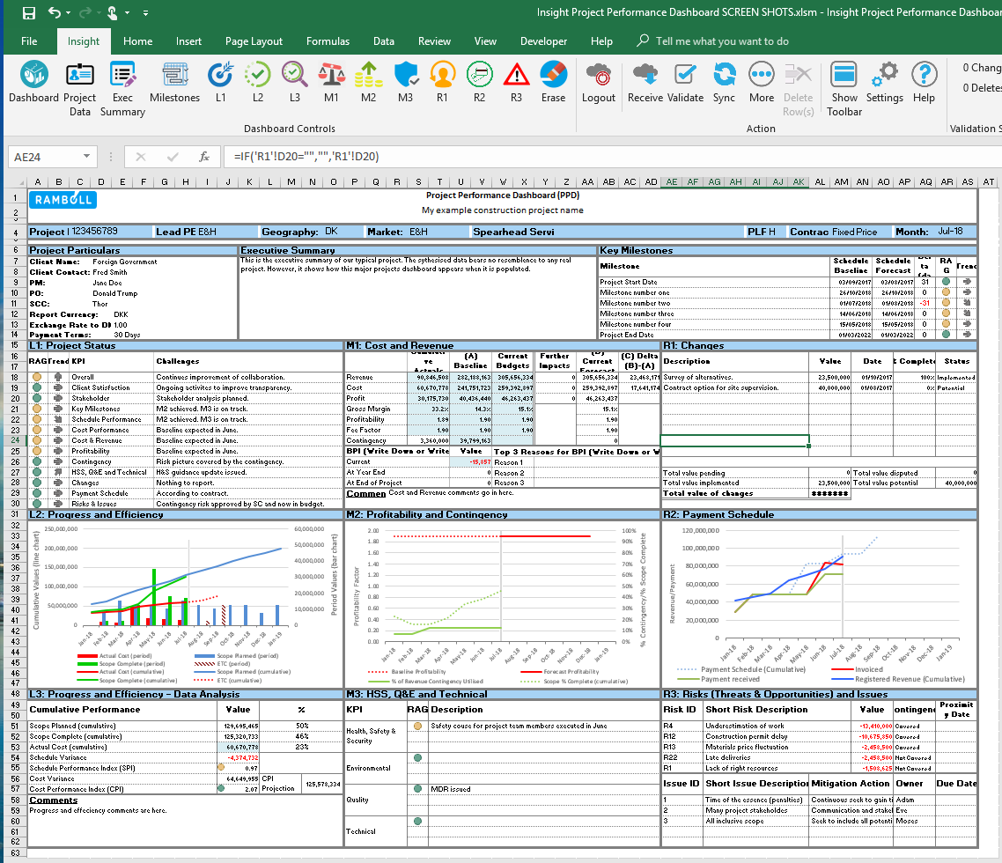
Project performance reporting
Early warning system

Slide 10
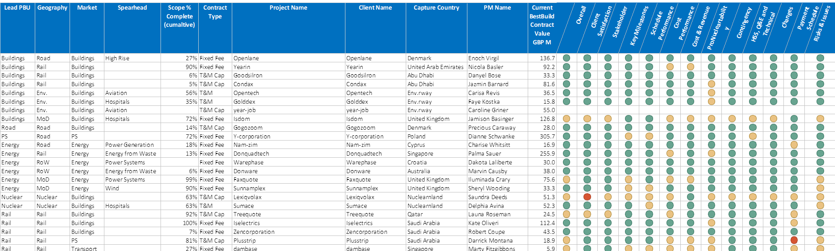
Portfolio Performance Reporting

Slide 11
The Data
Why it’s critical
Why it’s tough to get right
How the problems can be solved

Slide 12

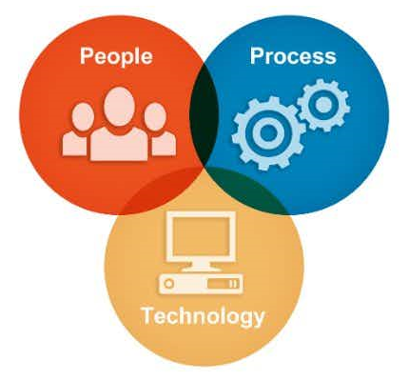
What shape is a typical project?
A: Triangular
Three pillars of governance & control…
…to best manage these competing drivers

Slide 13

Everyone needs to be aligned, so achieving consistently good project outcomes requires good data
Right People
Data
Right Time
Right Format

Slide 14
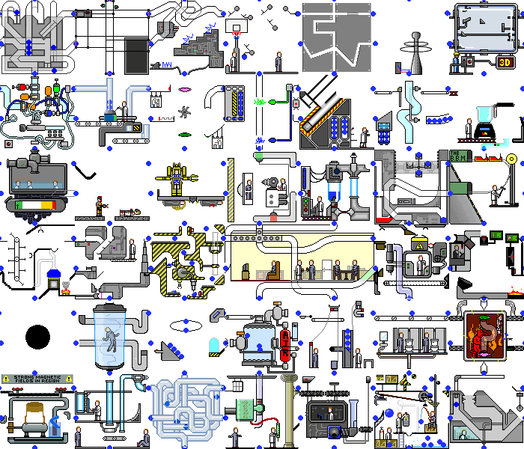





Reality check: Ever changing complexity & uniqueness
Many workflows … tuned to solve evolving challenges.
http://MyApp
http://MyApp
No integrated view for everyone to work with.
http://MyApp
http://MyApp
Technology is failing to come to the rescue.
http://MyApp

Slide 15

So how did we solve the data problems?
http://MyApp
http://MyApp
http://MyApp
http://MyApp
http://MyApp
While you’re thinking, lets look at why this was tough…

Slide 16



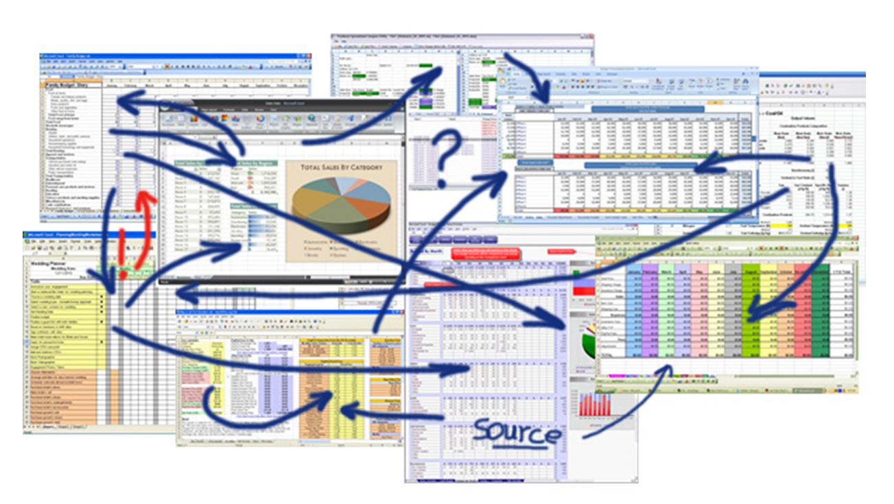







Give me back my life you @*~#@*&!!
I accidentally copied last month’s spreadsheet numbers over this month’s forecast…
Two approaches … neither are sufficient.
Soooo … are they close?
http://PPM
http://HR
http://ERP
http://Finance
The TOP DOWN approach
which imposes a template (often expensive and cloud-based) on every manager, and forces them to cut their management style to fit. This fails for adoption reasons.
The BOTTOM UP approach
which allows managers to report in the way they feel is most appropriate (often Excel™ based). There are no common standards. This fails for organisational reasons.

Slide 17


The TOP DOWN approach : Enterprise IT Vendors
Blue Chip IT suppliers were invited to meet Ramboll’s objectives.
A viable solution was sought, where viable means:
Delivered in reasonable time at reasonable cost
Met needs of all stakeholders from PMs to the CEO
Would encompass all the data needed
Would not inflict extensive business change
A viable solution was not forthcoming.

Slide 18






The BOTTOM UP+ approach
Solution designed with careful consideration for enterprise robustness
Designed by stakeholders, not imposed on them
Supported RAMBOLL’s flavour of ‘best practice’
Dependent on Excel™ - highly familiar & flexible
Project Reporting Dashboard
60+ workbooks
Project Managers
Project Controllers
Project Owners
Project Register
Project Excellence Leads
PMO
Major Projects Portfolio Reports
SME Oversight
PMO
Company Board
C-Suite
Heads of Business Units
Project Controllers
Write-Ups &
Write-Downs
2 x PowerPoint slide packs, exported to PDF.
Business Unit FDs

Slide 19

Early Benefits
Project outcomes consistently improved
Customer satisfaction scores improved
Project costs reduced
Project Managers had a single means to report
SMEs spotted issues early, prompt intervention to help PMs

Slide 20
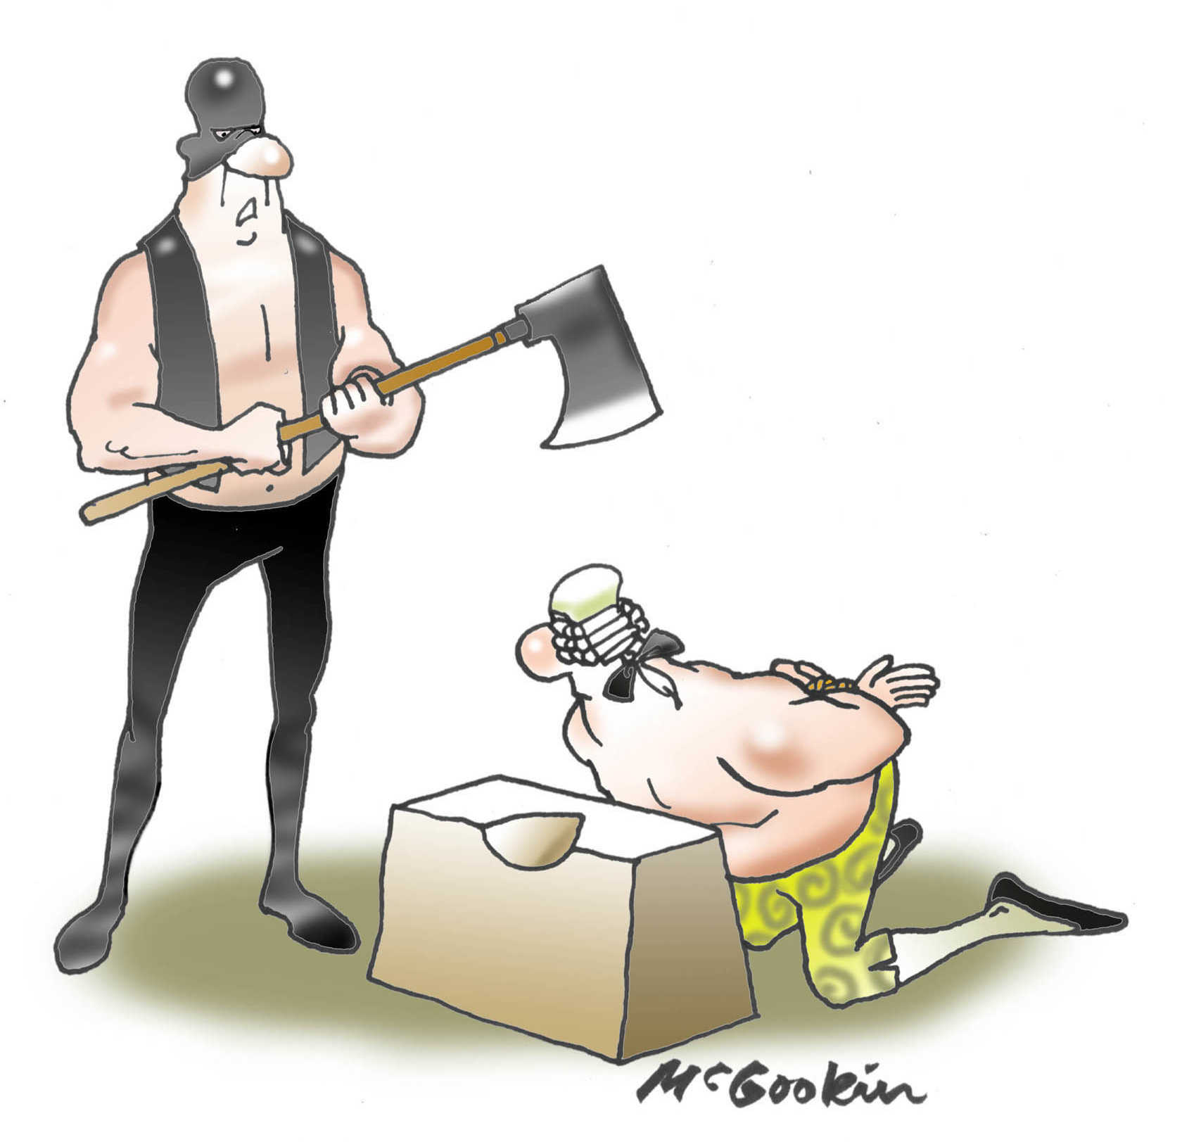
Final hurdle - breaking away from Excel’s major limitations …
Not multi-user
Not scalable
Error prone
Manual, expensive, time consuming
Fragile, vulnerable to corruption and data loss
Not auditable
Property IT Department
Well we did tell you to stop using spreadsheets
How could this be resolved … knowing that big software vendors could not economically fix this problem?

Slide 21
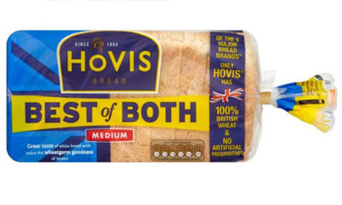
Can we combine the best of TOP DOWN & BOTTOM UP?

Slide 22


Connected Planning
A new, very different way to connect everyone working with projects
Notes:
Question roles of people in the audience: Project Controllers, Project Managers, Exec responsibility for project outcomes.

Slide 23
Connected Planning
http://MyApp
http://MyApp
Enables everyone to work how they want from the same single source of truth.
Moved Ramboll Major Projects Reporting from this…
to this…
http://MyApp
http://MyApp
http://MyApp

Slide 24







Connected Planning
Ramboll applied Insight to enhance and connect their Excel™ spreadsheets.
Flexible and familiar, but now enterprise grade.
Project Controllers
Project Teams
Operations & HR
Finance
C-Suite
A shared, single version of truth in an auditable database
Tools familiar to everyone, all Excel™ retained and all weaknesses overcome
No disruptive IT deployment, Near zero training, Very high stakeholder engagement

Slide 25

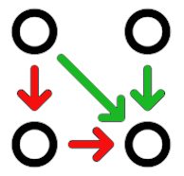



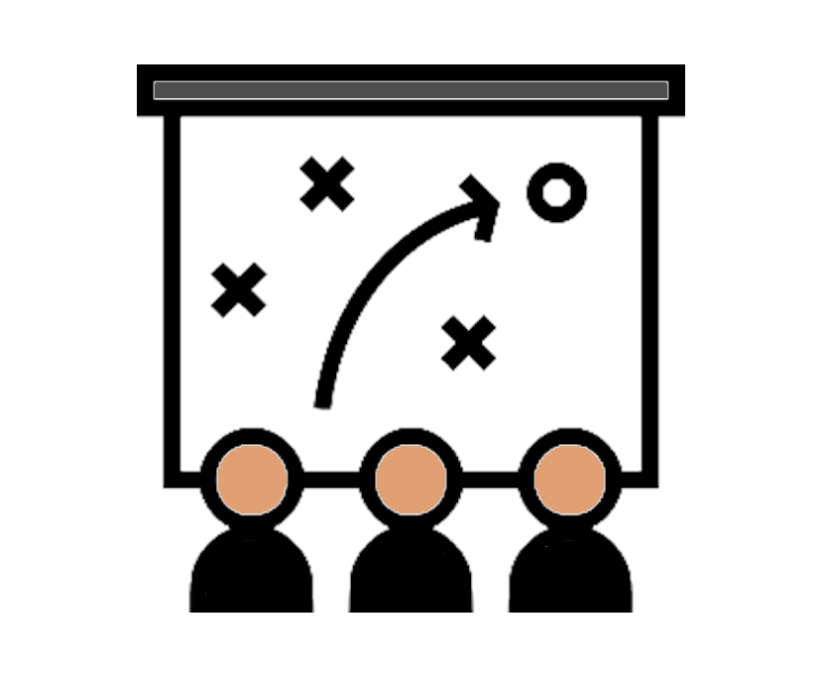



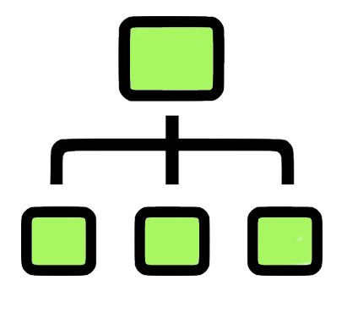
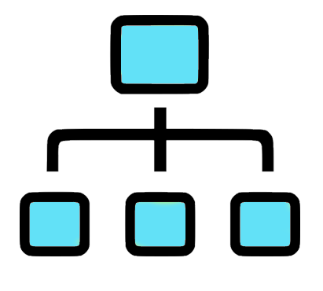



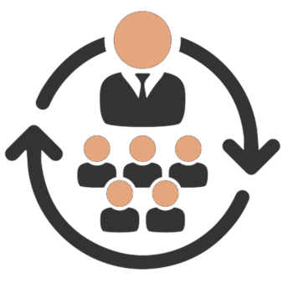



Eight Themes of Connected Planning
Mix ‘n match any themes, connect people with the data across functions and projects.
1
2
3
4
Alignment & Benefits
Costs & Revenues
Risks & Issues
Dependencies
Business Hierarchy
Portfolio Hierarchy
6
Scope & Changes
5
Schedules
Live sync with Excel™ workbooks
Integration with other Apps.
7
Resources
8
KPIs
25
Trends ◄ Status ► Forecast

Slide 26







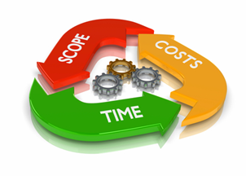



Ramboll gain alignment, in real-time across functions and management levels
Group Executive Board
Business Unit and Programme leaders
Transparency is not always a good thing. Employ cadence, time is needed to ‘get ducks in a row’.
Project teams
Time ►

Slide 27

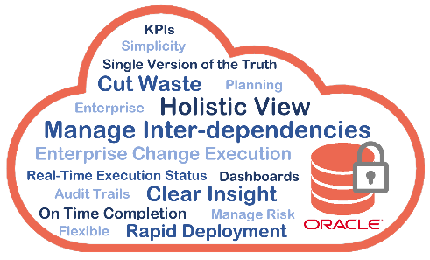

Connected Planning in Ramboll
Insight Automation
Project Dashboard
Major Projects Portfolio Report
Group Board
C-suite
Heads of Business Units
Project Managers
Project Controllers
Operations
Project Register
100+ Projects – will scale to 1,000s
2 x PowerPoint slide packs, exported to PDF.
Project Excellence Leads
Sylvia & team
Write Ups/Downs
Project Register
Major Projects Portfolio
Client Configuration
Project Register
Project Dashboard
Write Ups/Downs
Project Controllers
Write Ups/Downs
Business Unit FDs
27

Slide 28

So what does it actually look like?
The measurements
Cost performance
Revenue Performance
Schedule Performance
Contingency
Earned Value (fixed price projects)
Risks & Issues
Changes
13 KPIs (financial & non-financial)
Lets look at some examples.
Note for the eagle-eyed: The data shown in the following slides is randomised for sharing and bares no resemblance to Ramboll’s actual data.

Slide 29
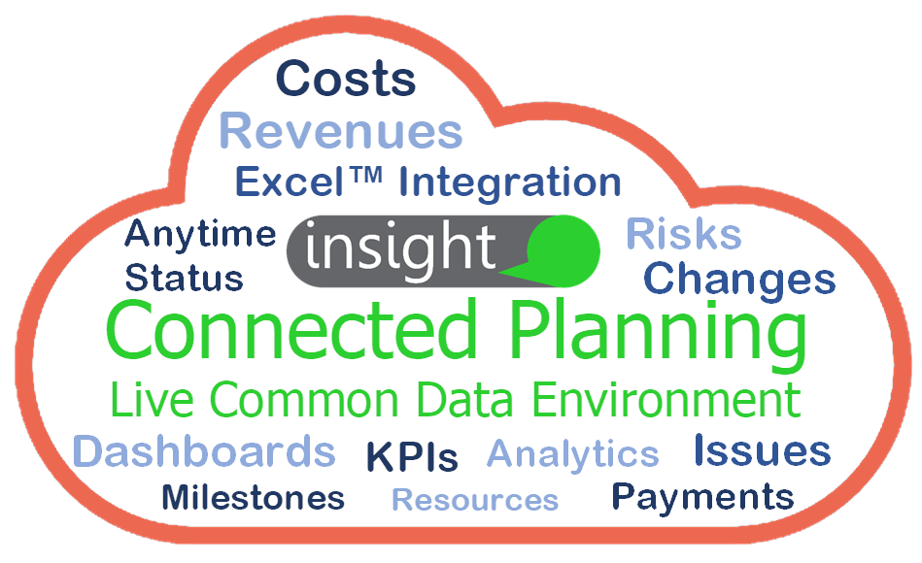


A delighted team
Insight Cloud ‘understands’ portfolios of projects. It’s the ‘hub’ that connects everything.
Excel™ workbooks … a few to 1,000’s bi-directionally connected (even the unstructured ones)
Data connected from
other systems

Slide 30
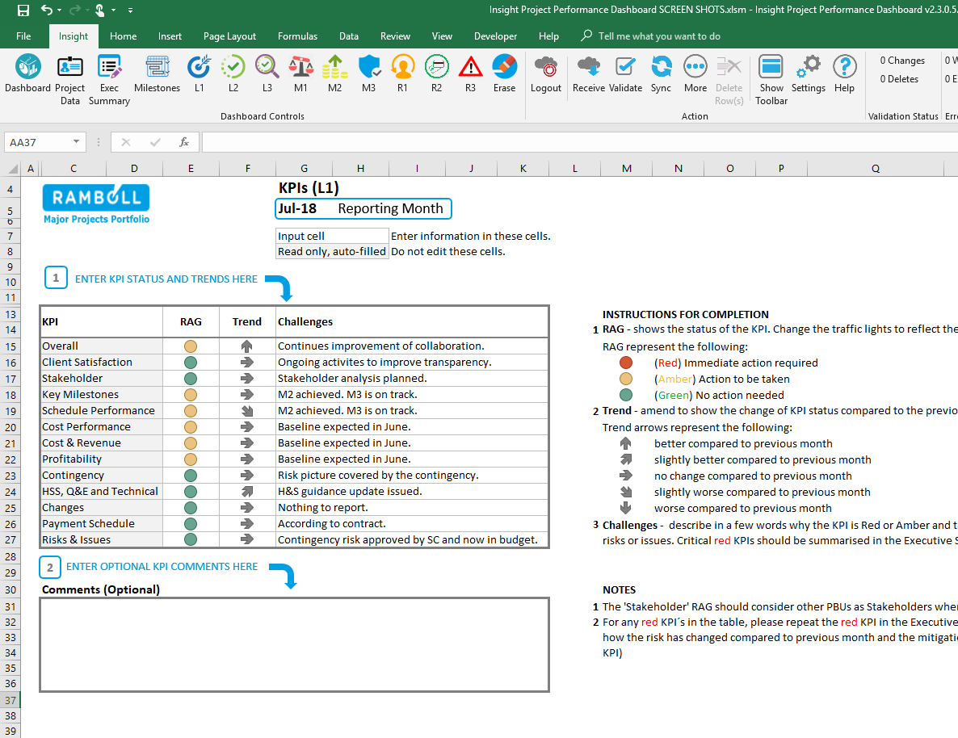
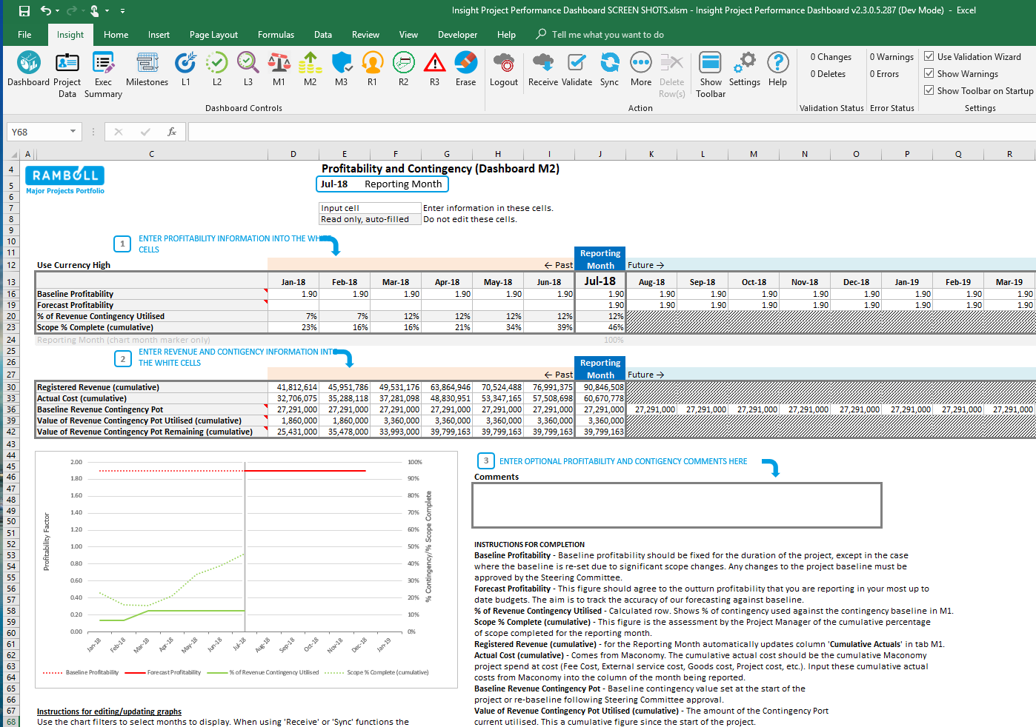
Example Views at Project Level

Slide 31
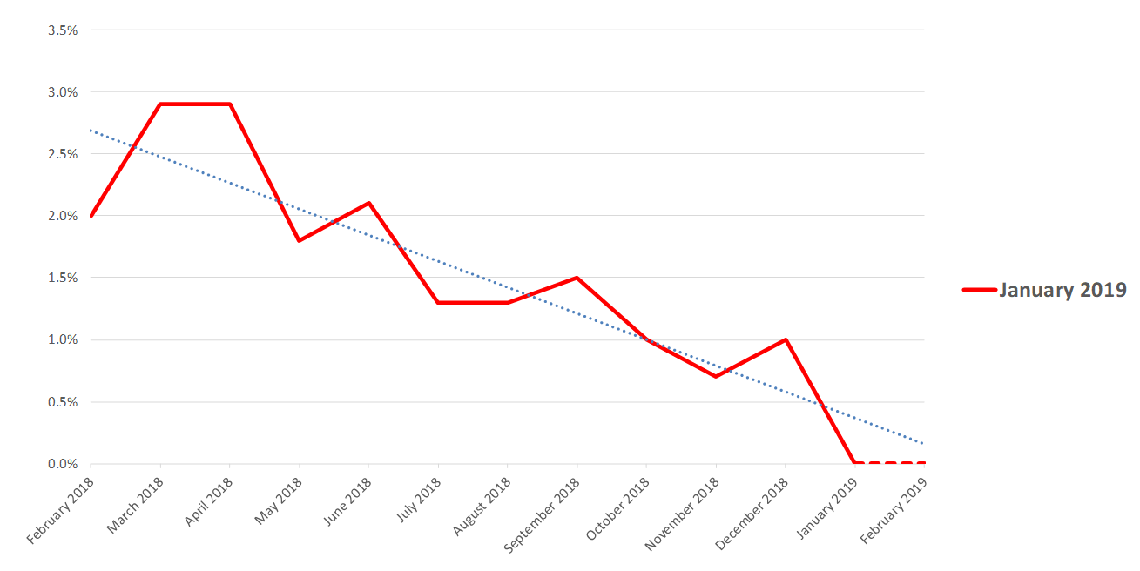
Example Views at Senior Leadership Level
…to Board level reports that can be written to PowerPoint or PDF in minutes.

Slide 32

Lessons Learned
Engage stakeholders from the start
We’ve been conditioned to treat spreadsheets as the pariah, that’s no longer justified
Think about people, process AND technology at the same time
Have the courage to initiate change … it’s often a battle, but the gains are significant
Challenge tech vendors. How they will meet unique needs and cope with inevitable change?
Set out the strategy, but look for incremental improvements along the journey … be aware IT disruption is a double-edge sword

Slide 33
- Benefits Recap
Elapsed time to build the monthly Board report pack reduced from 10 days to 1 day
Sustainable savings of over £4m pa
Effort to maintain data quality and build reports reduced by 97%
From requirements analysis to globally live in 35 countries with full engagement in <4 months
Began with 100 projects, on route to >2,000
Gains unlocked without expensive & risky disruption. Cross-functional governance moved to real-time

Slide 34

Sean Blencowe, CEO
Sylvia Sciuchetti, Global Senior Consultant, Operational Excellence
sean.blencowe@greenlightchange.com
+44 7896 557172
SYSC@ramboll.com
+45 51617866

