Slide 1
Early warning indicators

Slide 2
Bestoutcome
Our ethos: Outcome management
Outcome Management is a ‘lean’ approach to programme and project management focused on delivering positive business outcomes, leading to realising the planned business benefits.
Budget, schedule, scope and quality needs are highly important. But achieving positive business outcomes still trumps them all and so must be at the heart of project management.
‘Programme success’ must be defined by the customer (not the supplier) based on the delivery of the desired business benefits.

Slide 4
Early Warning Indicators
Indicating what?

Slide 5
Early Warning Indicators
Key measure is whether the work will be successful in delivering value to the organisation.
Notes:
One of the first issues we face is being clear what indicators are indicating!
Are they indicators of health? Or indicators of performance, what has been done?
I’m going to assume that the key thing we want to measure is whether the work will be successful in delivering value to the organisation.
Does that work for you? If so, how well do you think that existing approaches are working for you?

Slide 6
Standard project behaviour
They don’t turn out as originally expected (to a greater or lesser degree)
We (mostly) assume that things will turn out ok

Slide 7
The project F*%! word
“If you can meet with triumph and disaster And treat those two impostors just the same;”
Rudyard Kipling
Notes:
Project failure is the elephant in the room. We are trained to expect that failure in projects in commonplace but what does fail really mean and does it help us?

Slide 8
Measuring the right things
PMI (Pulse of the Profession) cite the following factors for project f%*!ure
Poor vision/goals or objectives
Poor communication
Poor risk management
Poorly managed requirements
Organisation changes
A similar story comes from the Standish Group (Chaos Report) and the work done by Boston Consulting Group led to creation of their DICE approach

Slide 9
Does your organisation track these as part of project weekly/monthly status checks?
Clarity of vision/goals or objectives
Quality of communication
Effectiveness of risk management
Stability of requirements
Impact on project of organisation changes

Slide 10
Are we measuring the right things?

Slide 11
The Iron Triangle We know it’s insufficient but we still use it!

Slide 12
Leading and Lagging indicators
Leading indicators – useful as they warn us BEFORE something happens
Lagging indicators – accurate because they measure something that has happened

Slide 13
Aren’t all projects unique?
By definition, all projects are unique
So are people
But we can make assumptions about the way that they will behave and the more information we have, the more accurate we can be

Slide 14
What we should be measuring
What is the scale of success in the project? Is that changing at a rate that should concern us?
Key risks that we can fix before they impact the project
How well is the project being controlled and managed?

Slide 15
The right indicators
Measure at the right time – early enough to avoid rather than fix problems
Not all projects are equal, focus on the ones that matter
Leverage the expertise available
Ask the right questions
Lots of project data available – use it

Slide 16
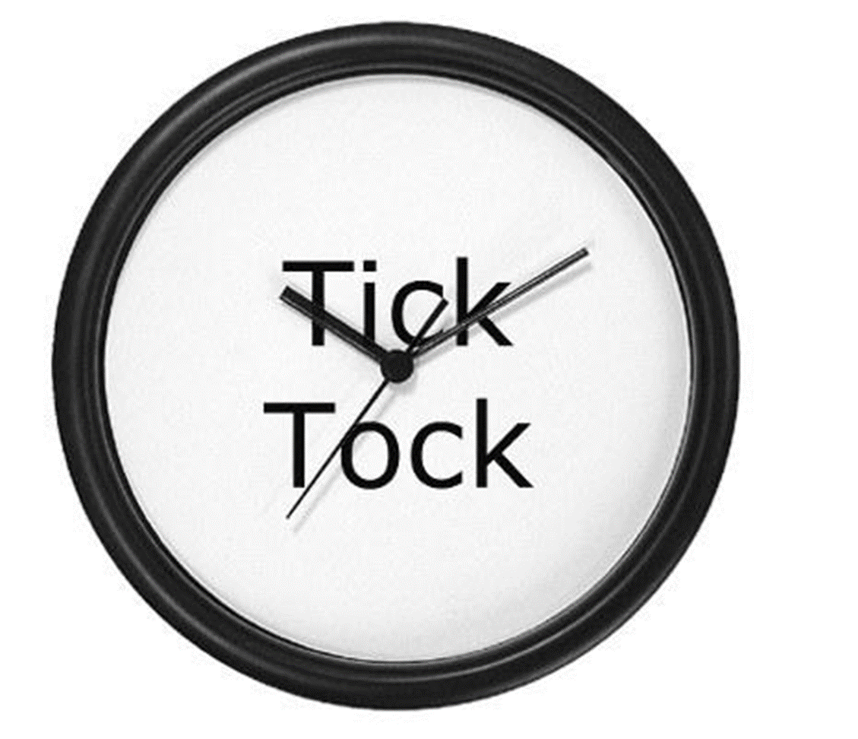
Where’s the Early in EWI?
Ask the right questions before the issues arise
Look for trends

Slide 17
Focus on what is important
We can reduce the volume of projects to check according as:
Some work has higher priority
Some PMs are more likely to manage projects well than others
Use portfolios/filters to split work into 3 categories:
Projects we check very regularly
Projects checked occasionally
Projects checked very occasionally

Slide 18
Experts in project management
As a profession, project managers are (mostly) skilled and also capable of giving insights into the project
Don’t ask the “How was school today”
Don't ask them to tell you questions you know the answer for
Focus on outcomes

Slide 19
Experts in project management
What can the PM warn you about?
Stability and clarity of vision/goals or objectives
Quality of communication around the project
Stability of requirements
Concern about organisation changes
Can we apply RAG status to these?

Slide 20
Experts in projects
What about the other experts on projects?
Sponsor, stakeholders and senior management can know more about a project than the project team, can you capture this information?

Slide 21
Ask the right questions - stable is good
After checking the basics, it’s not easy to evaluate project management performance without spending a lot of time understanding each project. However, there is a reasonable correlation between the stability of information and the control of that project and change is (relatively) easy to measure.
What to check | How
Is the schedule stable | Compare baseline (Planned) plan and milestone dates vs latest (Revised)
Are costs changing | Compare Budget vs Actual Monitor change in Forecast
Are resources being used as expected | Compare Budget vs Actual Monitor change in Forecast

Slide 22
Ask the right questions - is project (still) set up for success?
Just checking that the basics are in place is an easy way to start the QA process.
Check
Are there clear Objectives
Does the Description make sense
Are there Benefits outlined
Does the schedule have Gates, Milestones, Tasks and Dependencies? Do they make sense?
Do the project Costs match what is in the finance system?
Are the required Resources defined in the plan?
Are there Risks with clear descriptions and owners
Have the Assumptions been captured?

Slide 23
Costs – what is the right question?
Project costs are similar to auction costs
In both cases you don’t know what the final price will be (but usually it goes up).
Problem comes when the cost exceeds the value, in an auction you just drop out!
Notes:
Trying to determine the “value” of a piece of work to the organisation is not easy and may not be valuable. However, estimating the cost at which point work is no longer worthwhile is easier

Slide 24
Ask the right questions - Costs
3 key financial measures
Is this still the right place to invest?
Is the project managing money well?
Is the work delivering the right Value?

Slide 25
Costs - Value indicator
Cost
Max cost for work to still be worthwhile
%
Notes:
Trying to determine the “value” of a piece of work to the organisation is not easy and may not be valuable. However, estimating the cost at which point work is no longer worthwhile is easier

Slide 26
Schedule – schedule criticality indicator
Current Contingency
Original Contingency
“Spare” time is the gap between when you absolutely must deliver a key milestone and the current forecast.
Measuring the remaining “spare” is useful, as is the rate that the “spare” is decreasing
%

Slide 27
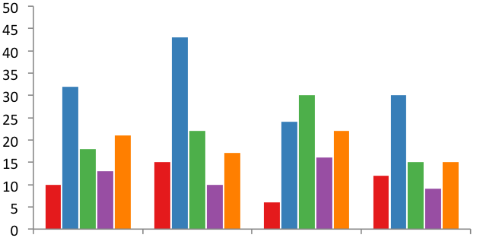
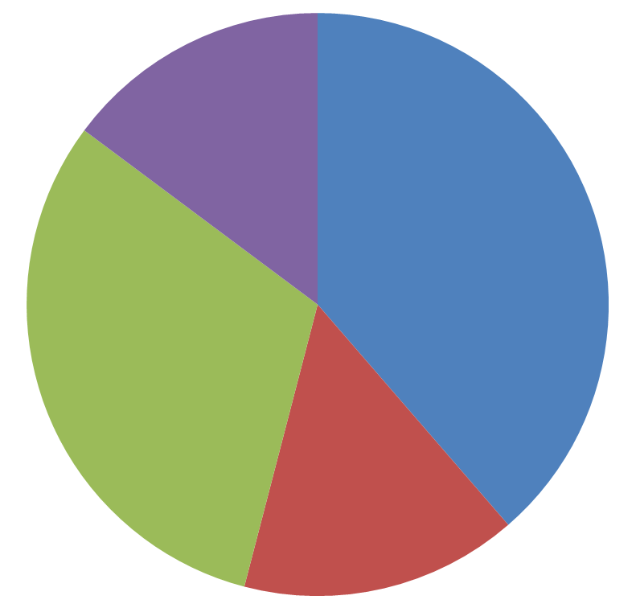
Projects generate lots of data – use it
Statistically, projects generate a lot of data points
Using a Project Management System, this data is available
At a portfolio level, you can correlate data and also draw upon history

Slide 28
Is the project under control?
What to check | Check
Is the PM updating Delivery Status on a regular basis? | Is Delivery Status updated for this month and last month? Are milestones being kept up to date?
Is the schedule being maintained? | At a glance view of the status/quantity of milestones in all projects in a portfolio
Are the risks being managed? | Are there “enough” open risks? If there are few open risks for a project, is this curious? Are risks being updated? If so, the trend arrows should show changes Are risk actions being managed? Is the level of risk concerningly high? Are there many high exposure risks?
Are there a lot of issues? | A significant number of high severity issues MIGHT indicate that the risk identification is not working well
Projects not under complete control does not mean that the project is poor led or has a poor project team BUT it is a serious concern for future success

Slide 29
Quantify the minimum expectations
At a basic level, it’s useful to have minimum criteria to measure. It doesn’t guarantee quality but does encourage quality. An example set of expectations:
It is expected that 95% of projects will complete the Delivery Status update each month
It is expected that <25% of Risk Actions are late (Red) in each project
It is expected that <25% of Milestones are late (Red) in each project
It is expected that each project will have >10 milestones
These give the PM quality expectations but also give you measures to show overall health of the portfolio.

Slide 30
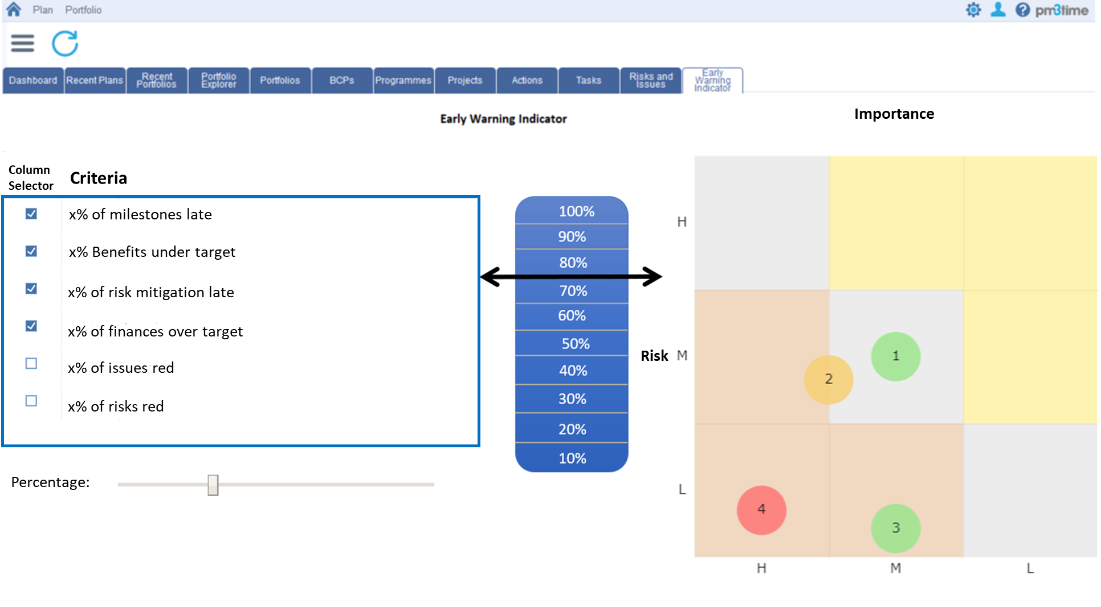
Align your measures to your organisation – and the different types of project within it

Slide 31
Any questions?
Please visit Bestoutcome at Stand 26
www.bestoutcome.com

